Slide 1
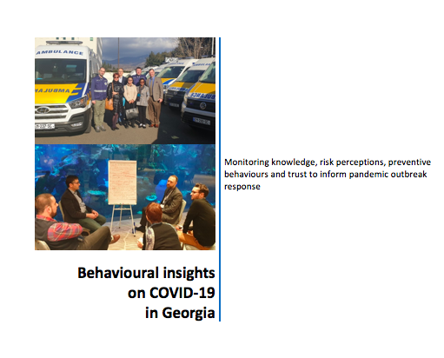
Behavioural insights on COVID-19 in Georgia
Monitoring knowledge, risk perceptions, preventive behaviours and trust to inform pandemic outbreak response
Round 5 of data collection
15-20 September 2020

Slide 2
Background
The first person infected with COVID-19 was confirmed in Georgia on 26 February. The first transmission from an unknown source or internal transmission in the country was detected on 23 March, in Marneuli region. Georgia has implemented a multisectoral response to the COVID-19 outbreak led by the Prime Minister, and coordinated by the Ministry of Health, which started on 25 January 2020. This includes a strong focus on health communication, physical distancing, isolation and quarantine, monitoring and surveillance, and testing.
The Georgia National Center for Disease Control and Public Health (NCDC), WHO Country Office for Georgia and UNICEF Georgia adapted the survey tool made available by WHO/Europe to the context of the COVID-19 situation in the country and have collected data five times. The first three rounds were at the national level between April and May 2020. The fourth round focused on two regions. This fifth round once again looks at the national level. One additional round of data collection is planned after this.
Data collected directly contributes to the COVID-19 response in Georgia in the areas of communications and messaging, interventions, programmes and policy – alongside epidemiological data and considerations of economic, cultural, ethical, structural political nature and other.

Slide 3
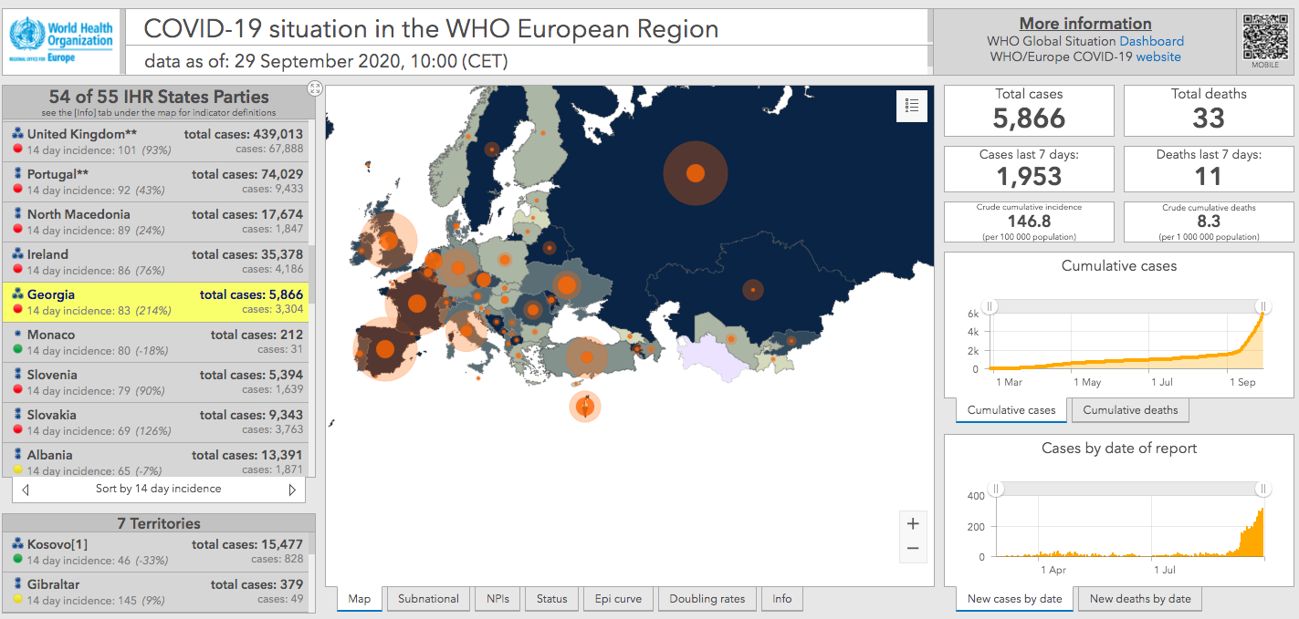

Slide 4
How to read the data
Interpretation: The regression tables present the results of linear and logistic regression analyses (backwards elimination).
The best models are presented. This means, that we look at a lot of variables, but the tables contain only those that make an impact. The original models contain the following predictors: age, gender, education, urban/rural living, membership of a risk group (65 years of age, chronic diseases), trust in institutions (e.g. IPH, ministry of health), trust in the medical sector (e.g. doctors, hospitals), felt closeness to the virus, perceived speed of spreading of the virus, frequency of information search about the situation, perceiving it as a media-hype.
CIs are the 95% confidence intervals of the standardized coefficients (beta). If these include zero, the corresponding variable has no statistically significant influence. Bold printed factors are significant and have a statistically significant influence. This means for values with a positive sign: higher values on this influencing factor lead to more knowledge. This means for values with negative sign: higher values on this influencing factor lead to less knowledge.

Slide 5

Summary #1
For discussion and further analysis and interpretation
Health literacy was measured for the first time in this round, and it appears to be very high with a majority of respondents reporting they can find, access and use information about COVID-19
Looking at risk perception over time, we see a trend where fewer people believe the infection would be severe if they got it while slightly more people think it’s probable they will get COVID-19 and a higher number of people think it’s possible they will become infected.
Overall, the data shows high compliance with recommended behaviours—washing hands for 20 seconds (90%) and wearing face masks (95%), which shows a similar trend compared to previous data collections. However, practicing social distancing (76%) has dropped significantly from an average of 95% in previous data collections.
Regarding emotions, fear has dropped significantly by 22% since May data while at the same time 8% more people believe the pandemic is very much media hyped.
Resilience in general scores about average. Almost half of the respondents find it hard to make it through a stressful event or to snap back when something bad happens.
Respondents rate fairness of decisions as above average (5.20/7.00). Over 60% said strict measures are necessary, while 35% strongly agree that current measures are exaggerated.
A majority (57%) believe COVID-19 government measures are to be adequate. However, it follows a decreasing trend since it’s the lowest recorded score from April, and more people now think restrictions are greatly exaggerated.
Trust/confidence in institutions remains relatively high but has dropped in all 15 institutions measured since May, especially in the ones from the field of education (kindergartens, universities, schools and Ministry of Education)
In a scenario where a person is told they have been near someone who tested positive for COVID-19, over 80% said they would get tested themselves.
If someone tested positive, 94% would share names of all the people they had been near for contact tracing.
If a vaccine were available and recommended for them, 45% said they would take it while 55% believe that a vaccine can help stop the spread of COVID-19. Experience with the vaccine being used for a long time (64%) and being used in other countries first (62%) are the most important drivers for vaccine acceptance.

Slide 6

Summary: key predictors
For discussion and further analysis and interpretation
A few key predictors were identified:
Frequency of information searching: People who search for information more frequently are more likely to:
Perceive the virus to be close
Apply general protective measures
Show higher levels of emotionality
Trust the MoH and all other health authorities
Have higher sense of fairness and are more likely to get tested if they had been in contact with someone positive to Covid-19
Age: Older people are more likely to:
Have lower health literacy
Perceive higher severity of an infection, but low self susceptibility
Have lower levels of wellbeing
Trust the health authorities
Younger people are more likely to:
Have higher health literacy
Perceive the virus to be close
Show less emotionality
Health literacy: People with higher levels of health literacy are more likely to apply protective measures, show less emotionality, trust the health authorities and find the measures taken by the government relatively fair.
Media hype: People who believe that the pandemic is media hyped show less trust to the health authorities, believe that the measures taken are exaggerated, they feel that it is less fair for them and they would not test themselves if they had been in contact with a person positive to Covid-19.
Sex: Women are more likely to follow recommended behaviours and to be more emotionally affected by the pandemic.

Slide 7

Summary: recommendations
For discussion and further analysis and interpretation
Suggested topics to discuss
Frequency of information searching is quite strong: We see that frequency of searching for information is a predictor for many behaviours. How might you make the best use of this knowledge? Have any new initiatives or actions been taken with journalists/media since round one of data collection?
Risk perceptions: While more people believe it’s very likely that they will get an infection, they feel less susceptible to the virus and that an infection will be less severe. Given the incidence in many countries, how could you increase risk perception without causing alarm?
Protective behaviours: Most are very high, and this might be used as a way of motivating others. We know that human beings are influenced by what they think other people are doing. If people know so many fellow citizens are following recommendations, they might want to continue to do so themselves.
COVID-19 Vaccine: It is important to start preparing for COVID vaccine introduction early as acceptance is low; media could be a key ally.
We recommend conducting a meeting with pandemic response stakeholders and decisions makers with the objectives to:
Review the findings
Discuss findings, using the reflection questions on light blue pages
Consider appropriate responses and action

Slide 8
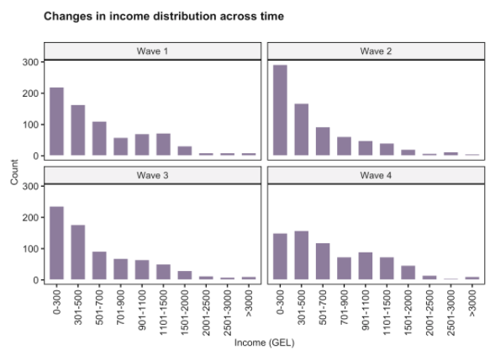
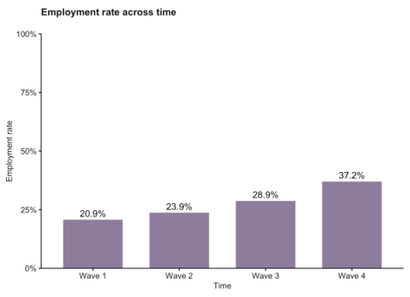
Income and Employment
Data collected multiple times since April shows that income and employment levels have shifted, with more people now employed and respondents indicating somewhat higher levels of income.

Slide 9
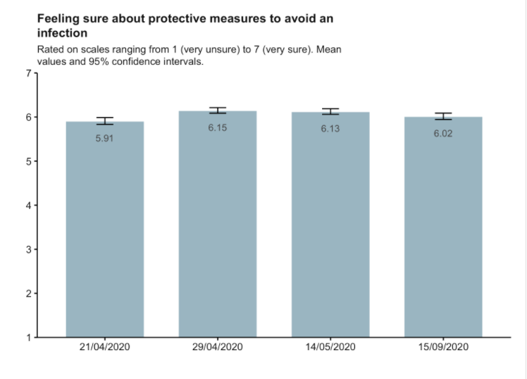
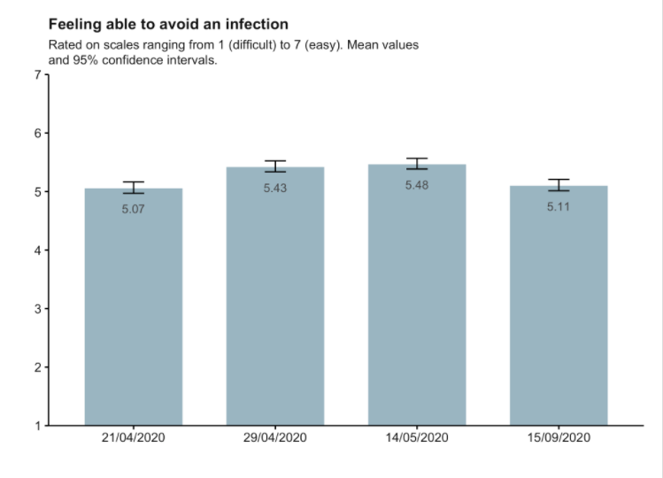
Preparedness and perceived self-efficacy
“I know how to protect myself from coronavirus”
A feeling of preparedness and self-efficacy to avoid an infection with the coronavirus is important as it enables protective behaviour.
On a scale from 1-7:
Feeling sure about knowing how to prevent infection receives a score of 6.02, which is decreased compared to the previous rounds of data collection in May and April.
Feeling able to avoid infection receives a lower score of 5.11, which is also lower than May and April data collection rounds.
“For me avoiding an infection with the novel coronavirus in the current situation is… Extremely difficult >>> Extremely easy”
This shows that confidence regarding the knowledge on how to be protected from COVID-19 has been fairly stable, but with a slight drop in this round. People feel somewhat less able to avoid an infection. This may be explained by the spreading nature of the virus and the fact that it’s clear we will all have to deal with this for a long time.

Slide 10
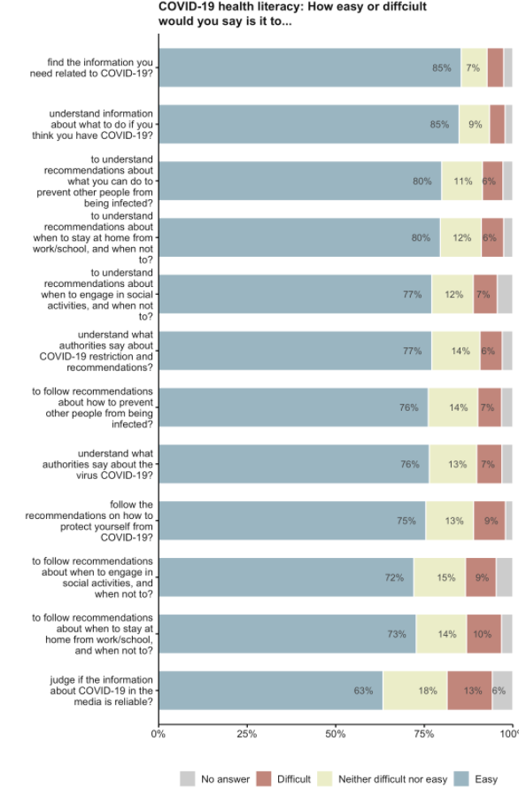
Health literacy related to COVID-19
The health literacy scale allows assessment of health information on three levels:
Availability/access
Understanding
Use/acting on behalf of
The figure shows that people have a relatively high self-assessed COVID19-related health literacy, with the majority of people stating that it’s very easy to find, understand and use most of the guidance they receive.
More people find it difficult to judge whether information in the media is reliable, but 63% do state that they find it easy.
The people who are more likely to have low health literacy related to COVID-19 in particular include those who:
Are older
Have less trust in the medical sector
Believe the virus is not spreading fast
Believe that it is likely that they get infected
Have lower level of education
Search for information less frequently
Overall health literacy is high especially among younger people and those who trust the medical sector and those who search for information frequently.
The lowest score relates to judging the reliability of media information, and we know in the COVID-19 pandemic this remains a challenge everywhere (infodemic).

Slide 11
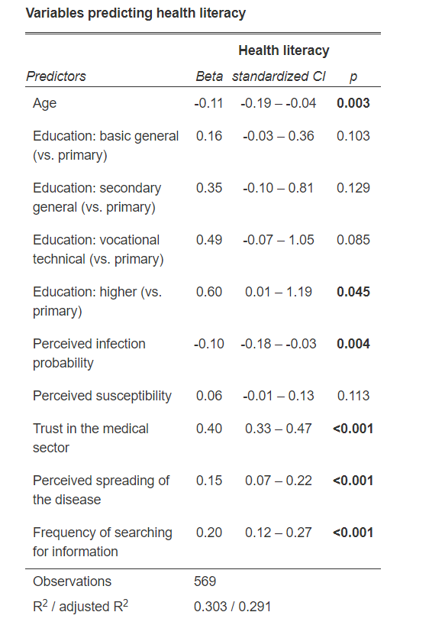

Slide 12
Health literacy and self-efficacy: discussion
Questions to discuss in the team
It looks like Georgia has done a good job of making information available and understandable.
It‘s great that younger people feel more knowledgeable about the virus, as we see increasing cases among younger people. it may be important however to reframe information and messaging to ensure people know that older groups can still become infected and get severely ill.
Ensuring accessible and understandable information will be especially important around influenza and a possible future vaccine
How can we further support health care workers to feel more able to avoid infection?
Possible action or follow up
Continue to tailor measures, policies, communications or community outreach activities related to COVID-19 to prepare for next phases (influenza, etc.)
Continue to engage community leaders and health mediators
Continue to provide clear explanations and criteria for recommendations and changes in recommendations
Tools and resources
WHO Europe RCCE Strategy Template
RCCE for Health Care Workers

Slide 13
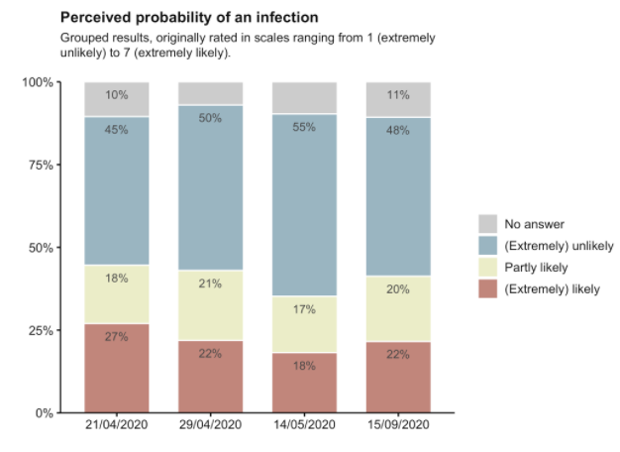
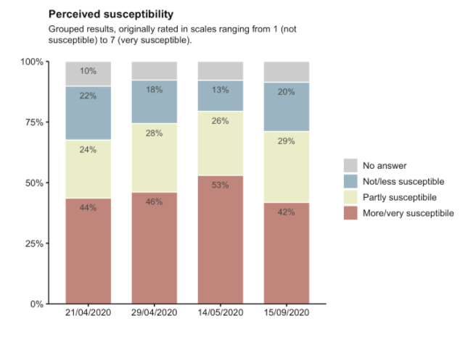
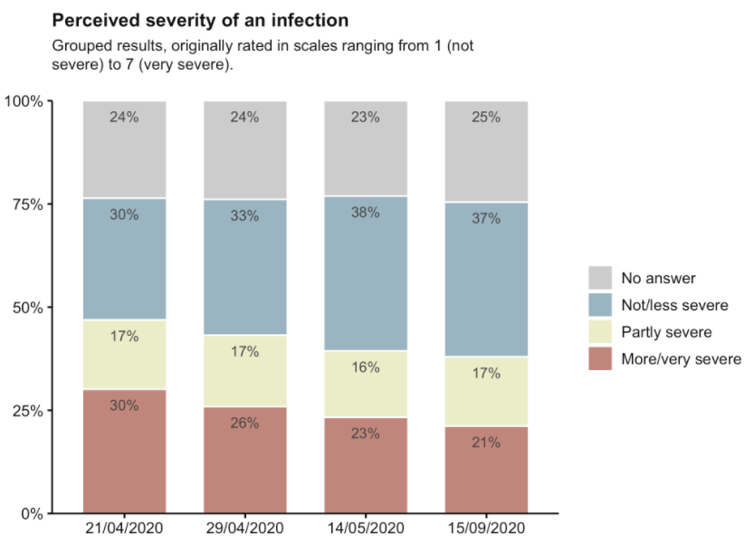
Risk perception
“What do you consider to be your own probability of getting infected with the novel coronavirus?”
“How susceptible do you consider yourself to an infection with the novel coronavirus?”
“How severe would contracting the novel coronavirus be for you (how seriously ill do you think you will be)?”
Perceived susceptibility, probability and severity of an infection together constitute a person’s risk perception related to COVID-19.
22% of people believe that it is extremely likely to get infected (increased from 18% in May)
48% believe that it is (extremely) unlikely to get infected
(decreased from 55% in May)
Interestingly only 42% of people feel very susceptible to the virus (lowest recorded score so far) whereas 7% more people feel not or less susceptible to the virus (compared to data from May)
The perception of high severity of an infection has also dropped to 21%, marking the lowest score so far.
The above indicate that although more people believe it’s very likely to get an infection, they feel less susceptible to the virus. Less people also believe the virus can be very severe.
People who perceive an infection to be less severe include those who:
Are younger
Are male
Do not belong to a risk group
Perceive the virus not to be spreading fast
Believe the pandemic is media hyped
Search for information frequently
With relatively small changes from the previous rounds, more than a third of people believe it’s likely they would get infected with COVID-19, while only 21% believe that if they did get infected it would be very severe. It continues to be important to tailor communication to increase accurate risk perception.

Slide 14
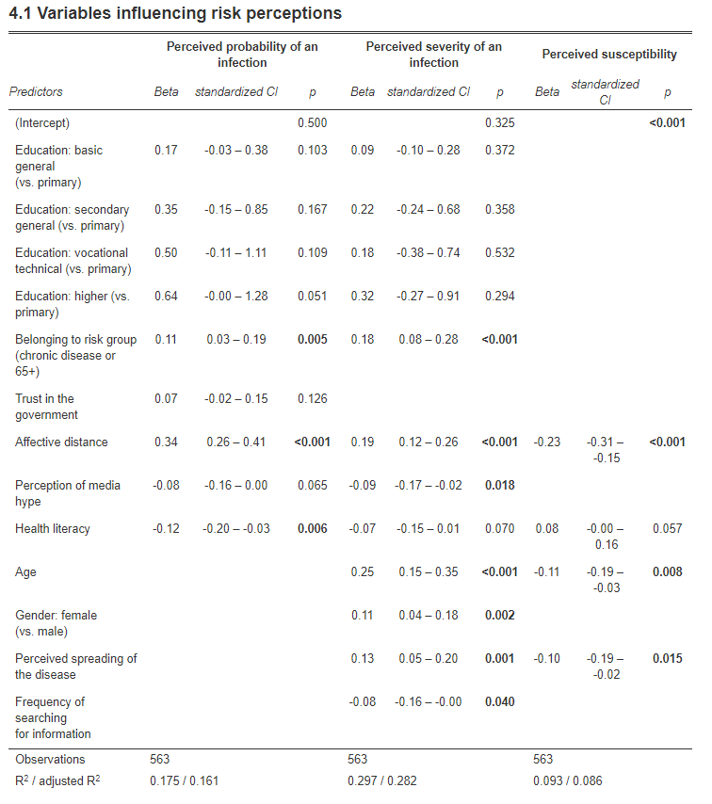

Slide 15
Risk perception: discussion
Questions to discuss in the team
Looking at the trends in risk perception over time is very interesting. Can you identify different events happening in Georgia over these months to help explain the changes?
Which risk assessment is appropriate in Georgia right now? High, medium, low?
Is there a need to address the low perception of probability and severity among many?
Which events may have affected people’s risk perception?
Do we need to do more to ensure an appropriate risk perception?
Possible action or follow up
Revise the media strategy to ensure continued focus and appropriate risk assessment
Personal stories of people with COVID-19 – communicated through various channels
Special effort to ensure appropriate risk perception among trusted stakeholders – e.g. daily updates or a special info source for physicians
Be transparent and clear on how decisions are made and the current risk assessment by the government
Tools and resources
WHO Europe RCCE Strategy Template
WHO Audience Message Priorities (AMPs) available from WHO Europe office

Slide 16
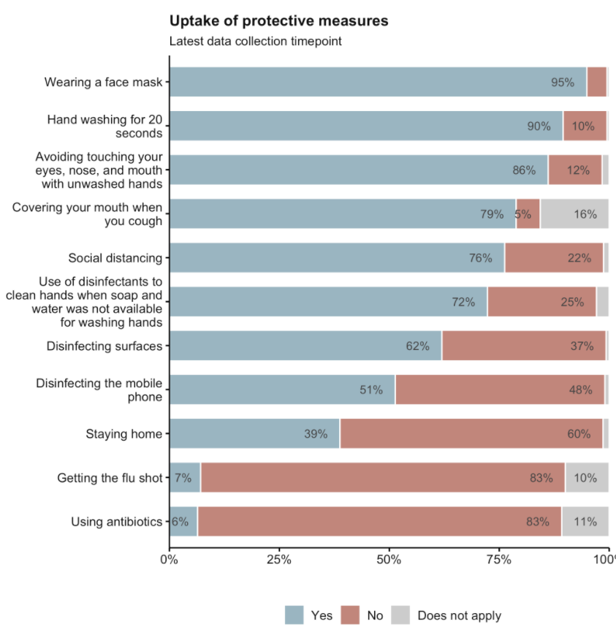
Behaviours: prevention
“Which of the following measures have you taken to prevent infection from the novel coronavirus (if applicable)?”
Respondents generally show high compliance with preventive behaviours such washing hands and wearing a face mask. 76% indicate practicing social distancing.
48% and 37% do not disinfect mobile phones and surfaces respectively, where only 39% would stay home as a preventive measure against COVID-19.
People who do not follow general protective measures in particular include those who:
Have lower health literacy
Have lower trust to the government
Are male
Search for information less frequently
Specifically, not ensuring physical distancing include those with low health literacy and those who feel less susceptible to the virus.

Slide 17
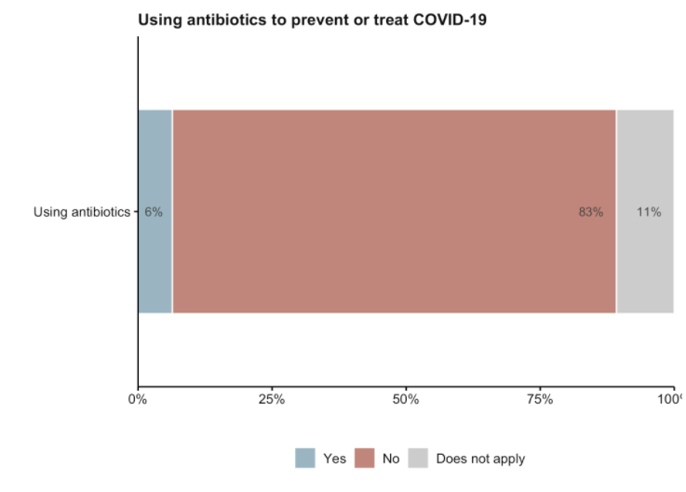
Use of antibiotics
Respondents generally appear to not use antibiotics against Covid-19, however 6% reported that they have used them.

Slide 18
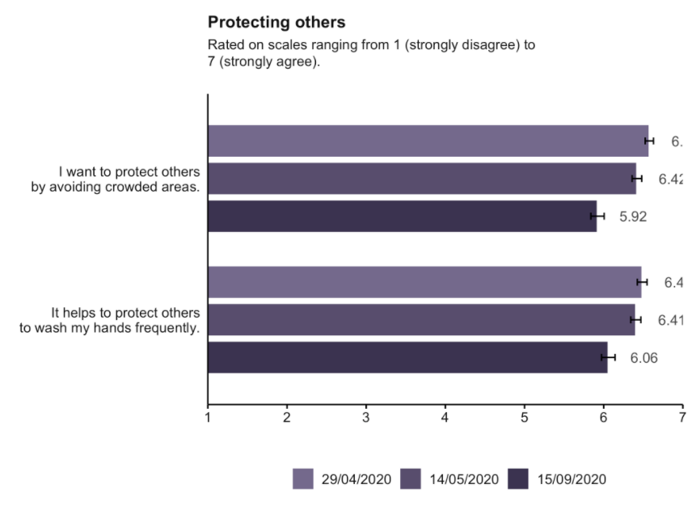
Protecting others
Respondents generally score well above average in wanting to protect others.
However, compared to previous rounds of data collection, fewer people say that they want to protect others by avoiding crowded areas and fewer people believe that washing hands frequently can help to protect others.
The above might indicate a call for targeted communication strategies on preventive measures, especially to remind people that handwashing is effective for prevention of disease

Slide 19
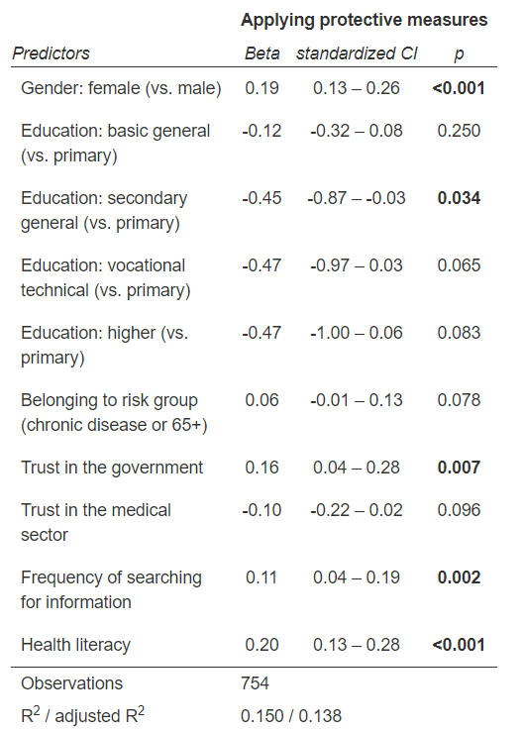

Slide 20
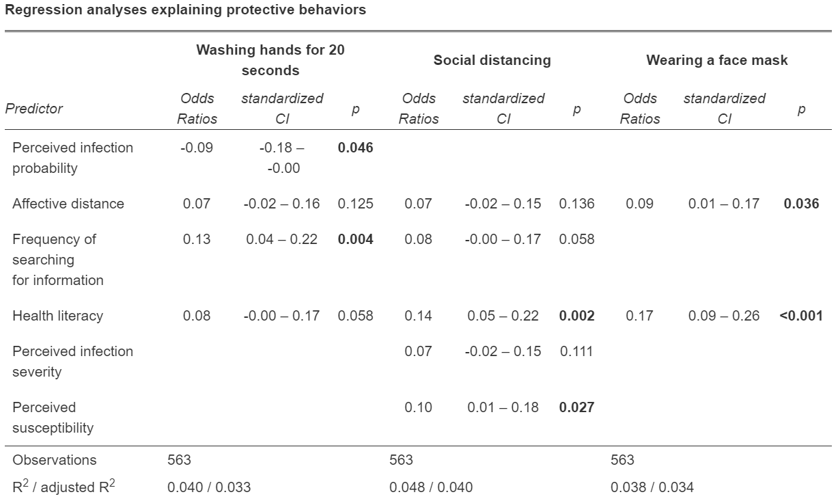

Slide 21
Behaviours: discussion
Questions to discuss in the team
We see that those with low health literacy and those who feel less susceptible to the virus are less likely to keep physical distance. How might you increase the sense of susceptibility to the virus?
Which recommended behaviours are more critical at current time, given current transmission as well as evidence for effect and feasibility?
Can we use the very high levels( 95%) of some protective behaviours to encourage others?
How have recommended behaviours been communicated so far?
Which social norms or recent events may have impacted on behaviours?
Are there opportunities for qualitative research to learn more? Does such research already exist, e.g. about norms?
While the percentage is low, how might we reduce inappropriate antibiotic use?
Possible action or follow up
Highlighting high levels of compliance with recommended measures in communication materials may help motivate others to also follow the good example set by the majority.
Clear guidance for shops, public spaces, work places, hospitals, schools, kindergartens, health clinics, government offices with clear steps and criteria for response to COVID-19 cases and how to avoid them.
Communicate only a few very concrete recommended behaviours.
Develop guidance on navigating social expectations, e.g. saying no to big social events.
Ensure creativity and diversity of messages and approaches to avoid message fatigue
Nudging techniques, e.g. marking space on floors and in public spaces; easy access to and attention directed towards disinfectant.
Communicate social norms and expectations, either through personal stories or nudging techniques.

Slide 22
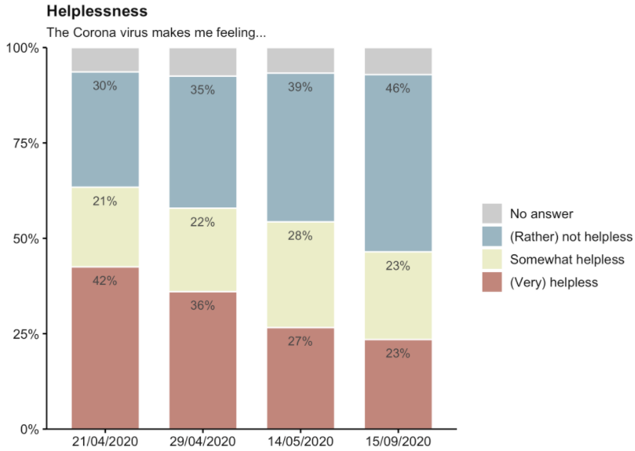
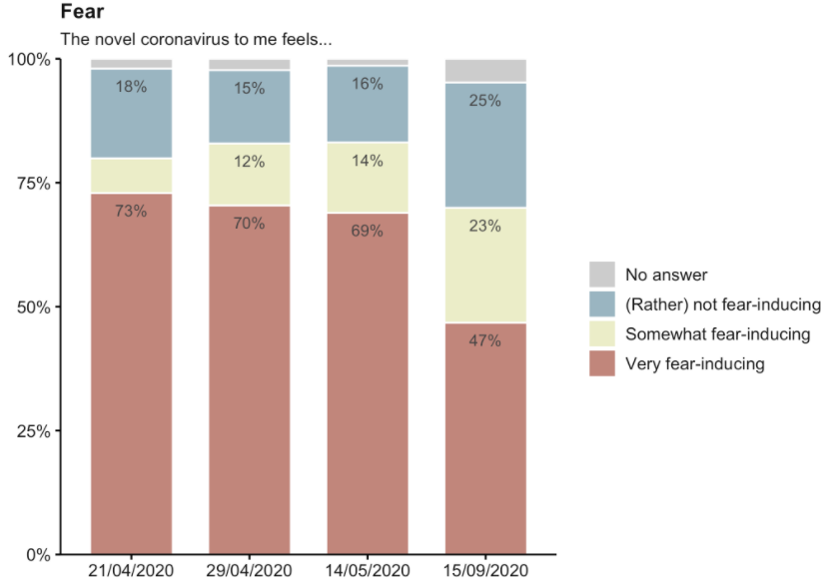
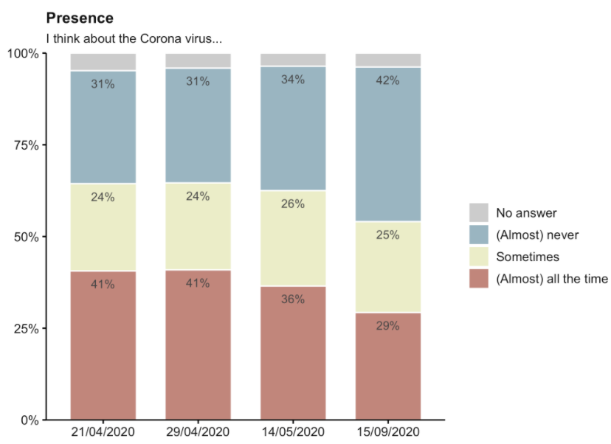
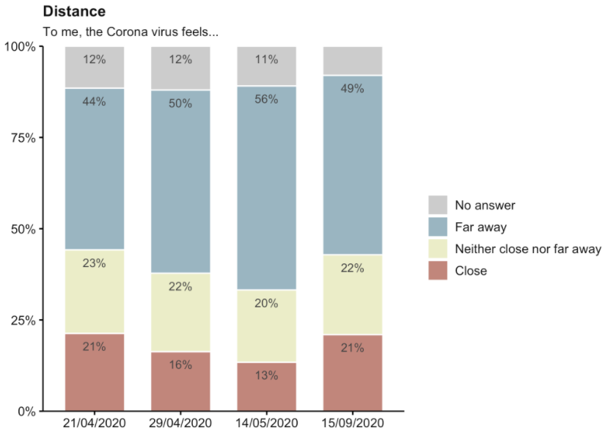
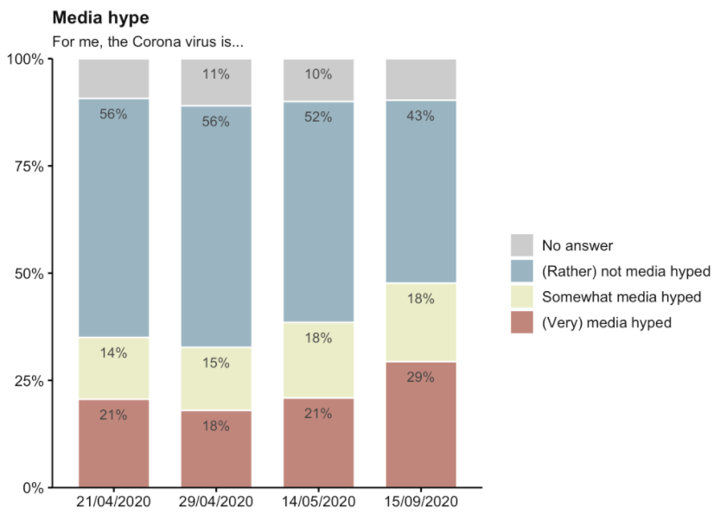
Affect: emotions
“The novel coronavirus to me feels ...
In terms of the emotional response to the pandemic (fear, helplessness), people have significantly felt less affraid since May, where the scores of helplessness have also dropped to 23% (lowest recorded since April).
On the other hand, more people believe that the pandemic is media hyped.
Interestingly, 21% of people believe the virus is very close (similar scores with April 1st dataset and higher than April 2nd dataset and May), a trend that may accurately follow the epidemiological evidence.
The above trends of decreased fear and helplessness are positive after the emotional distress of the pandemic. However, the above together with the increased perception of a media hyped pandemic might indicate a lenient approach towards the virus.
This, combined with the increased perception of the virus to be close might be connected to a general decreased perception of the severity of an infection.

Slide 23
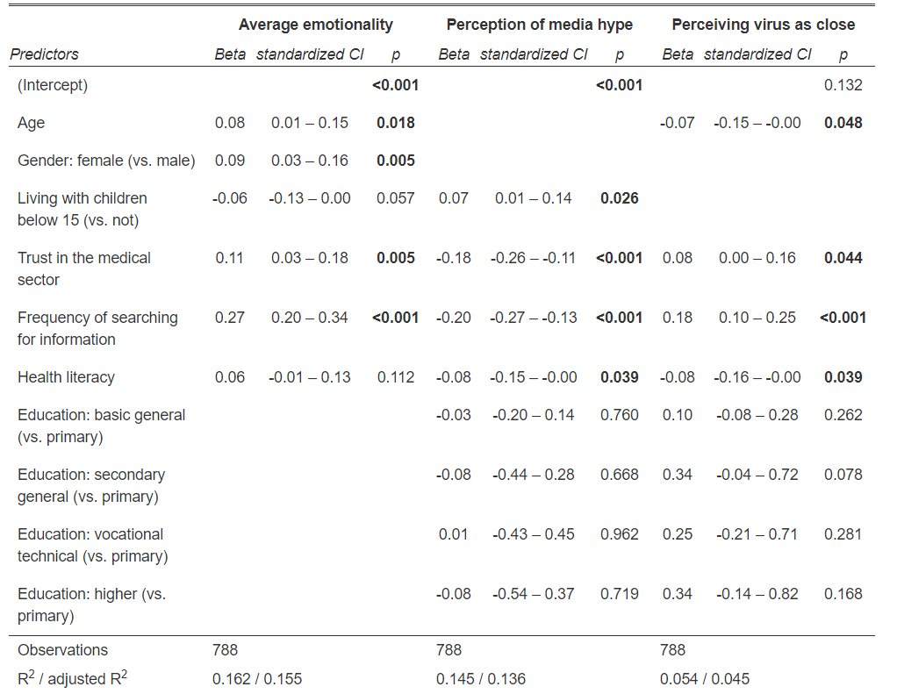

Slide 24
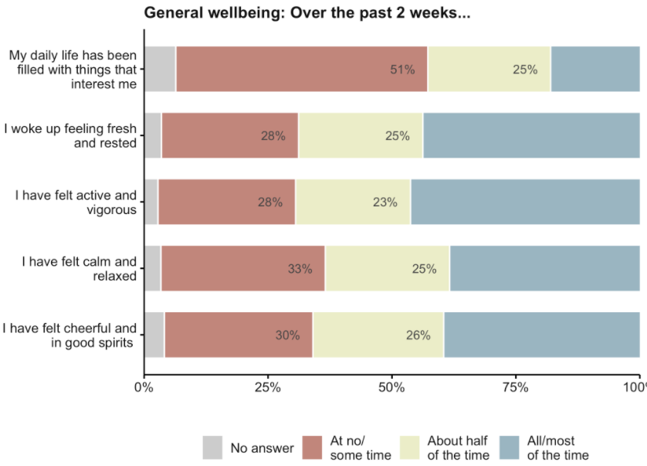
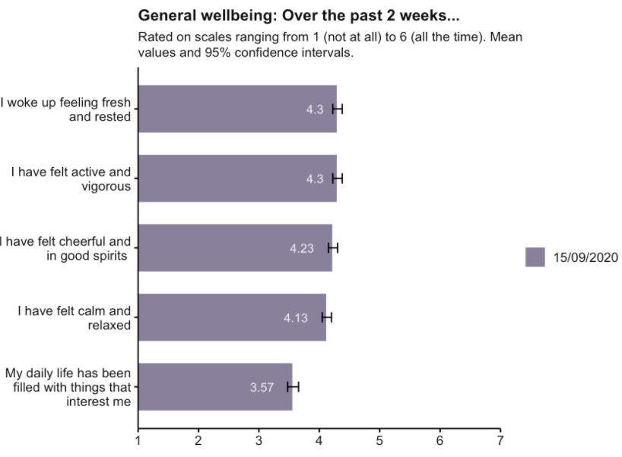
General wellbeing
In terms of general wellbeing over the past 2 weeks, respondents have reported scores just above average.
People feel somehow fresh/rested and active/vigorous with the feelings of cheerfulness, calmness and relaxation following .
Things of interest during the daily life scores average (3.57 out of 7)

Slide 25
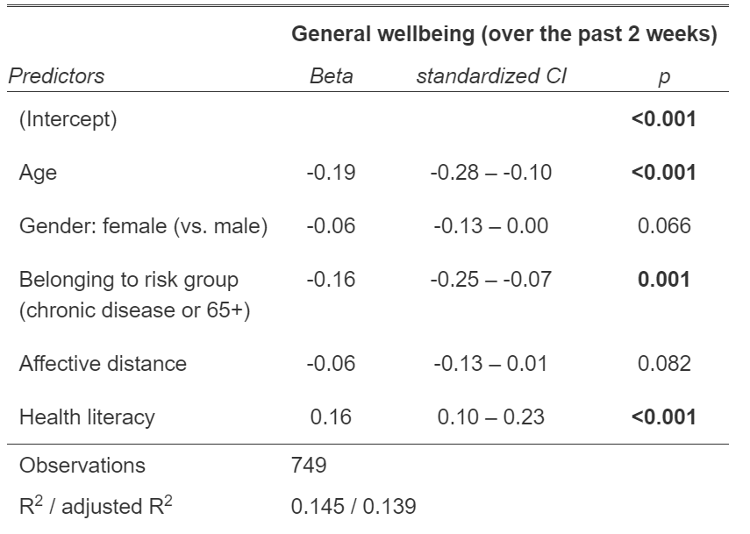

Slide 26
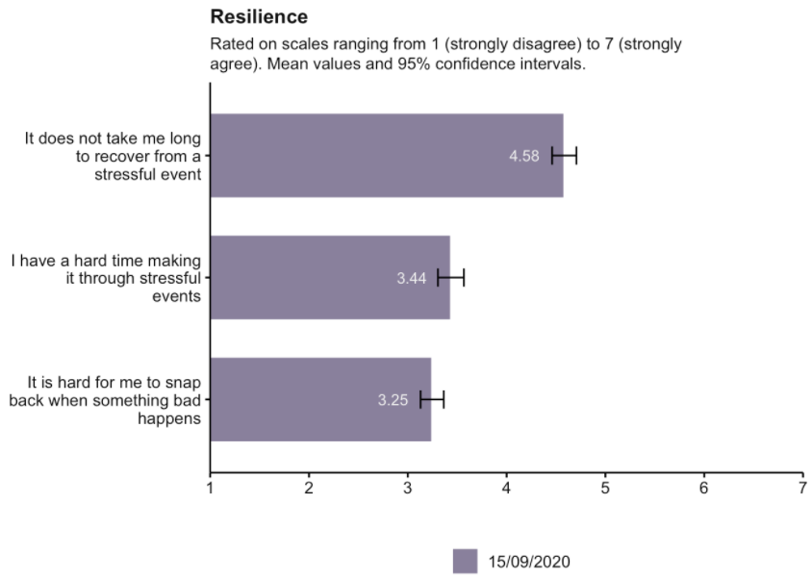
Resilience
“It does not take me long to recover from a stressful event”
“It is hard for me to snap back when something bad happens”
“I have a hard time making it through stressful events”
The resilience scale shows average resilience among respondents: they are more likely to agree that they recover fast from a stressful event than being easy for them to make it through it or snapping back when something bad happens.
People who are likely to be less resilient are in particular those who:
Have low health literacy
Perceive a higher probability of an infection
Show more trust to the government
Are female
Perceive the severity of an infection to be higher
Resilience seems to be average in general, those with low resilience are those who appear to be concerned about the virus but show less health literacy.
It will be interesting to see if the resilience changes over time as the epidemiology changes.

Slide 27
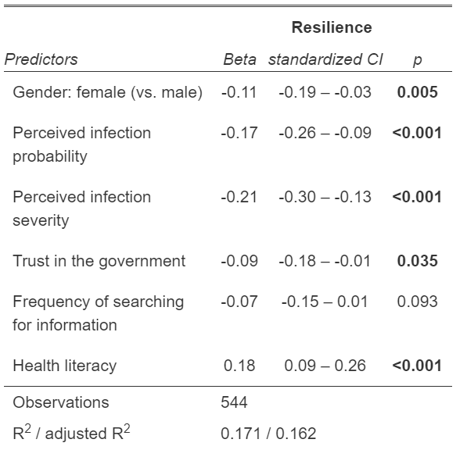

Slide 28
Emotional response: discussion
Questions to discuss in the team
What have we learned from other sources (e.g. hotline, media monitoring) about the mental health and wellbeing of the population during the pandemic/transition?
How can we support those who are less resilient?
What have we done to support those with low COVID-related health literacy whose wellbeing is more negatively affected?
Possible action or follow up
Focusing on acknowledging hardship – almost half of the respondents indicate hard time making it through stressful events.
Tailored measures, policies, communications or community outreach activities to women and people with low COVID-related health literacy whose wellbeing is being affected.
Always assess impacts on mental health and well-being before reintroducing any possible restrictions/measures.
Consider the provision of mental health services or support related to COVID-19, e.g. social support opportunities, hotlines, community support mechanisms, guidance on social isolation.
Coordinate with mental health providers to ensure services are available, accessible and known.

Slide 29
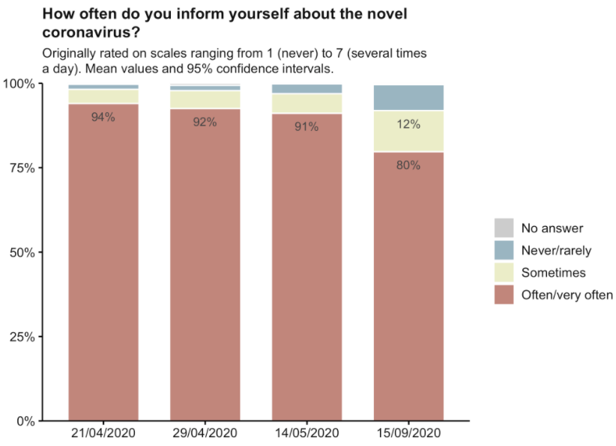
Frequency of information search
Eight months after the outbreak, and with most people feeling like COVID-19 is not very dangerous and would not be severe even if they got infection, 80% of respondents report searching for information often or very often. The score remains high however it has decreased by 11% since May.
It will be interesting to watch this level over time to see if seeking information decreases further.
This shows that people have lowered their interest to seek information compared to previous data collection. This may mean that there is an issue with the quality or the content of information.

Slide 30
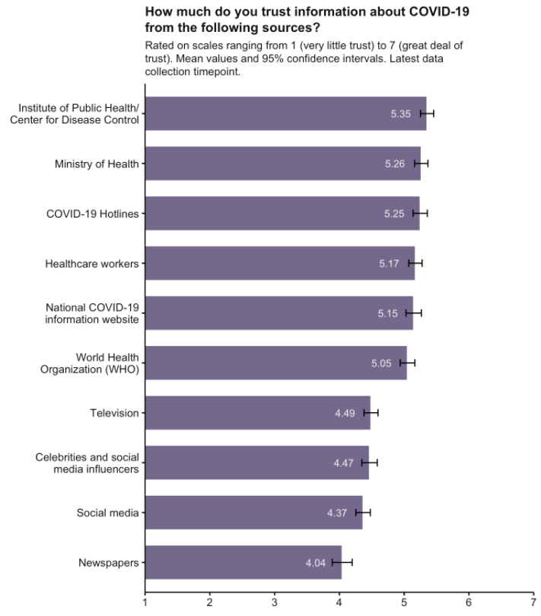
Trust in information sources
Respondents generally have high trust (more than 5 out of 7) in the Institute of Public Health, the MoH, the Covid-19 hotlines, the healthcare workers, the national Covid-19 website and the WHO.
Sources that generally receive low scores include:
Television
Celebrities and Influencers
Social media
Newspapers
Interesting to note that the more trusted source of information is the Institute of Public Health/Center for Disease Control followed by the MoH, official hotlines/website, healthcare workers and the WHO

Slide 31
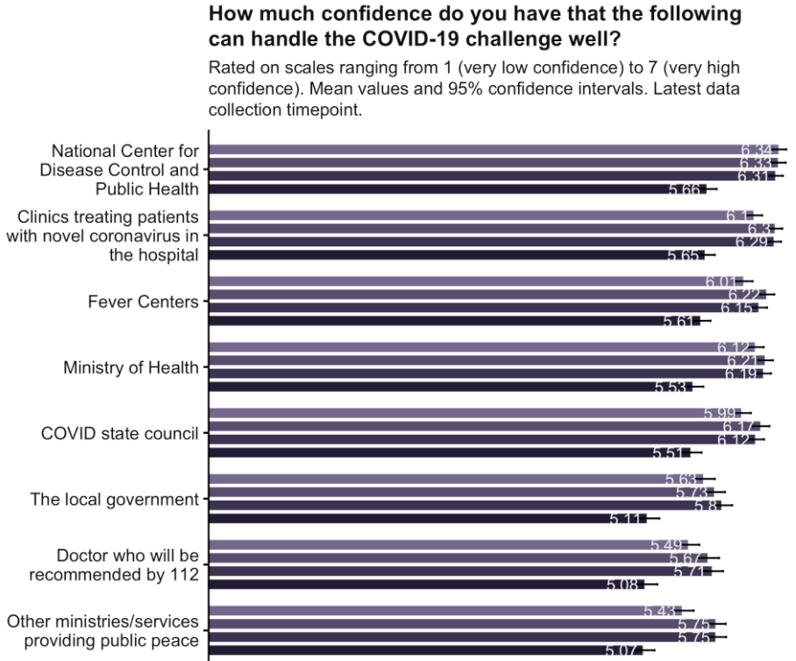
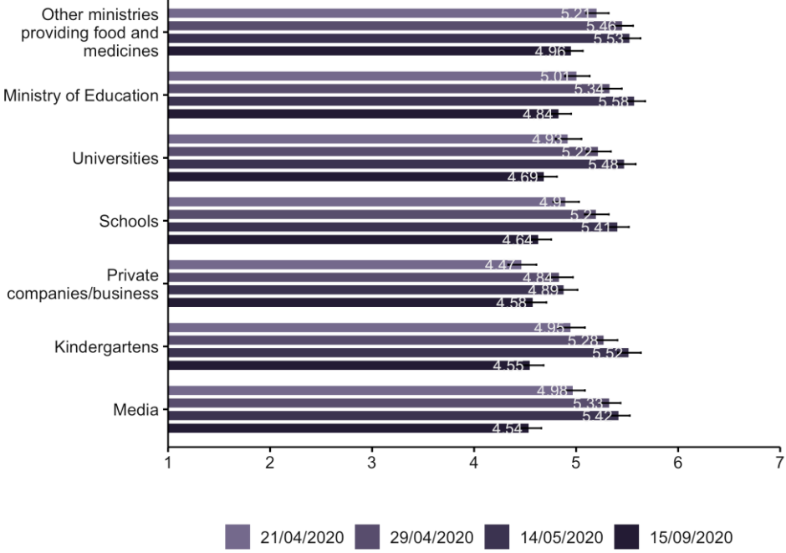
Trust/Confidence in institutions
Overall, trust in institutions remains relatively high, however there is a decrease in trust of all 15 institutions mentioned, compared to previous datasets.
The ones with the highest decrease are: kindergartens, media, universities, schools and Ministry of Education.
The lowest decrease was recorded for: private companies, fever centers and other ministries providing food and medicines.
People who do not trust the National Center for Disease Control and Public Health tend to be those who:
Have low health literacy
Believe that the virus is not spreading fast
Believe COVID-19 is media hyped
Use media less frequently
Are younger
Those who do not trust the MoH share very similar characteristics.
The most significant fall of trust is observed towards the education. The institutions around education score fairly low even in absolute terms. All institutions have lost trust compared to previous datasets. This could be linked to the lenient stance towards the pandemic and the low perception of infection severity.

Slide 32
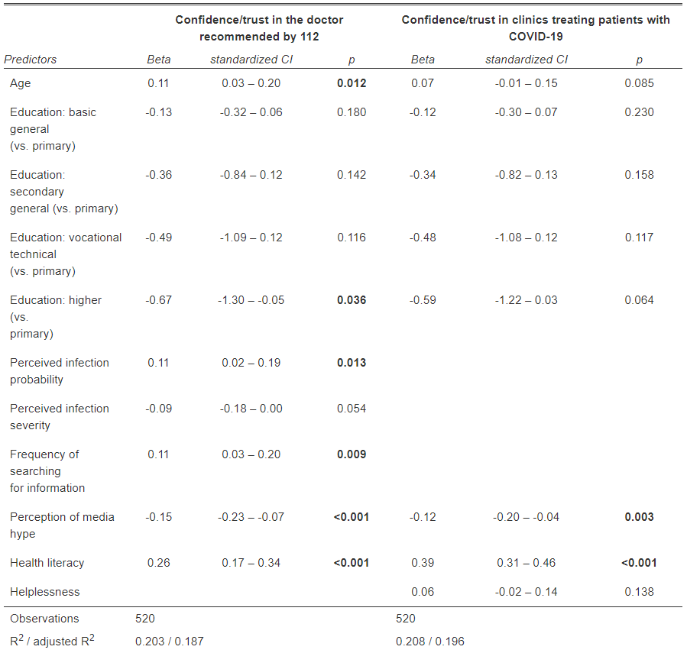
Detail 1: Drivers of trust in the health sector
In the following tables, the variables which influence trust in family doctors and hospitals are explored.

Slide 33
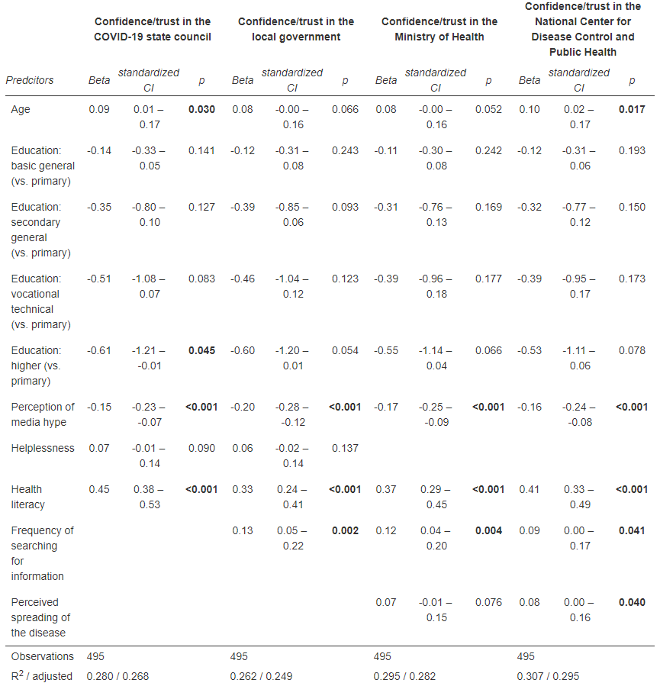
Detail 2: Drivers of trust in the government

Slide 34
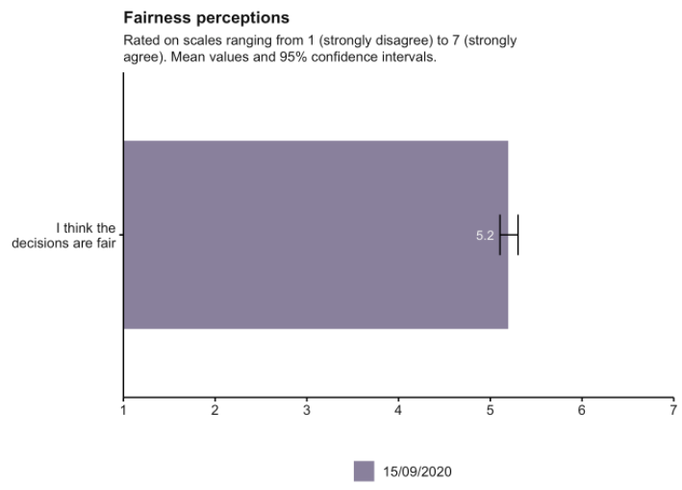
Fairness
Respondents score fairly high on the fairness scale.
People who disagree decisions are fair in particular include those who:
Have low health literacy
Think the pandemic is media hyped
Have low trust in government
Search for information re COVID less frequently
Risk perception has an impact on ideas of fairness, as does trust in government and the use of media.
We see the fairness perceptions relatively high, however it will be interesting to follow the future scores, as people are starting to feel less susceptible to the virus.

Slide 35
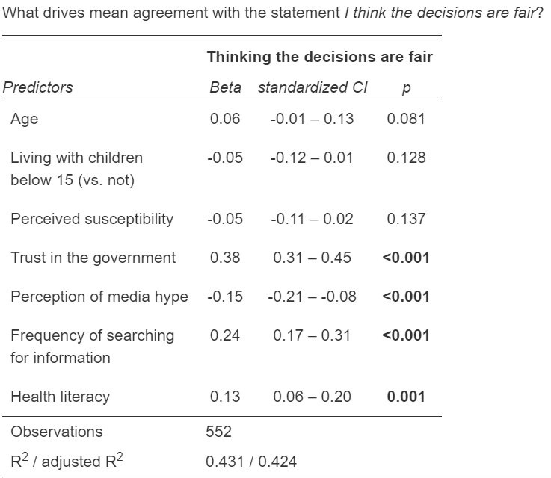
Fairness

Slide 36
Confidence and trust issues: discussion
Questions to discuss in the team
We know that higher trust in institutions means people are more likely to follow recommendations. How have issues related to trust been approached successfully in the past?
How may trust in institutions have impacted the pandemic so far?
There is a link between low risk perception and low perception of fairness. What can be done to increase appropriate risk perception?
Possible action or follow up
Create or strengthen COVID-19 response working group; include communicators from all departments/organizations to ensure decisions made are communicated well and messages are aligned.
Consider holding regular press briefings or public forums for sharing information
Tailored measures, policies, communications or community outreach activities.
Consider activities to increase/restore trust, including through transparency, early announcements of new findings, explaining clearly reasons and criteria for new policies.
Consistency in decision-making and measures, structures for coordination, alignment across institutions and influencers.
Tools and resources
WHO Europe RCCE Strategy Template

Slide 37
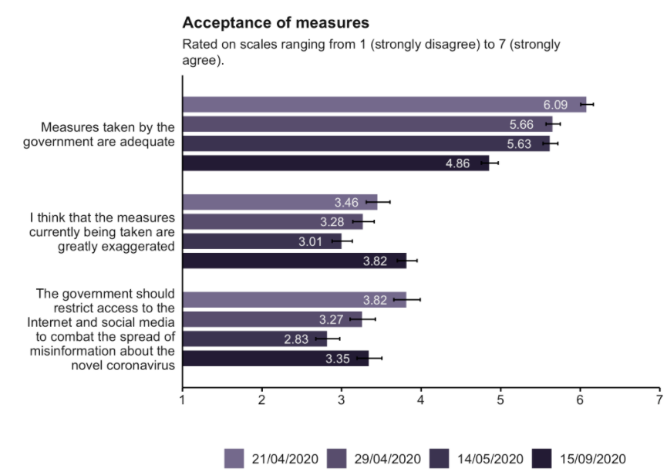
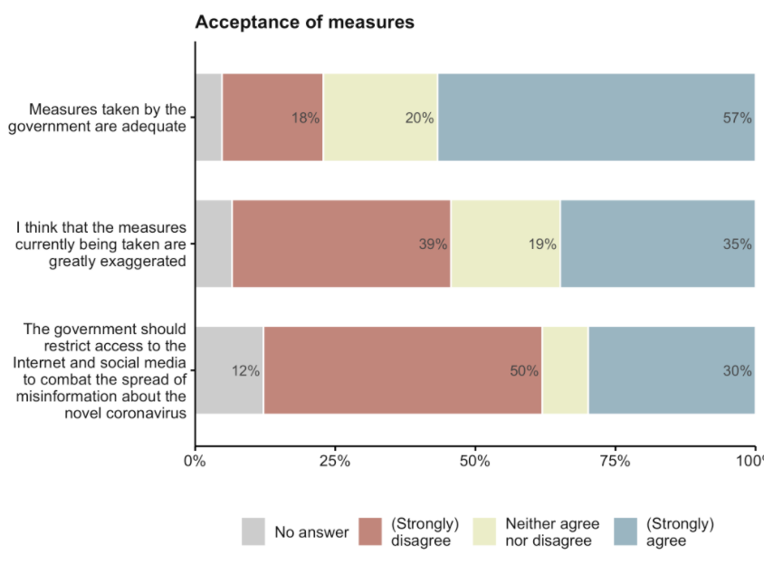
Policies - Interventions
“Please now give your opinion on the following statements”
Generally, people find the measures taken by the government adequate. However, the score 4.86/7.00 is the lowest recorded since April data collection.
35% state that the measures being taken are greatly exaggerated where the score 3.82/7.00 appears to be the highest recorded since April data collection.
Half of the respondents disagree that the government should restrict internet access as a measure of preventing misinformation.
People who believe that the measures taken are greatly exaggerated in particular include those who:
Believe COVID-19 is media hype
Believe an infection would not be severe
Do not search for information frequently
Live with children under 15 y/o
There is a clear fall in the acceptance of measures since April with an increasing belief that the measures are greatly exaggerated. This could be connected to the lowering trends in risk perception. 57% consider the measures to be sufficient however, a decreasing trend since April is being observed.

Slide 38
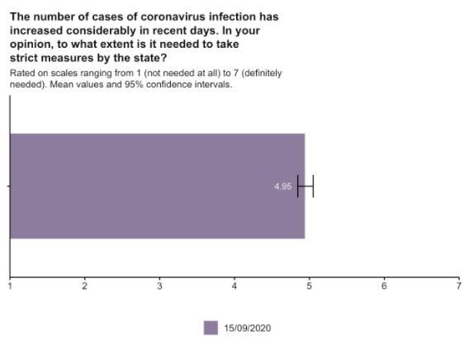
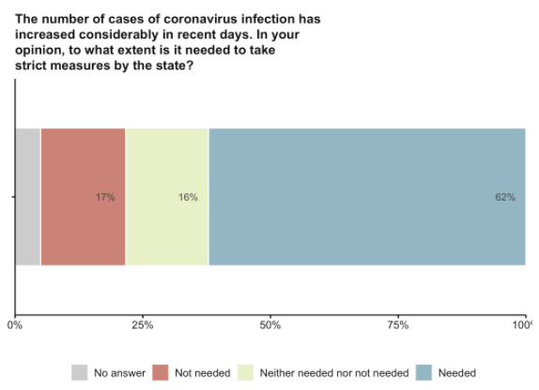
Policies – Strict Measures
There is a medium correlation between those who think measures taken by the government are exaggerated and those who do not agree with stricter measures.

Slide 39
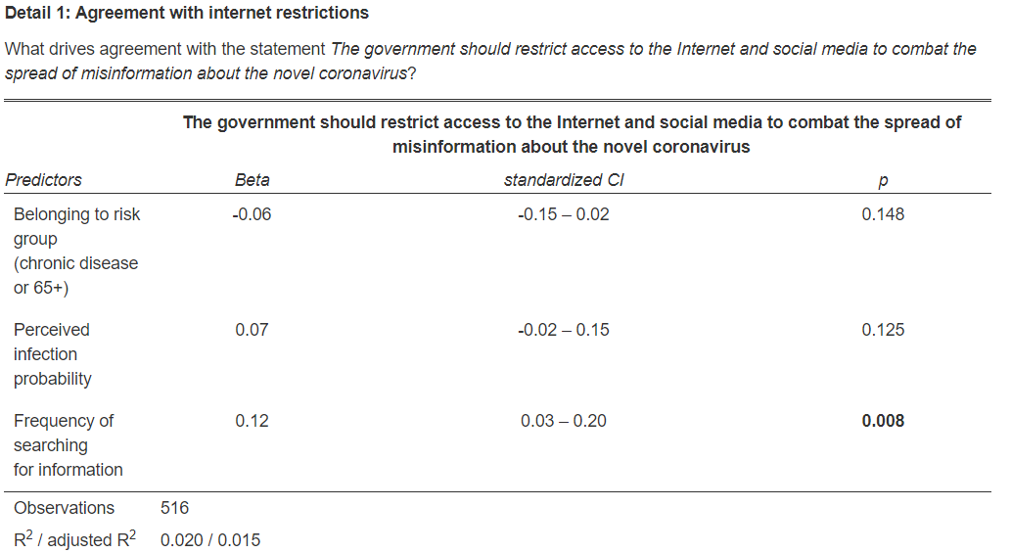

Slide 40
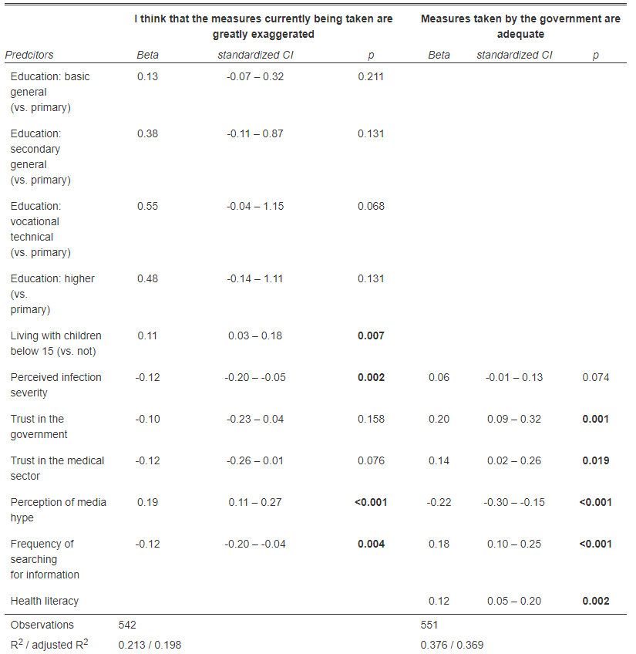
What drives agreement with the statements:

Slide 41
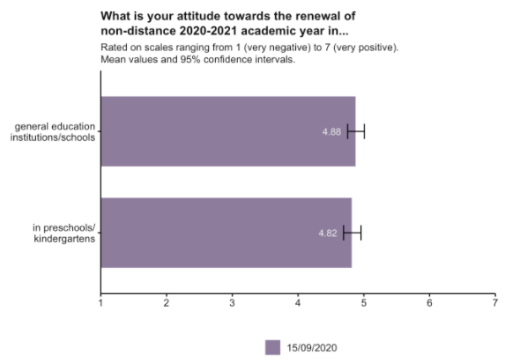
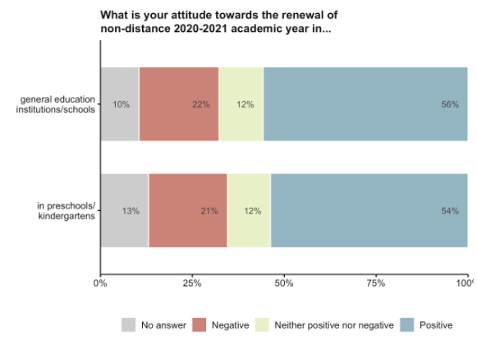
Attitudes towards schooling
The majority of respondents support the renewal of in-person schooling for the 2020-2021 academic year.
56% agree with in-person schooling for general education
54% agree with in-person schooling for younger students

Slide 42
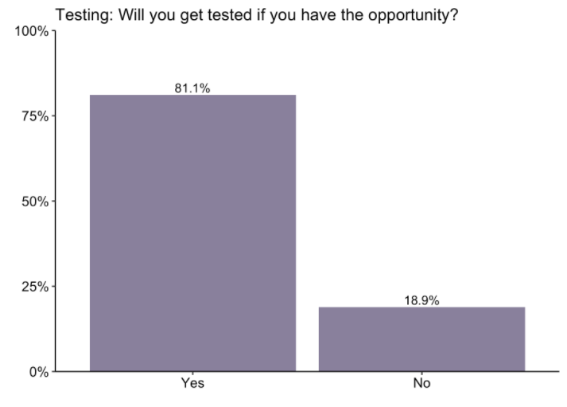
Testing: acceptance
“If you have been in contact with someone who tested positive for COVID-19 and have no symptoms yourself – will you get tested if you have the opportunity?” 812 participants indicate they would get tested for sure, 189 may not get tested.
This variable refers to a scenario where getting tested is a clear recommendation: respondents are asked to imagine that they had been in contact with someone who tested positive.
Compared to the acceptance of vaccination levels observed, the acceptance of testing is strikingly high.
Still, nearly 1 in 5 say that would probably not get tested if they had been in contact with someone who was tested positive for COVID-19.
People who are less likely to get tested in particular include those who:
Have low health literacy
Think the pandemic is media hyped
Do not search for information frequently
This may be set as a target for future rounds that the acceptance of testing should increase.

Slide 43
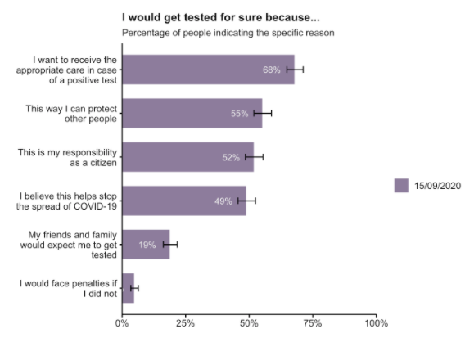
Testing: motivations
“If you have been in contact with someone who tested positive for COVID-19 and have no symptoms yourself – will you get tested if you have the opportunity?” Of those who indicated they would get tested (812 participants) the following are reasons they gave for why.
Of the respondents who said they would definitely get tested, most of them indicated that the reason they would test is so they could receive the necessary treatment (68%), followed by a desire to protect other people (55%) and the sense that it is one’s responsibility as a citizen to do so (52%).
This information can help to shape communication materials related to testing and contact tracing. It’s interesting to note that social norms (what others would expect of me) are relative low in terms of motivating factors

Slide 44
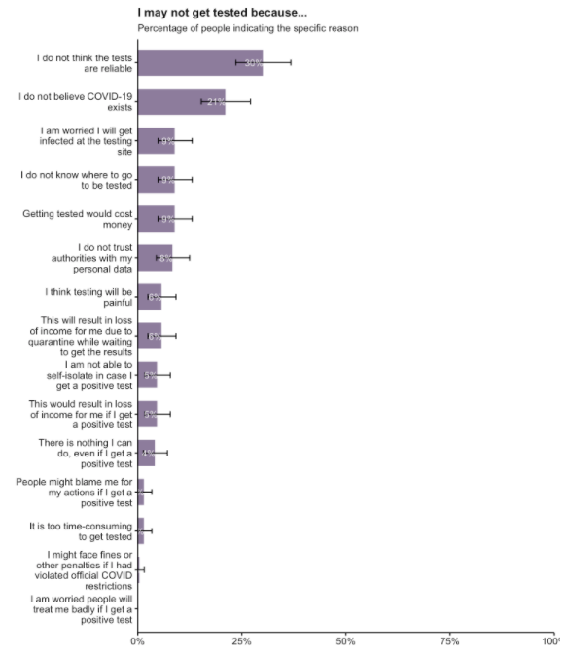
Not testing: reasons
“If you have been in contact with someone who tested positive for COVID-19 and have no symptoms yourself – will you get tested if you have the opportunity?” Of the 189 who said they may not get tested, below are reasons they gave for not testing.
Of the respondents who said they may not get tested, the most common reason given is that they do not think the tests are reliable (30%).
The second most common reason is that respondents don’t believe COVID-19 exists (21%).
It is concerning to see that some respondents would not get tested for COVID-19 even if they were told they had been near someone who was positive because they do not believe COVID-19 exists. It is important to take this into consideration in all communication campaigns.

Slide 45
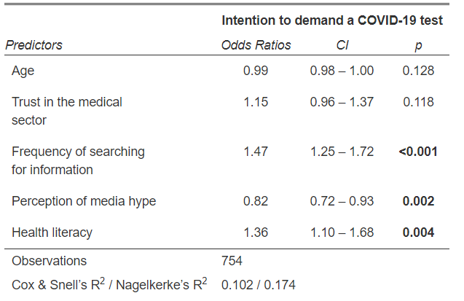
Who agrees with getting tested:

Slide 46
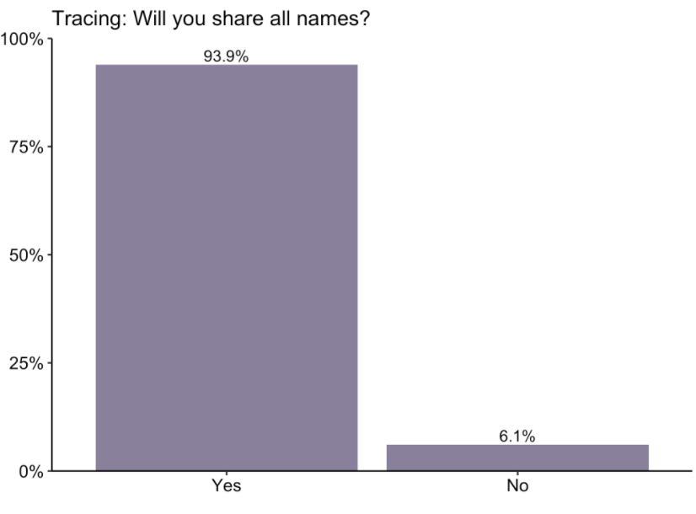
Contact tracing: perceptions
“If you test positive for COVID-19 and are asked to share with health authorities the names of people you have been in contact with – will you share all names?”
Acceptance of sharing names for contact tracing in case of a positive COVID-19 test gets the very high level of acceptance.
People who are less likely to share information/names in particular include those who:
Have low health literacy
Believe that the virus is not spreading fast

Slide 47
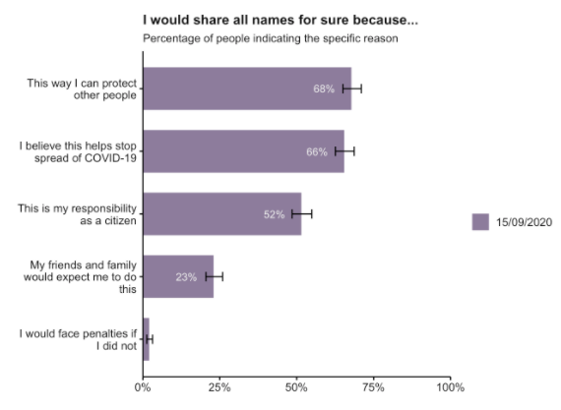
Contact Tracing: motivations
Of the 940 participants who indicated they would share the names, most cited that doing so would protect other people (68%) and help stop the spread of COVID-19 (66%).
Again, this information can help to shape communication materials related to testing and contact tracing. It’s interesting to note that social norms (what others would expect of me) are relative low in terms of motivating factors.

Slide 48

No contact tracing: reasons
“If you have been in contact with someone who tested positive for COVID-19 and have no symptoms yourself – will you get tested if you have the opportunity?” Of the 189 who said they may not get tested, below are reasons they gave for not testing.
Of the respondents who said they may not get tested, the most common reason given is that they could contact people directly rather than provide names to authorities (39%).
The second most common reason is that it would cause inconvenience to those whose names are shared (23%).
The majority of respondents said they would share names of people they had been in contact with, but others indicated they would rather tell people themselves than shar names with authorities.

Slide 49

Who agrees with sharing contact names (tracing):

Slide 50


Future COVID-19 vaccine:
perceptions
There are contradictory statements related to a future COVID-19 vaccine:
55 % believe that a vaccine can help can help control the spread of COVID-19
But
Only 45% state they would get vaccinated.
And
32-43% agree with not being vaccinated if everyone else has been.
41% said if they knew they had been infected previously they would not get vaccinated
The percentage of undecided (22%) on vaccination acceptance is relatively high. (Sub-analysis follows)
Preparations for new vaccine introduction should start early and be planned well, building on these findings. Esoecially the safety of the vaccine.
Particular focus should be put on those who are already favourable and the fairly large group of people who are undecided in relation to the vaccine. Those who have already decided against are more difficult but should also be targeted.

Slide 51

Future COVID-19 vaccine: barriers and drivers
Various potential barriers and drivers to vaccination were suggested to respondents to assess which factors may be important for planning the new vaccine introduction.
Noticably, experience with the vaccine (been in use for a long time (64%), in use in other countries (62%) are the most important drivers.
Recommendation from the MoH (57%) and country of production (57%), are also important drivers aprt from the risk of infection at the time of introduction.
All of the suggested drivers are agreed to by more than 47%
One of the major factors of the vaccine acceptance is whether it has been used for a long time without major side effects. Many respondents have stated that they would like to see that the vaccine works well in another country before they decide to get it. This could suggest that the vaccine safety is the main concern and all information related to this should be communicated carefully and clearly.

Slide 52


Sub-analysis for those undecided about getting vaccinated
Among those who are undecided (22%) as to whether they would get a future COVID-19 vaccine or not, most of the possible barriers and drivers get slightly higher score than for the entire sample – however, the prioritization of barriers is similar to the one for the entire sample, and the same five barriers/drivers range at the top.
[5.27]
[5.17]
[5.07]
[4.90]
[4.83]
Below figure shows barriers and drivers for the 22% who are undecided regarding COVID-19 vaccination. Numbers in brackets indicate the corresponding finding for the entire sample.
[4.66]
[4.74]
[4.59]
[4.46]

Slide 53

Routine vaccination
When asked In general, do you get your child or child under guardianship a routine vaccination? in wave 4, 256 participants (25.6%) answered yes while 34 participants (3.4%) said no. 71% gave no answer (because they had no child or refused to answer)

Slide 54


Flu vaccination
We see that about one third of the respondents consider flu vaccination to be important at this time. Of those who gave a specific reason for not vaccinating against flu, most said that it is not a serious disease, which is an opportunity for information/communication campaigns

Slide 55
Transition phase: discussion
Questions to discuss in the team
It’s important to recognize that more people now find the measures in place to be exaggerated. We are seeing this pandemic ‘fatigue’ everywhere. How does this appear in Georgia?
Responses to the questions on testing and contact tracing show high levels of willingness to comply, which is very positive. Do we know the motivations for this?
Are there relevant perspectives to draw on from other sources of information, e.g. hotlines, (social) media monitoring or other research related to this?
How can we best start preparing for a future COVID vaccine introduction already now?
Possible action or follow up
Use responsibility as a citizen and help to control the virus as key messages.
Consider possible changes in recommendations/restrictions, based on the acceptance of these.
Start preparing for vaccine introduction early: consider health system, health workers, public, priority groups.
Do not communicate about a vaccine which does not yet exist – communicate about the progress and the processes in place to ensure the safety of any vaccine.
Consider health workers as a critical target group for a potential COVID-19 vaccine introduction.
Tools and resources
WHO Europe RCCE Strategy Template

Slide 56

Data by demographics

