Slide 1
Georgia Improving the TB care delivery model
02 June 2017

Slide 2
Key circumstances and systemic factors in Georgia that should be accounted for
Decentralized, predominantly private setup of health care provision
Limited leverage of the Government / MoLHSA over private providers
Expiration of the current agreement on ownership of facilities and provision of services at the end of 2018 (?)
No proper inclusion of TB care in the Universal Health Care (UHC) program
Rollout of molecular TB diagnostics (Xpert MTB/RIF) to peripheral level
Implementation of new TB drugs and shorter MDR treatment regimens (STRs)
Acute problems with ensuring human resources in the specialized TB service
Lack of capacities and status at NCTLD for oversight of TB service units
Weak oversight and coordination at the regional level
Decreasing external funding for TB control; need for rapid and effective takeover

Slide 3
Number of outpatient TB service units and staff, by provider institution
 | TB units | Doctors | Nurses | Total staff
Evex (including Unimed) | 18 | 17 | 19 | 37
GeoHospitals | 10 | 10 | 12 | 22
MedAlpha | 4 | 4 | 5 | 9
Archimedes | 2 | 2 | 2 | 4
Alliance MedService | 2 | 1 | 2 | 3
New Medical Center | 2 | 1 | 2 | 3
Other private providers (1 each) | 11 | 30 | 37 | 67
Total private providers (17) | 49 | 65 | 79 | 144
Regional Healthcare Centers | 10 | 10 | 10 | 20
NCTLD | 1 | 9 | 68 | 77
Other public providers (1 each) | 7 | 22 | 17 | 39
Total public providers (9) | 18 | 41 | 95 | 136
Total country (26 providers) | 67 | 106 | 174 | 280

Slide 4
Age of TB service doctors (outpatient services, civilian sector), full years on 31 March 2017
 | Regions | Tbilisi | Total
Number of respondents | 83 | 23 | 106
Min-max | 37 – 83 | 40 – 67 | 37 – 83
Median | 58 | 55 | 58
Average ± SD | 58.8 ± 9.8 | 55.3 ± 7.3 | 58.0 ± 9.4

Slide 5
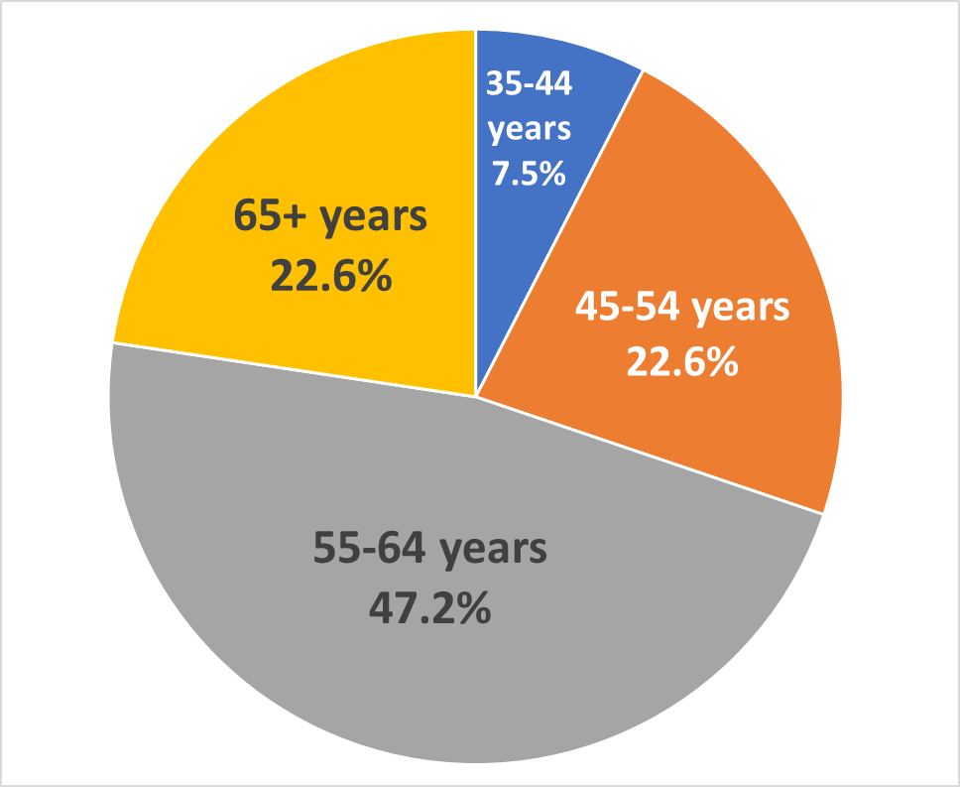
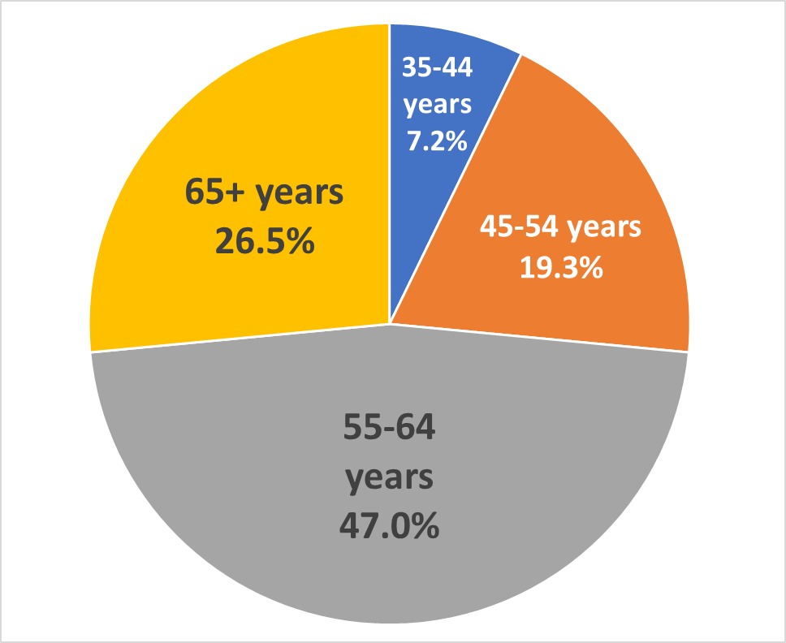
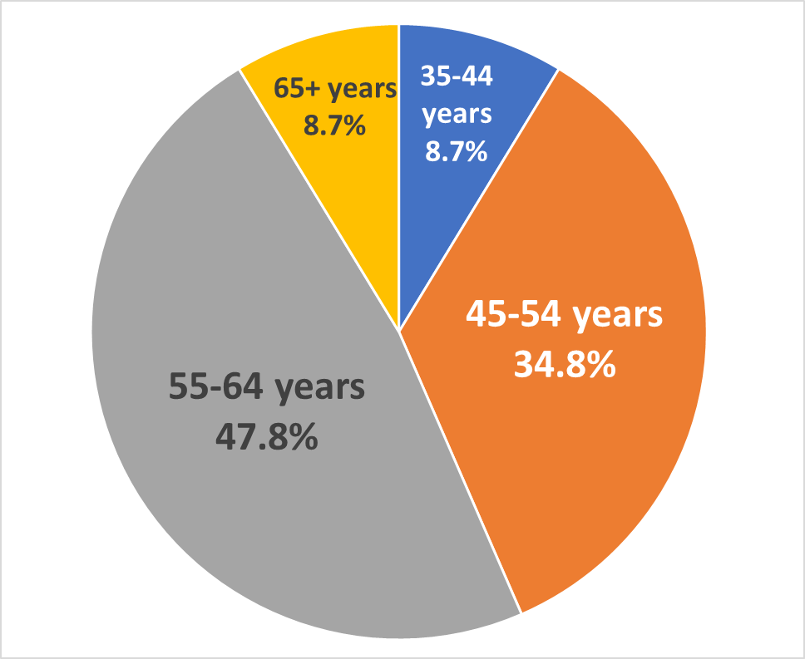
Age of TB service doctors (outpatient services, civilian sector), by age group, full years on 31 March 2017
Regions
Tbilisi
TOTAL
In total, 69.8% of TB service doctors are of pre-retirement and retirement age (≥ 55 years); in the regions – 73.5%, in Tbilisi – 56.5%

Slide 6
High priority districts for actions regarding human resources (age of TB service doctors 55+ years on 31 March 2017)
1 | Khulo | 15 | Keda | 23 | Zestafoni
2 | Ninotsminda | 16 | Tianeti | 24 | Kvareli
3 | Lentekhi | 17 | Ozurgeti | 25 | Telavi
4 | Kaspi | 18 | Martvili | 26 | Gori
5 | Vani | 19 | Shuakhevi | 27 | Kharagauli
6 | Tsageri | 20 | Chokhatauri | 28 | Tskaltubo
7 | Lanchkhuti | 21 | Sagarejo | 29 | Abasha
8 | Lagodekhi | 22 | Akhaltsikhe | 30 | Adigeni
9 | Marneuli |  |  | 31 | Chiatura
10 | Baghdati |  |  | 32 | Sachkhere
11 | Khobi |  |  | 33 | Senaki
12 | Tsalenjikha |  |  | 34 | Borjomi
13 | Dmanisi |  |  | 35 | Dedoplitskaro
14 | Chkhorotsku |  |  | 36 | Sighnaghi
 |  |  |  | 37 | Akhalgori
 |  |  |  | 38 | Akhalkalaki
 |  |  |  | 39 | Tkibuli
 |  |  |  | 40 | Gurjaani
 |  |  |  | 41 | Khashuri
65+ years
60-64 years
55-59 years
Urgent actions are required for 49 TB units out of 67 (73%):
8 currently without TB service doctors and 41 in the table above

Slide 7
Monthly salary level, 'Gross', TB service doctors (outpatient services, civilian sector), GEL
 | Regions | Tbilisi | Total
Number of respondents | 76 | 22 | 98
Min-max | 300 – 1,100 | 280 – 1,200 | 280 – 1,200
Median | 373 | 794.5 | 398
Average ± SD | 445.7 ± 145.1 | 719.2 ± 238.9 | 507.1 ± 204.4
40 TB service doctors (40.8% of valid responses; 38 from the regions (50.0%)
and 2 from Tbilisi) stated receiving ‘minimum-level’ gross salary (GEL 360) or less

Slide 8
Monthly salary level, Net', TB service doctors (outpatient services, civilian sector), GEL
 | Regions | Tbilisi | Total
Number of respondents | 76 | 22 | 98
Min-max | 240 – 880 | 224 – 960 | 224 – 960
Median | 309.5 | 632 | 338.4
Average ± SD | 363.8 ± 116.1 | 573.8 ± 192.2 | 410.9 ± 161.8
35 TB service doctors (35.7% of valid responses; 33 from the regions (43.4%)
and 2 from Tbilisi) stated receiving ‘minimum-level’ net salary (GEL 288) or less

Slide 9
Average Monthly salary levels, TB service doctors, by type of provider institution (GEL)
GROSS
NET

Slide 10
Main questions to be answered when designing the TB care model
Which interventions are needed? WHAT
Which inputs are required to perform these interventions? HOW
In which institutions will the interventions be performed? WHERE
Who will perform these interventions? WHO
How much will it cost, and what are the payment methods? HOW MUCH
Who will pay the costs? BY WHOM
How the whole system will be managed?

Slide 11
What are the steps on the TB patient pathway?
Step 0. Symptomatic patient seeking care
Step 1. Screening for TB symptoms and signs
Step 2. Clinical and bacteriological evaluation for active TB disease
Step 3. Full bacteriological evaluation for TB and drug resistance
Step 4. Treatment (outpatient and inpatient) and follow-up

Slide 12
Step 1. Screening for TB symptoms and signs
WHAT | Patient history Basic checkup Referral of patient for diagnosis
HOW | Medical doctor – generalist
WHERE | PHC facility General outpatient medical facility
WHO | Family doctors in rural areas Doctors in medical centers in urban areas
HOW MUCH | Capitation
BY WHOM | Universal Health Care program

Slide 13
Step 2. Clinical and bacteriological evaluation for active TB disease
WHAT | Patient history - Clinical laboratory investigations Basic checkup - Rapid HIV test Rapid ds test for MTB and RR - Shipping of sputum specimens Chest X-ray - Referral of pt for diff. diagnosis or tx
HOW | Medical doctor – ‘TB specialist’ - X-ray equipment Xpert MTB/RIF technology - Clinical laboratory
WHERE | General outpatient medical facility Specialized TB facility
WHO | TB specialists (phthisiatricians; pulmonologists; other specialty doctors trained in TB) Nurses
HOW MUCH | Adjusted capitation Per visit, diagnostic purpose
BY WHOM | Universal Health Care program

Slide 14
Step 3. Full bacteriological evaluation for TB and drug resistance
WHAT | Direct smear microscopy - Identification of strains Rapid ds test for MTB and RR - DST to FLDs and SLDs Isolation of strains (culturing)
HOW | TB laboratory specialist - Automated MGIT technology Xpert MTB/RIF technology - LPA technology Culture and DST in solid media - General laboratory equipment
WHERE | TB reference laboratories
WHO | Laboratory doctors (bacteriologists) Laboratory technicians
HOW MUCH | Global budget Per test
BY WHOM | State budget / NCDCPH (vertical program)

Slide 15
Step 4a. Outpatient treatment and follow up
WHAT | Patient history, basic checkup - Management of adverse drug reactions Clinical laboratory investigations - Treatment of comorbidities (incl. HIV) Clinical instrumental investigations - Counseling and patient support Administration of TB treatment
HOW | Medical doctor – ‘TB specialist’ - Nurses Medical doctors of other specialties - Chest X-ray and other ds technologies Medical doctor – generalist - Clinical laboratory
WHERE | Specialized TB facility - PHC facility General outpatient medical facility
WHO | TB specialists (phthisiatricians; pulmonologists; other specialty doctors trained in TB) Doctors of other specialties Family doctors and nurses in rural areas Doctors and nurses in medical centers in urban areas
HOW MUCH | Adjusted capitation - Per case Per visit
BY WHOM | Universal Health Care program

Slide 16
Step 4b. Inpatient treatment
WHAT | Patient history, basic checkups - Surgical treatment Clinical laboratory investigations - Management of adverse drug reactions Clinical instrumental investigations - Treatment of comorbidities (incl. HIV) Administration of TB treatment - Counseling and patient support
HOW | Medical doctor – ‘TB specialist’ - X-ray, other ds and interventional t-s Medical doctors of other specialties - Surgery, anesthesia and intensive care Nurses and support staff - Clinical laboratory Infrastructure, infection control
WHERE | Specialized TB hospitals
WHO | TB specialists (phthisiatricians; pulmonologists) - Nurses Doctors of other specialties - Support staff
HOW MUCH | Global budget Per case Per case, diagnosis-adjusted
BY WHOM | Universal Health Care program State budget (vertical program)

Slide 17
Which other components of the national TB program need to be considered?
Screening for active TB disease / active case finding (contacts of TB cases and other groups);
Management of latent tuberculosis infection (LTBI);
Management of TB/HIV (and TB/HCV) co-infection;
Pharmacovigilance;
Adherence support;
Information, education and communication (for general population and special target groups);
TB control in the penitentiary system;
Other special populations and high-risk groups;
Clinical and operational research.

Slide 18
Number of TB suspects and contacts investigated per 1 TB case (all cases) in Georgia, 2011-2015 (civilian sector only)

Slide 19
‘Ranking’ of regions by the need for improving TB case detection, 2015
NOTES: 1. Excluding Tbilisi
2. The higher the points, the worse is case detection (and the higher the need for improvement)

Slide 20
‘Ranking’ of districts (municipalities) by the need for improving TB case detection, 2015
NOTES:
1. Excluding Tbilisi and districts with population < 20,000
2. The higher the points, the worse is case detection (and the higher need for improvement)

