Slide 1



Technical Assistance to Social Welfare in Georgia
Report on the mental health survey in Georgia
Pr. Viviane Kovess-Masfety

Slide 2
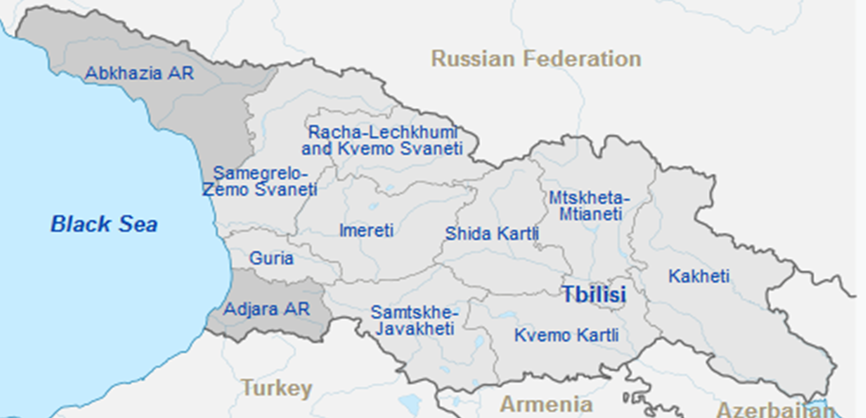
Sample location

Slide 3
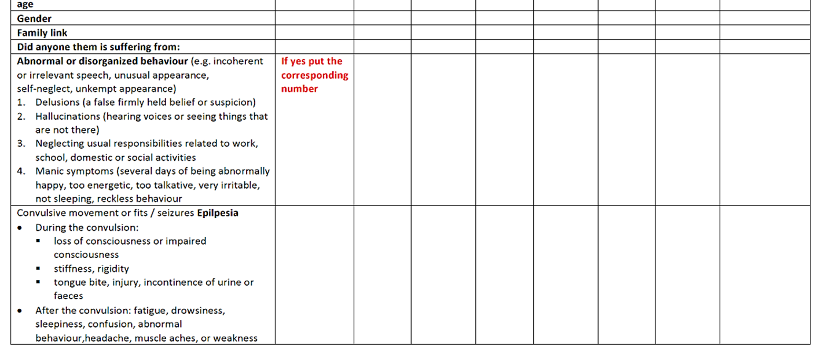
Household questionnaire (WHO, Mhgap)

Slide 4
N=5640 | Total | Number of persons
Non affective psychoses | 0,52% | 25
Manic episode | 0,79% | 38
Severe mood disorders | 2,3% | 110
Severe somatic anxiety | 3,19% | 152
Severe addiction | 0,6% | 29
Any impairment due to the above disorders | 4,24% | 239
Dementia | 1,95% | 93
Any impairment with dementia | 4,77% | 269
Behaviour disorders | 0,39% | 22
Attention-Deficit Hyperactivity Disorder | 1,51% | 85

Slide 5
Individual questionnaire
Socio demographic determinants
Psychological distress (MH5 from SF36)
Mental Health disorders diagnoses (CIDI SF)
Major depressive episode and some questions on mania.
Generalized anxiety;
Questions on suicidal behaviour;
Measures of PTSD
The life event checklist five (LEC-5) assesses exposure to 16 events known to potentially result in PTSD + The PTSD Checklist for DSM-5 (PCL-5) is a 20-item self-report measure.
The ITQ (International Trauma Questionnaire)
Psychotic experiences: hallucinatory experiences and delusional experiences
Addictions: ASSIST: WHO Alcohol, Smoking and Substance Involvement Screening Test
Access to care for mental health problems: access, provider, reason, place and cost

Slide 6
Prevalence of mental health problems
 | Psychological Distress 1m | MDE (without imp) 12m | MDE 12m | GAD 12m | Panic anxiety LT | PTSD (ITQ) 1m | Moderate/ Sev risk any substances 3m | severe risk sub 3m | Any Psychotic Exp LT | Suicidal Thoughts LT*
Men | 31,99 | 5,61 | 2,92 | 1,43 | 11,65 | 8,5 | 21,23 | 2,27 | 4,85 | 14,44
Women | 37,68 | 7,16 | 3,12 | 2,5 | 15,99 | 10,14 | 5,83 | 0 | 4,8 | 13,59
Total | 35,05 | 6,45 | 3,03 | 2,01 | 13,99 | 9,38 | 12,94 | 1,05 | 4,83 | 13,98
 | p=0.02 | P=0.18 | p=0.81 | p=0.10 | p=008 | p=0.22 | p=0.0000 | p=0.0000 | p=0.96 | p=0.82
*in addition 2,73% either refused or declared not knowing the answer

Slide 7
Substance | Frequency | Men | Women | Average | P-value
Tobacco | No/Low | 46,63% | 81,68% | 65,51% | P = 0,0000
 | Moderate | 51,75% | 17,99% | 33,56%
 | High | 1,61% | 0,33% | 0,93%
Alcohol | No/Low | 87,78% | 98,97% | 93,81% | P = 0,0000
 | Moderate | 11,10% | 1,03% | 5,68%
 | High | 1,12% | 0,00% | 0,52%
Cannabis | No/Low | 91,39% | 98,97% | 95,47% | P = 0,0000
 | Moderate | 8,37% | 1,03% | 4,42%
 | High | 0,25% | 0,00% | 0,11%
Cocaine | No/Low | 99,52% | 100,00% | 99,78% | P = 0,0321
 | Moderate | 0,48% | 0,00% | 0,22%
 | High
Amphetamine | No/Low | 98,14% | 99,54% | 98,89% | P = 0,0035
 | Moderate | 1,86% | 0,46% | 1,11%
 | High
Sedative | No/Low | 96,75% | 98,58% | 97,74% | P = 0,0073
 | Moderate | 3,25% | 1,42% | 2,26%
 | High
Hallucinogen | No/Low | 99,86% | 100,00% | 99,93% | P = 0,2809
 | Moderate | 0,14% | 0,00% | 0%
 | High
Opioids | No/Low | 97,54% | 99,90% | 98,81% | P = 0,0000
 | Moderate | 2,32% | 0% | 1,13%
 | High | 0,14% | 0,00% | 0%
Narcotic | No/Low | 97,79% | 99,80% | 98,87% | P = 0,0003
 | Moderate | 1,97% | 0,20% | 1,02%
 | High | 0,24% | 0,00% | 0,11%
Other | No/Low | 99,24% | 100,00% | 99,65% | P = 0,0293
 | Moderate | 0,51% | 0,00% | 0,24%
 | High | 0,24% | 0,00% | 0,11%
Any addiction (tob excluded) | No/Low | 80,19% | 96,63% | 89,04% | P = 0,0000
 | Moderate | 17,57% | 3,37% | 9,93%
 | High | 2,24% | 0,00% | 1,03%
The risk factors product by product constantly point some at risk group: men, middle aged or aged, unemployed and self-employed together with the protective role of high education and the regional differences

Slide 8
To summarise:
At least 5% of the Georgian population is facing at any time a mental health problem severe enough to be noticed by his surrounding and having an impact of his or her activities
Rates of 12 month major depressive disorders or Generalised Anxiety disorders are in the range of what has been reported in most Western European countries or lower.
Rates of suicidal thoughts and attempts are high, mostly due to men and a particular high percentage of refusal to that question, denotes a highly stigmatised attitude.
Alcohol, tobacco, Cannabis and other drug usage required attention for men

Slide 9
Psychological Distress | Odds Ratio | P>t | [95% Conf. | Interval]
(Mutivariate)
gender F/M | 0.99 | 0.984 | .78 | 1.26
placebirth
Large city
2. town | 0.67 | 0.017 | .49 | .93
3. village | 0.98 | 0.919 | .66 | 1.45
education
Primary
4. secondary | 0.61 | 0.126 | .33 | 1.14
6. university | 0.40 | 0.008 | .20 | .78
matrimonial
Single
2. married or living togther | 0.66 | 0.008 | .48 | .89
3. div sep | 2.92 | 0.000 | 1.84 | 4.63
5. widowed | 1.27 | 0.297 | .80 | 1.99
employment
Employed
2. self emp | 1.31 | 0.119 | .93 | 1.84
3. unemp | 1.91 | 0.000 | 1.36 | 2.66
4. retired | 2.29 | 0.000 | 1.44 | 3.50
5. student | 0.32 | 0.031 | .11 | .90
6. handicaped | 7.66 | 0.030 | 1.22 | 47.90
7. other | 2.02 | 0.284 | .55 | 7.29
Âge
18-29
30-59 | 1.72 | 0.005 | 1.18 | 2.51
>=60 | 2.14 | 0.001 | 1.35 | 3.38
region
Adjara
2. Kakheti | 2.38 | 0.001 | 1.40 | 4.02
3. Mtskheta-mt | 0.54 | 0.032 | .31 | .95
4. Samegrelo | 1.68 | 0.050 | .99 | 2.83
5. Samtskhe-Ja | 0.84 | 0.574 | .46 | 1.52
6. Tbilisi | 1.98 | 0.005 | 1.22 | 3.21
Each of these diverse risks factors who have to be confirmed, indicate some at risk population:
the 60 years and above,
the unemployed,
the divorced,
those who have a low level of education and
those living in Tbilissi.
This could support programs better focused on the most fragile taking in account the type of problem for example addiction for the self-employed, anxiety for the 60 and over, suicidal thoughts and depression among the unemployed or handicapped.

Slide 10
Odds Ratio | MDE (without impairment) | MDE | GAD | Panic anxiety | PTSD (ITQ) | Addiction Moderate/ Sev risk | Addiction severe risk sub | Psychotic experience (long-term) | Suicidal Thoughts (long term)
Gender F/M | 1.15 | 0.78 | 1.48 | 1.20 | 1.15 | .24 |  | 0.89 | 0.83
Placebirth
Large city
town | 1.04 | 2.15 | 0.89 | 0.55 | 0.76 | 0.85 | 0.77 | .067 | 0.98
village | 0.73 | 1.58 | 1.19 | 0.63 | 1.23 | 1.17 | 0.90 | 1.08 | 1.57
Education
Primary
secondary | 0.39 | 0.27 | 0.41 | 0.51 | 0.88 | 1.01 | 1 | 0.31 | 0.49
university | 0.41 | 0.38 | 0.49 | 0.50 | 0.75 | 0.66 | 1 | 0.21 | 0.44
Matrimonial |  |  |  |  |  |  | 1
Single
married or as | 0.61 | 0.65 | 1.95 | 0.98 | 1.40 | 0.67 | 0.76 | 0.45 | 0.68
div sep | 1.52 | 1.90 | 7.45 | 2.04 | 2.46 | 1.57 | 5.68 | 1.37 | 1.81
widowed | 1.68 | 1.67 | 4.12 | 1.40 | 1.43 | 0.90 | 1 | 0.84 | 0.64
Employment
Employed
self emp | 1.74 | 2.42 | 1.55 | 1.17 | 1.16 | 1.89 | 2.34 | 1.49 | 1.38
unemp | 2.80 | 5.13 | 2.44 | 2.79 | 1.18 | 2.13 | 8.39 | 2.58 | 2.30
retired | 1.70 | 1.84 | 3.17 | 1.27 | 1.04 | 0.67 | 3.68 | 1.83 | 1.58
student | 1.63 | 3.33 | 1 | 0.72 | 1 | 0.92 | 6.03 | 0.63 | 1.07
handicaped | 2.50 | 7.72 | 10.18 | 4.15 | 1.37 | 2.01 | 1 | 3.65 | 5.78
other | 1.48 | 3.95 | 1 | 0.62 | 1 | 1.89 | 1 | 1.59 | 1.88
Age
18-29
30-59 | 2.22 | 1.82 | 1 | 1.33 | 1.70 | 1.60 | 2.22 | 1.10 | 0.77
>=60 | 2.15 | 1.48 | 1.77 | 2.27 | 2.81 | 1.60 | 0.40 | 0.69 | 0.76
Region |  |  | 1
Adjara
Kakheti | 0.58 | 2.32 | 3.66 | 0.35 | 1.24 | 0.88 | 1 | 7.05 | 6.28
Mtskheta-mt | 0.40 | 0.90 | 0.61 | 1.12 | 2.92 | 1.40 | 1 | 6.75 | 1
Samegrelo | 0.62 | 1 | 1.47 | 0.55 | 2.24 | 1.40 | 1.11 | 0.88 | 0.66
Samtskhe-Ja | 0.10 | 1 | 1 | 0.32 | 0.78 | 0.83 | 1 | 23.16 | 0.35
Tbilisi | 1.28 | 3.86 | 5.47 | 1.42 | 5.59 | 1.27 | 0.64 | 15.23 | 7.23
The risk factors product by product constantly point some at risk group: men, middle aged or aged, unemployed and self-employed together with the protective role of high education and the regional differences

Slide 11
Important role of traumatic events
number of events | 1, men | 2, women | Total
0 | 83,98% | 77,96% | 80,72%
1 to 3 | 14,50% | 19,91% | 17,42%
4 and over | 1,52% | 2,13% | 1,85%
P = 0,0057
number of events | 18-29 years | 30-59 | =>60 | Total
0 | 88,20% | 81,17% | 74,20% | 80,72%
1 to 3 | 10,82% | 17,25% | 22,73% | 17,42%
4 and over | 0,98% | 1,58% | 3,07% | 1,85%
P = 0.0000
Internaly displaced persons
number of events | no | yes | Total
0 | 81,32% | 70,19% | 80,72%
1 to 3 | 16,83% | 27,77% | 17,42%
4 and over | 1,84% | 2,04% | 1,85%
P = 0,0204
Odds Ratio number of events | MDE (without impairment) | Major Depressive Episode | GAD | Panic anxiety | Moderate/ Sev risk any substances | severe risk substances | Any Psychotic Experience | Suicidal Thoughts (long term)
0
1 to 3 | 4.56 | 5.98 | 11.32 | 8.13 | 1.23 | 1.51 | 3.09 |  | 3.11
4 and over | 17.12 | 38.84 | 52.94 | 8.59 | 2.79 | 1.19 | 3.17 |  | 8.96
On a lifetime period 20% of the Georgian population declared “to have experienced any extremely traumatic or life-threatening event”: 17, 42% one to 3, and 1,85% four or more. IDP have higher rates than the general population; people aged 60 and over report more traumatic events.

Slide 12
Role of physical problems
Probability to suffer from any menta health pb (controlled for gender and age)
Do you have rheumatism and arthritis? | 1,69 | 0.000
Do you have chronic problem of back or neck? | 2,03 | 0.000
Do you have frequent or severe headache? | 2,45 | 0.000
Do you have other chronic pain? | 2,44 | 0.000
Do you have cerebrovascular accidents? | 2,52 | 0.000
Do you have heart attack? | 2.98 | 0.000
Do you have arterial hypertension? | 1.61 | 0.000
Do you have diabetes? | 1.26 | 0.206
Do you have digestive ulcer? | 1,62 | 0.002
Do you have neurological problems? | 6.74 | 0.000
Do you have lung problem such as COPD or emphysema? | 5.00 | 0.000
Do you have cancer or leukemia? | 2.60 | 0.000
Do you have any other long term problem which was not mentioned above? | 2.56 | 0.000
Do you have any accident which required medical or surgical intervention? | 1.79 | 0.000
to have 1 or 2 physical problems, controlling for each demographic, is associated with suicidal thoughts OR=1.52 and paroxysmal anxiety 0R=3.12; OR for psychotic experience is 1.97 but did not reach significance
to have 3 or more physical problems is associated with Major depressive episode (without impairment criteria) OR=3.75, paroxysmal anxiety OR=6.21, PTSD symptoms OR=1.97 and moderate addiction OR=1.85; these OR are controlled for socio demographics which add their own risk such as being self-employed OR=1.79 or retired OR= 9.76

Slide 13
Seeking help for a mental health problem (LT)
6,45 % of the population has declared to have looked for any help for a mental, drug or alcohol problem at least once in their live.
10,84% of those having any type of problem,
14,73% if psychological distress is not counted.
Anyhelp LT | Men | Women | Total
No | 94,26% | 92,94% | 93,55%
Yes | 5,74% | 7,06% | 6,45%
P = 0,2640
Any help LT | 18-29 years | 30-59 | =>60 | Total
No | 93,13% | 93,38% | 94,21% | 93,55%
Yes | 6,87% | 6,62% | 5,79% | 6,45%
P = 0,7910
The lifetime rate for having asked for help for a mental or addiction problem is low as compared to West Europe; at the same question 29,9% of the Dutch, 27,8% of the French answered positively, 22,3% of the German , 15,4% of the Spanish but 9,7% only for the Italian. In Eastern countries: Bulgaria the rates are 14,7 for women and 8% for men but Romania has rates close to Georgia: 8,1% for women and 6,8% for men.

Slide 14
Type of provider for mental health pb help
Among those looking for help N=117( %)
GP | PSYCHOLOGIST | PSYCHIASTRIST/NEUROLOGIST | MOBILE TEAM | Religious | SELF HELP | OTHER
10,47 | 40,17 | 17,24/38,31 either:44,23 | 0,99 | 4,2 | 3,51 | 1,93
Contrary to what is found in most countries, GP is the lowest resource. GP is by far the highest rate among those consulting
for that type of problem: 78,4% in France, 71% in the Netherlands, 51,8% in the USA, In Germany, 50,2% in Japan.
The lowest rate is Mexico: 33%.
Important role of neurologists who act as psychiatrist and may be less stigmatised and of psychologists;
a risk if not well trained

Slide 15
Type of treatment received
Type of treatment received (N=105)
Psychotropic drugs | 61,36%
Psychotherapy or counseling | 31,98%
Psychosocial support | 6,65%
Type of psychotropic drugs N=71
Anxiolytics | 25,66
Sleeping pills | 35,96
Antidepressant | 28,75
Antipsychotic | 3,18
Mood regulator | 1,62
Psychostimulant | 3,23
Other | 1,62
Reported to the total sample, the rates are very low; approximately: 1,01% for sleeping pills, 1,3% for antidepressant, 1,12 for anxiolytics, 0,10% for anti-stimulants and antipsychotics.

Slide 16
Places of consultation (N=99) -45,61% of the consultation were held at the private office of the practitioner (plus 3,81% at a private polyclinic) and 26,73% at a public polyclinic (plus 8,70% at a psychiatric outpatient, 8,03% a psychosocial center, 2,52% an hospital) and 4,61% at another site. In total 51.8% were in a private setting , 48,2% in a public setting
Who pays for it ? (N=64)
Yourself | 40,68%
Your family | 44,50%
A private insurance | 1,48%
A governement program | 7,31%
other | 6,02%

Slide 17
Looking for help for a mental or addictive problem (lifetime) wgt
 | Socio demo | + Psych distress | + trauma events | + physical pb
Psych Distress |  | 3.34 | 2.27 | 1.87
Physical pb |  |  |  | 1.29
Trauma event 0
1-3 |  |  | 3.63 | 2.80
>=4 |  |  | 7.12 | 3.78
Gender F/M | 1.11 | 1.07 | 1.00 | 0.91
Placebirth
Large city
town | 1.03 | 1.22 | 1.37 | 1.16
village | 1.29 | 1.36 | 1.42 | 1.34
Education
Primary
secondary | 0.37 | 0.41 | 0.42 | 0.57
university | 0.37 | 0.49 | 0.48 | 0.72
Matrimonial
Single
married or as | 0.45 | 0.50 | 0.51 | 0.44
div sep | 1.37 | 1.02 | 1.02 | 0.87
widowed | 1.09 | 1.05 | 1.00 | 0.77
Employment
Employed
self emp | 1.03 | 1.04 | 0.85 | 0.78
unemp | 2.49 | 2.19 | 1.86 | 1.83
retired | 1.67 | 1.33 | 1.54 | 1.10
Student | 1.16 | 1.56 | 1.85 | 2.01
handicaped | 5.24 | 3.35 | 3.50 | 2.70
other | 3.04 | 2.94 | 2.12 | 2.23
Age
18-29
30-59 | 1.03 | 0.92 | 0.89 | 0.74
>=60 | 0.65 | 0.54 | 0.44 | 0.28
Region
Adjara
Kakheti | 0.28 | 0.23 | 0.21 | 0.35
Mtskheta-mt | 2.52 | 3.02 | 2.38 | 2.66
Samegrelo | 1.29 | 1.18 | 1.16 | 1.22
Samtskhe-Ja | 0.25 | 0.27 | 0.29 | 0.36
Tbilisi | 3.43 | 3.15 | 2.30 | 2.48
The presence of traumatic event dramatically increase the probability to search for help: OR=3.63 for 1 to 3 events, 7.12 for 4 or more events independently of the presence of psychological distress
Ultimately the presence of any physical problem increases that probability: OR=1.29 for each problem; to take in account the physical problem decrease the probability for the ageist to ask for help.
To be unemployed increased the probability and there is a regional effect

Slide 18
To summarize:
Rates for looking any help for a mental health or addiction problem is low as compared to Western countries and close to former soviet Eastern European countries. This could indicate a stigmatisation of mental health problems and a difficult access to mental health specialised care.
Rates for help seeking behaviours for depressive and anxious disorders are low
Presence of traumas and physical disorders added to the one of mental health disorders for demanding mental health care.
Primary care system is absent from the resource for mental health problems: the GP is rarely the person toward people will turn to in case of mental health problem
Neurologists and psychologists are the most important help providers , however, we do not have any information on their training nor on their financing , in order to judge their accessibility and the pertinence of the care delivered.
Half of treatment are done in private settings; most of the treatments were paid by the patient or his family, private insurance is very rare and government program concerns 7% only of the treatments as declared;
Addictions are the most important reasons to consult a mental health provider and concern men, whether Depression and anxiety are the second reason and concern both gender since gender did not influence the probability to look for help.
They are important variations of the regional patterns of help care seeking

Slide 19
THANK YOU FOR YOUR ATTENTION

