Slide 1

From 2013 up to now, surveys have confirmed that the government's decision to increase health care budgets and the "targeted" system to "universal health care" was the right decision, which is effectively implemented

Slide 2

What has changed for the population?
Has it increased in full and especially the financial security of the poorest part of society?
Have access to healthcare services doubled
25% decrease in pocket payments
Population satisfaction is more than 96% of the universal health care program
However, at the same time: increased population expenses on outpatient medications

Slide 3

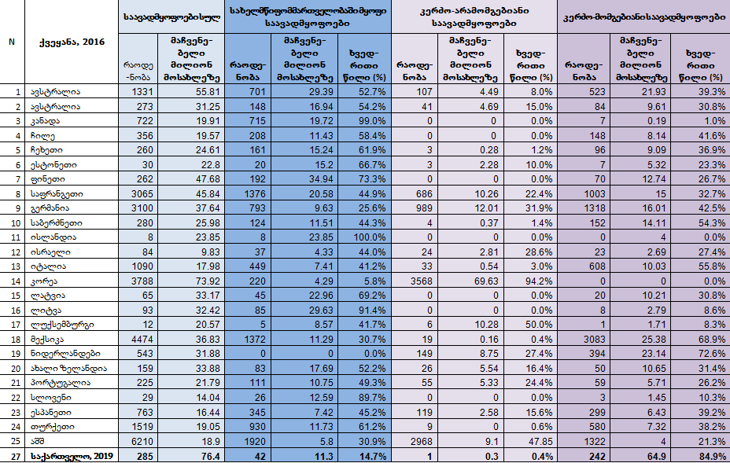
For medical services suppliers (for clinics):
Georgia is the world's first place on the number of the number of clinics
წყარო: https://stats.oecd.org/Index.aspx?DataSetCode=HEALTH_REAC&_ga=2.206671315.1541496006.1547541871-1020484715.1462264911; SRAMA

Slide 4

However, we have an average European rate of number of stationary beds
Qualitatively - 85% of the clinics are private-lucrative institutions
(Similar or even close parity is not in any country)
The amount paid from the state programs of 2/3 of their revenues

Slide 5
For the state:
Increasingly complicated cases occur
(14 million visits with a doctor each year) with complete monitoring and retention costs.
"Expensive spending" is globally characterized by health care because of its nature it is a supply supplier, and in this reality, the above parity significantly strengthens the above parity with the unprecedented dominance of privately-beneficial clinics and the abundance of hospitals.

Slide 6

Taking into consideration these terms, the following status is visible:
A new system of reforms that involves managing programs as well as introduction of new standards for medical service suppliers, will increase escalation costs and soon the system will be in default for 1-2 years.

Slide 7

Reforms to be implemented
Introduction of medical quality control system
Assessment of the need for delivery of hospital services
Develop / implement clinical audit system
Improvement of "Citizens Mobile"
"Electronic Health" will be fully operational
Move to the new system of upgrade (DRG)
Primary healthcare reform
Strategic Reorganization of the Social Service Agency
Selective Contracting *
Increase the population's ambivalent medicines
Restore / Improve Continuous Medical Education System
Creation of "Integrated Institution" of Financial Monitoring of Medical Institutions
* Proper implementation of selective contracts will be impossible without "sampling clinics".

Slide 8
Short SWOT analysis of the current situation
Strengths | Weaknesses
Institute of Great Experience with Regional Offices Experience of state procurement / tenders One-time buyer Complete IT system and databases The motivated executive team | Need to improve the organizational strategy The need for separation of responsibility and roles of the Agency for Social and Social Services The structured structure Does high resistance Need to upgrade -IT equipment
Opportunities | Threats
Improved regulation of the healthcare market Strengthen the quality of primary health care, as a result of preventing unnecessary hospitalizations Optimization of hospital sector Improve awareness / qualification of the employers and medical personnel | Increasing prices on medical services and medicines Easy access to the medical market Resistance to Reforms from Clinics This "resistance" will be particularly intense and the strong political backing of the reform will be needed from the larger "vertical and horizontal integration".

Slide 9

Thanks for your attention

