Slide 1

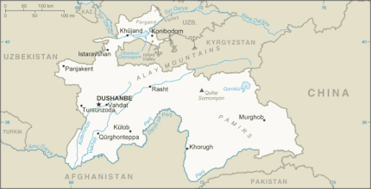
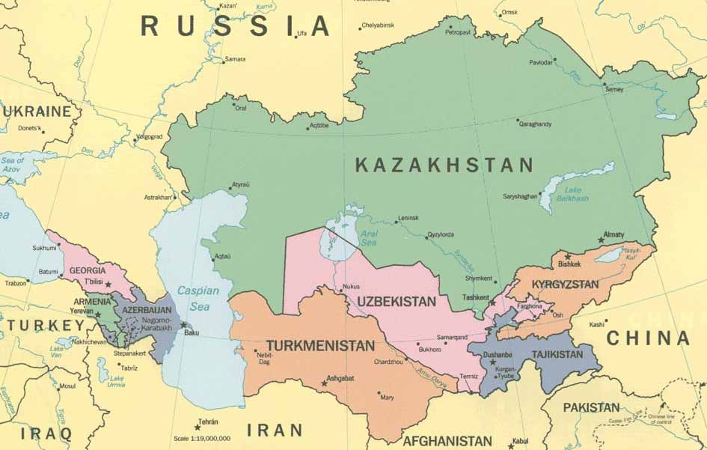

Women’s wellbeing: Emergency as a turning point to gender transformative interventions

Slide 2
Key concerns
Load of unpaid and family care work, increased during the pandemic of coronavirus, and compounded by traditional social norms that assign all care responsibilities to women and girls, leads to economic and other forms of dependence of women on their spouses, and often – to domestic violence
Additionally, imperfect mechanisms of support and lack of formal navigation in transition to family and formal economy negatively impacts on women’s right to fully participate in development processes

Slide 3
Impact of COVID-19 in Kyrgyzstan and Tajikistan
GENDER RAPID ASSESSMENT
UN Women, UNFPA, Swiss Embassy/ May-June 2020

Slide 4
The phycological and emotional wellbeing of women has been severely affected
Tajikistan
54 % indicated psychological, mental and emotional health issues including stress and anxiety during the ongoing pandemic.
A huge gendered differential was noted: women (62%) suffered more, than men (46%) – 16% points higher.

Slide 5
The phycological and emotional wellbeing of women has been severely affected
Kyrgyzstan
21.6% of general population sample responded that psychological/mental health worsened.
In terms of vulnerable groups, this indicator is many times higher among representatives of all groups.
Suspension of public transport caused major difficulties for 32.7% of women.
In vulnerable groups these figures are several times higher: 91.4% of people living with HIV, 72.8% - for survivors of violence, 69.3% of representatives of ethnic minorities.

Slide 6
Employment
Tajikistan
Out of all respondents 48% were employed, 50% - inactive and 2% - unemployed.
Employed: women 35%; men 60%.
Inactive - 64% women and 37% men.
Unemployed – 1% women and 3% men

Slide 7
Livelihood
Women’s main source of their income is salary/ paid job (27%) and remittances (27%).
Women dependent on remittances 27%; Men: 18%,
Women have support from family/ friends 24%; Men: 16%
Women have pension, other social payments 10%; Men: 6%;
A majority of men (44%), mentioned that their main source of income was from farming/ raising animals

Slide 8
Livelihood
75% of women and 63% of men working on contract base moved to a remote work schedule. 34% of men and 19% of women continued to go to work.
47% of business respondents had a strong negative effect on their business, 13% of them had to suspend it completely. Men indicated impact of COVID-19 on business more often rather than women.
Only 6% of men and 8% of women are paid unemployment benefits and/or some financial support from the government and/or local municipalities.
The highest % of the male income reduction is observed in agriculture, private business, paid work.
Women lost significantly cash income received from remittances, and income from family/own business.

Slide 9
Meeting basic expenses
Women of Kyrgyzstan and Tajikistan face difficulty in meeting basic expenses and might forgo seeking health services.
Overall, 85% of women stated that they will face difficulty in meeting basic expenses: food, rent, and utilities if restrictive measures endured, men: 80%.
Another 82% of women will have to exhaust their current savings; Men: 87%.
Alarming: 45% of women will forgo medical checkups and seeking health services due to financial limitations and to prioritize meeting the basic needs of food and shelter.

Slide 10
The proportion of people who did not know where to seek help in case of domestic violence

Slide 11
Unpaid care work - Tajikistan
Tajik women face higher share of unpaid care and domestic work ramps up.
70% of women are responsible for domestic household chores, household management, shopping for family, the care of children including teaching and playing, elderly and sick family members’ care.
During the current pandemic, the intensity of domestic unpaid work has increased.
Men help mostly with activities including household financial management, shopping for the family, and pet care.
Women mainly spent most of their time for cleaning / washing (37%) and cooking/serving meals (23%), while men spent most of their time for household management (23%) and shopping for family (20%).

Slide 12
Unpaid care work - Kyrgyzstan
Women allocated more time for cleaning, cooking and food service, games, talks and reading with children.
Men allocated time mostly to the household garden works and purchases made for their families. 35,6% of women responded that the partners did not help at all (Vs. 15% of men)
The respondents, in particular women (32,7%), faced with difficulties because of suspension of work of the public transport, while men were much less inconvenienced (19,3%).

Slide 13
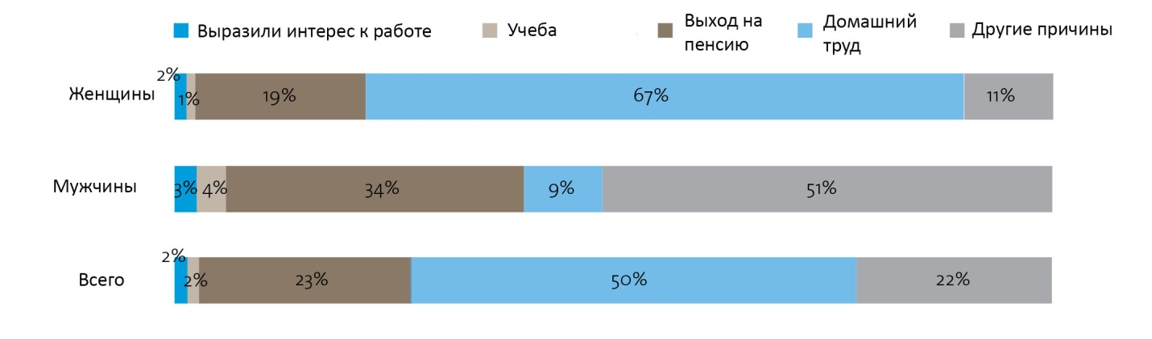
Причины неучастия в составе рабочей силы по полу, 2017 г.
Reasons for non-participation in labour force (by sex) 2017
Study
Pension age
Care duties
Other reasons
Has an interest
Women
Men
Total

Slide 14
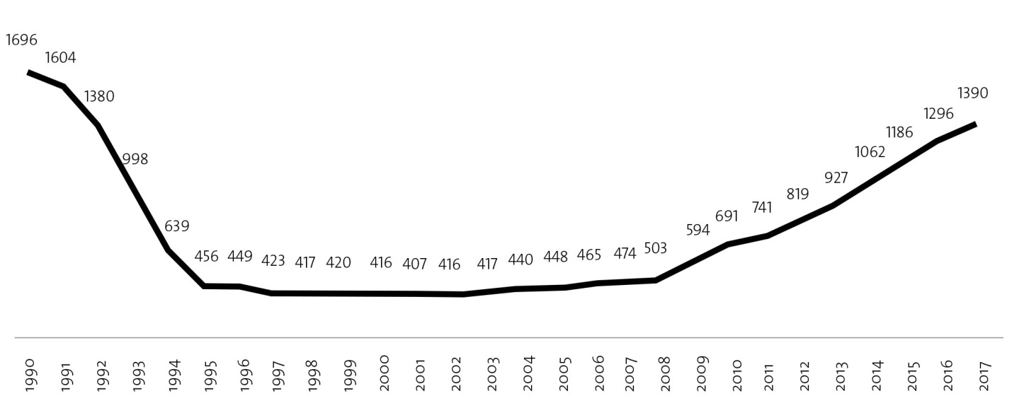
The number of kindergartens in the period 1990-2017 гг.

Slide 15
Employment opportunities
 | SDG Scenario - 50 per cent of children 0–2 years old, and 100 per cent of children of 3 y.o. -to-mandatory school age would be enrolled Employment in care sector – pre-school education |  |  | Construction scenario
 | Women | Men | Total | Women | Men | Total
Employment | 87 186 | 33 306 | 120 493 | 13 425 | 81 312 | 94 738
Share | 72,4 | 27,6 | 100% | 14,2 | 85,8 | 100%

Slide 16
Fiscal Returns, SDG-based versus Construction
 | SDG scenario |  | Construction scenario
 | bln soms | % of costs | bln. soms | % costs
Cost of expansion of preschool education sector | 15 853 | 100 | 15 853 | 100
Direct impact
Social contributions | 2,676 | 16.9 | 150 | 0.95
Employers | 1,694 |  | 95
Employees | 982 |  | 55
Income tax | 982 | 6.2 | 55 | 0.35
Total | 3,658 | 23.1 | 205 | 1.30
Indirect impact
Social contributions | 345 | 2.2 | 707 | 4.46
Employers | 218 |  | 448
Employees | 126 |  | 260
Income tax | 126 | 0.8 | 260 | 1.64
Total | 471 | 3.0 | 967 | 6.10
Total | 4 129 | 26.0 | 1 172 | 7.40

Slide 17
Reaching SDG targets on pre-school education enrollment has an impact on:
the well-being of children that will have a lasting impact over their life cycle in terms of school and work success
decreasing women’s unpaid care work and easing the time constraints on their labour supply
long-run economic returns, in the form of enhanced human capital, higher labour productivity and sustainable growth
potential to boost employment opportunities for many because it is a highly labour intensive sector, high number of jobs generated per unit of spending
potential for self-financing through increased tax revenues
better balanced and informed decision-making regarding the allocation of fiscal resources across sectors.

Slide 18
Patterns of new Vision influenced by COVID
Covid crisis – the frontier at the change of epochs – world will never be the same anymore
Covid crisis is a pushing factor for demanding radical changes – in development paradigms, mindsets, social expectations
For improving current situation and moving towards post-covid recovery there is a need to act differently
It is impossible to act conventionally and expect changes in outcomes

Slide 19
WHY ? The Leadership requires both Technical & Adaptive Solutions in times of Covid
Technical
Adaptive
Algorithm of actions from well known situations/processes
(not suitable for new situations/ uncertainties)
Active learning and learning strategies
Creativity, originality and initiative
Technology design and programming
It does not require consultations and involvement of different groups, even though they may be recipients of services
It needs involvement of a wide range of different groups.
It is impossible to create solutions without participation and diversity of ideas

