Slide 1


Impact of COVID-19 on Education Sector in Central Asia
Presentation by Ms Krista Pikkat, Director,
UNESCO Almaty Cluster Office for Kazakhstan, Kyrgyzstan, Tajikistan and Uzbekistan

Slide 2
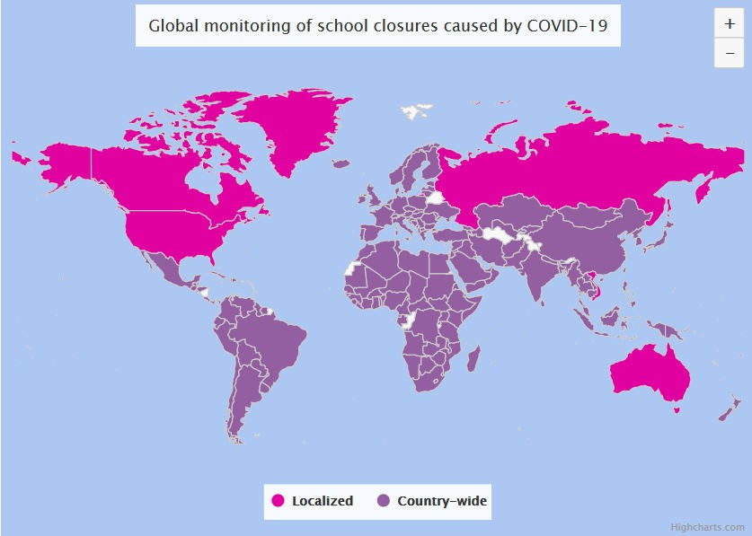


School closures caused by COVID‐19 globally and in Central Asia
> 16 mln. learners affected in Central Asia
≈ 1, 6 billion affected learners
94% of the world’s student population
> 190 country‐ wide closures
Source: https://en.unesco.org/covid19/educationresponse
Impact of COVID-19 on education in Central Asia

Slide 3
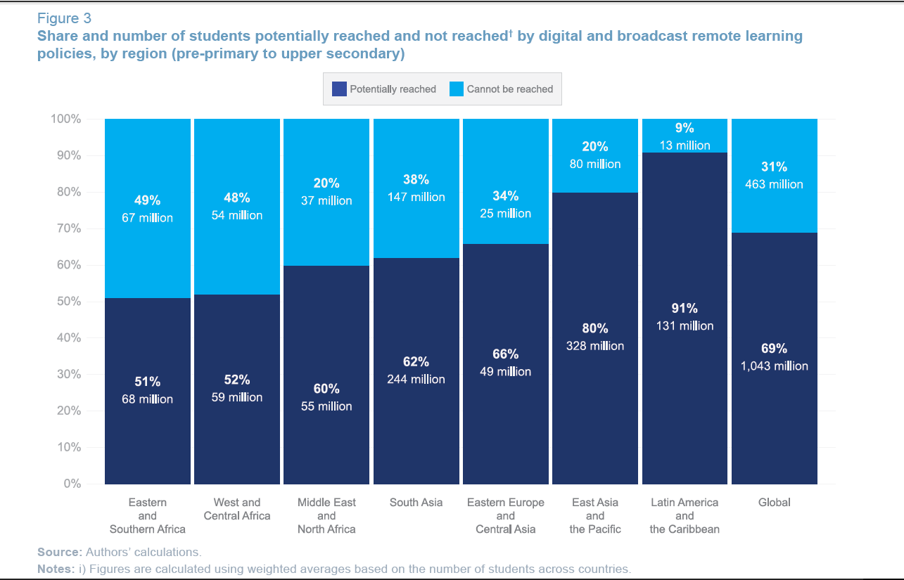
There are still learners that were not reached with digital and broadcast remote learning in Central Asia
3, 800
students
< 10 %
12.5 %
800, 000 students
94 %
2,400,000 students
98 %
1,57 billion affected learners
91.3% of total enrolled learners
191 country‐ wide closures
800, 000 students
Source: UNESCO/UNICEF/WB Survey on National Education Responses to COVID-19 School Closures
Impact of COVID-19 on education in Central Asia

Slide 4
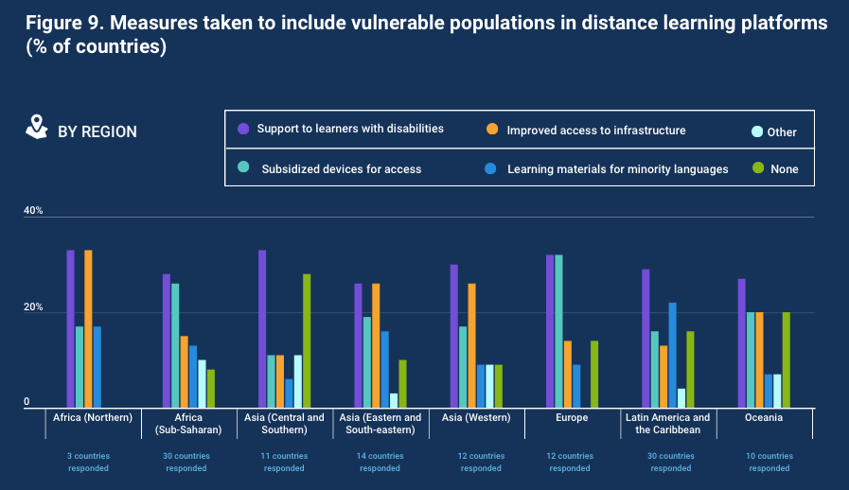
Not all countries have taken measures to ensure distance learning for vulnerable populations
3, 800
students
< 10 %
12.5 %
800, 000 students
94 %
2,400,000 students
98 %
1,57 billion affected learners
91.3% of total enrolled learners
191 country‐ wide closures
800, 000 students
Source: UNESCO/UNICEF/WB Survey on National Education Responses to COVID-19 School Closures
Impact of COVID-19 on education in Central Asia

Slide 5
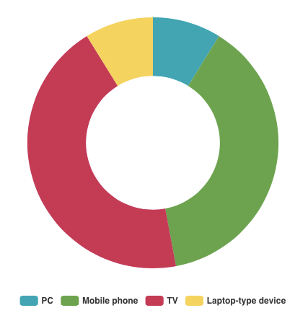
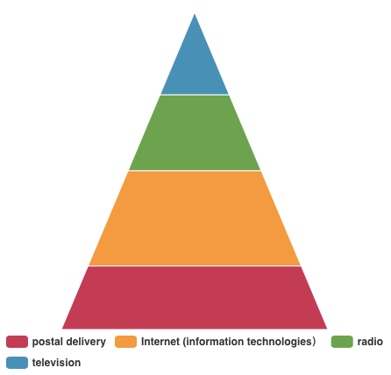
Impact of COVID-19 to education sector Central Asian countries
Kazakhstan, Kyrgyzstan, Tajikistan and Uzbekistan have moved to distance learning by using different digital learnings solutions (online learning, televised learning, etc.)
< 10 %
12.5 %
3, 800
students
Distance learning in Kazakhstan was facilitated
by 4 forms of major mass communication
Households in
Kyrgyzstan with:
800, 000 students
98 %
94 %
800, 000 students
1,57 billion affected learners
91.3% of total enrolled learners
191 country‐ wide closures
2,400,000 students
Source: UN Socioeconomic Response Framework in Kyrgyz Republic
Source: 1st webinar on education sector response to COVID-19 in CA
Impact of COVID-19 on education in Central Asia

Slide 6
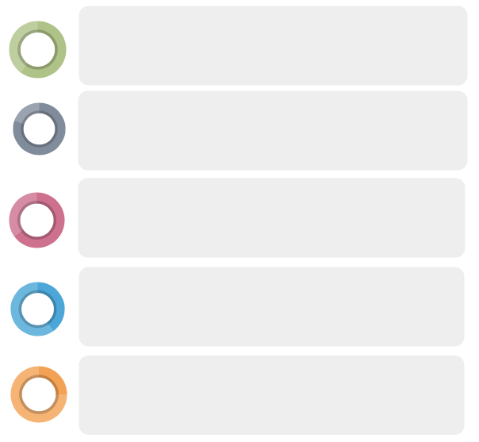

Key challenges in introducing distance learning programmes in the region of Central Asia
Sharp decline in education quality
Some findings from the UN Socio-Economic Impact Assessments:
Skills gaps to use ICT
In Kazakhstan, 70%
of the respondents
believe that education has become at least a quarter less productive
The early closure of schools and the fact that schools were not prepared to provide remote learning affected the quality of education.
Inequalities in access to distance learning
Shortage of quality online learning content
Emotional unrest and anxieties of students and a considerable
burden on home caregivers, particularly women
In Kyrgyzstan, more than half (60%) of young people and adolescents experienced a high level of anxiety.
Access to education has been adversely affected, despite robust efforts by the Government to put in place virtual learning options.
The World Bank estimates that in Central Asia due to the pandemic:
• The average learning levels will fall
• The share of children in early secondary education below the minimum proficiency level will rise
Source: http://pubdocs.worldbank.org/en/798061592482682799/covid-and-education-June17-r6.pdf (P16)
Impact of COVID-19 on education in Central Asia

Slide 7





UNESCO’s first actions to respond to COVID‐19 crisis
Set up of community of practice – with focal points from Ministries of
Education and launch of a series of webinars for this group
Provided a curated list of distance learning management solutions and
issue notes
Organization of policy dialogue among Ministers and creation of smaller
ad-hoc ministerial group with 12 Ministers from all regions of the world
Working to support countries, backed by a dedicated task force
Creation of dedicated website COVID‐19 Educational Disruption and
Response and the COVID‐19 Global Education Coalition
Impact of COVID-19 on education in Central Asia

Slide 8

Global Education Coalition
Context
Concerned with the negative impact of school closures on disadvantaged and marginalized children and youth, UNESCO called for the creation of an open Global Education Coalition, with due focus on equity and inclusion, launched on 25 March
Mission
The Coalition works with governments and provides capacity development to Ministries of Education to run distance learning solutions in response to the crisis.
It mobilizes a wide array of public and private partners and leverages resources, knowledge and innovations to deploy and defend universal access and equitable solutions.
Gender
Teachers on the frontlines
Connectivity
Impact of COVID-19 on education in Central Asia

Slide 9

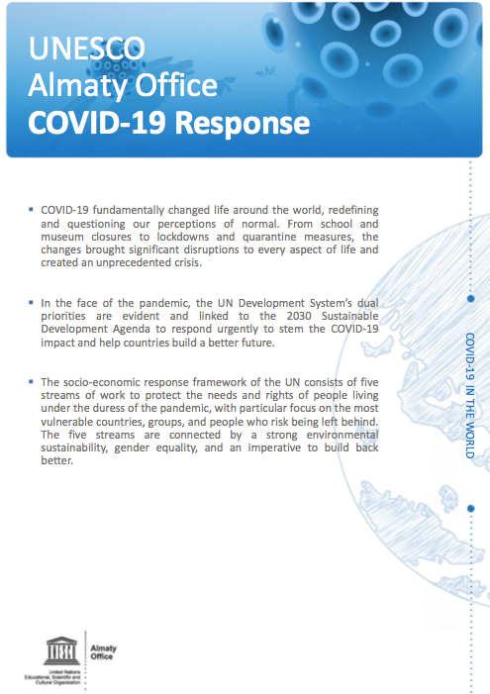
UNESCO Almaty COVID-19 Response in Education Sector
UNESCO’s support focuses on ensuring learning continuity and building resilient education systems for the future through:
Policy dialogue on approaches and
advocacy
Capacity-building for ministries and
teachers
Development of relevant content
Source: https://unesdoc.unesco.org/ark:/48223/pf0000374068
Impact of COVID-19 on education in Central Asia

Slide 10
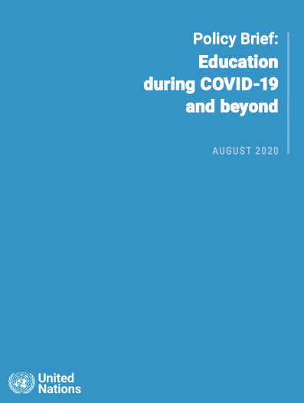

Education during COVID-19 and beyond: Policy Recommendations
UN Secretary-General's policy brief calls for action from all in the following areas:
Suppress transmission of the virus
and plan thoroughly for school re-opening
Protect education financing and
coordinate for impact
Build resilient education systems for equitable and sustainable development
Reimagine education and accelerate change in teaching and learning
Source: Policy Brief: Education during COVID-19 and beyond
Impact of COVID-19 on education in Central Asia

Slide 11


Thank you!
Website: http://en.unesco.kz/
Facebook: UNESCO Almaty
Instagram: @unescoalmaty

