Slide 1
CVD ASSIST Tool
Data Collection Training Module

Slide 2
Work through each slide on your own or in a group.

Slide 3
Structure of the training
Data collection guide
Data Collection Form
Data collection form
Practice examples
Know the guide exists
Know the content of the guide
Know how to access the form
Know how to use the form
Know about the offline and paper versions
Test the online form
Find any mistakes that need to be fixed before collecting the data
Ask for clarification
Suggest additions to the guidebook

Slide 4
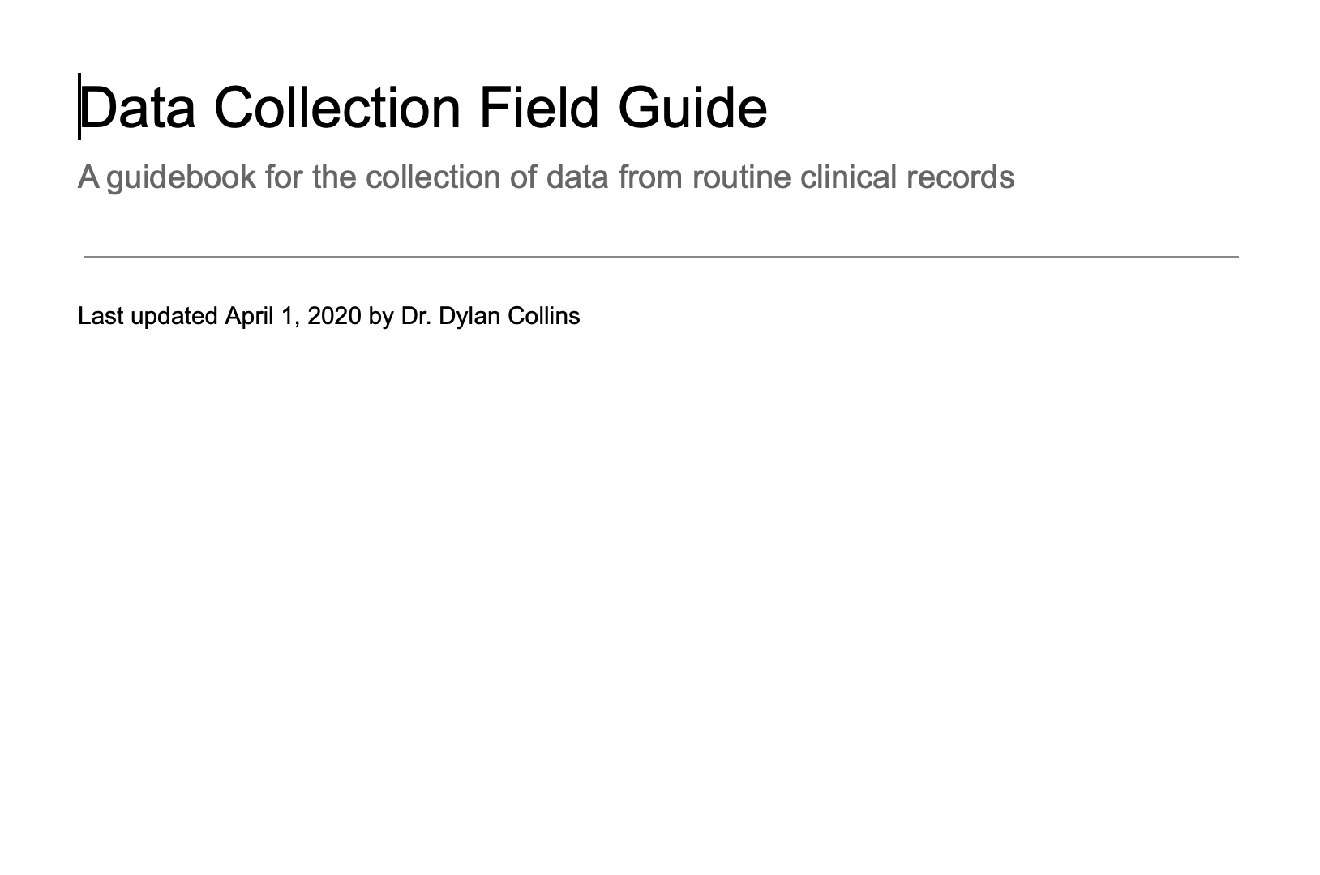
Read the data collection field guide

Slide 5
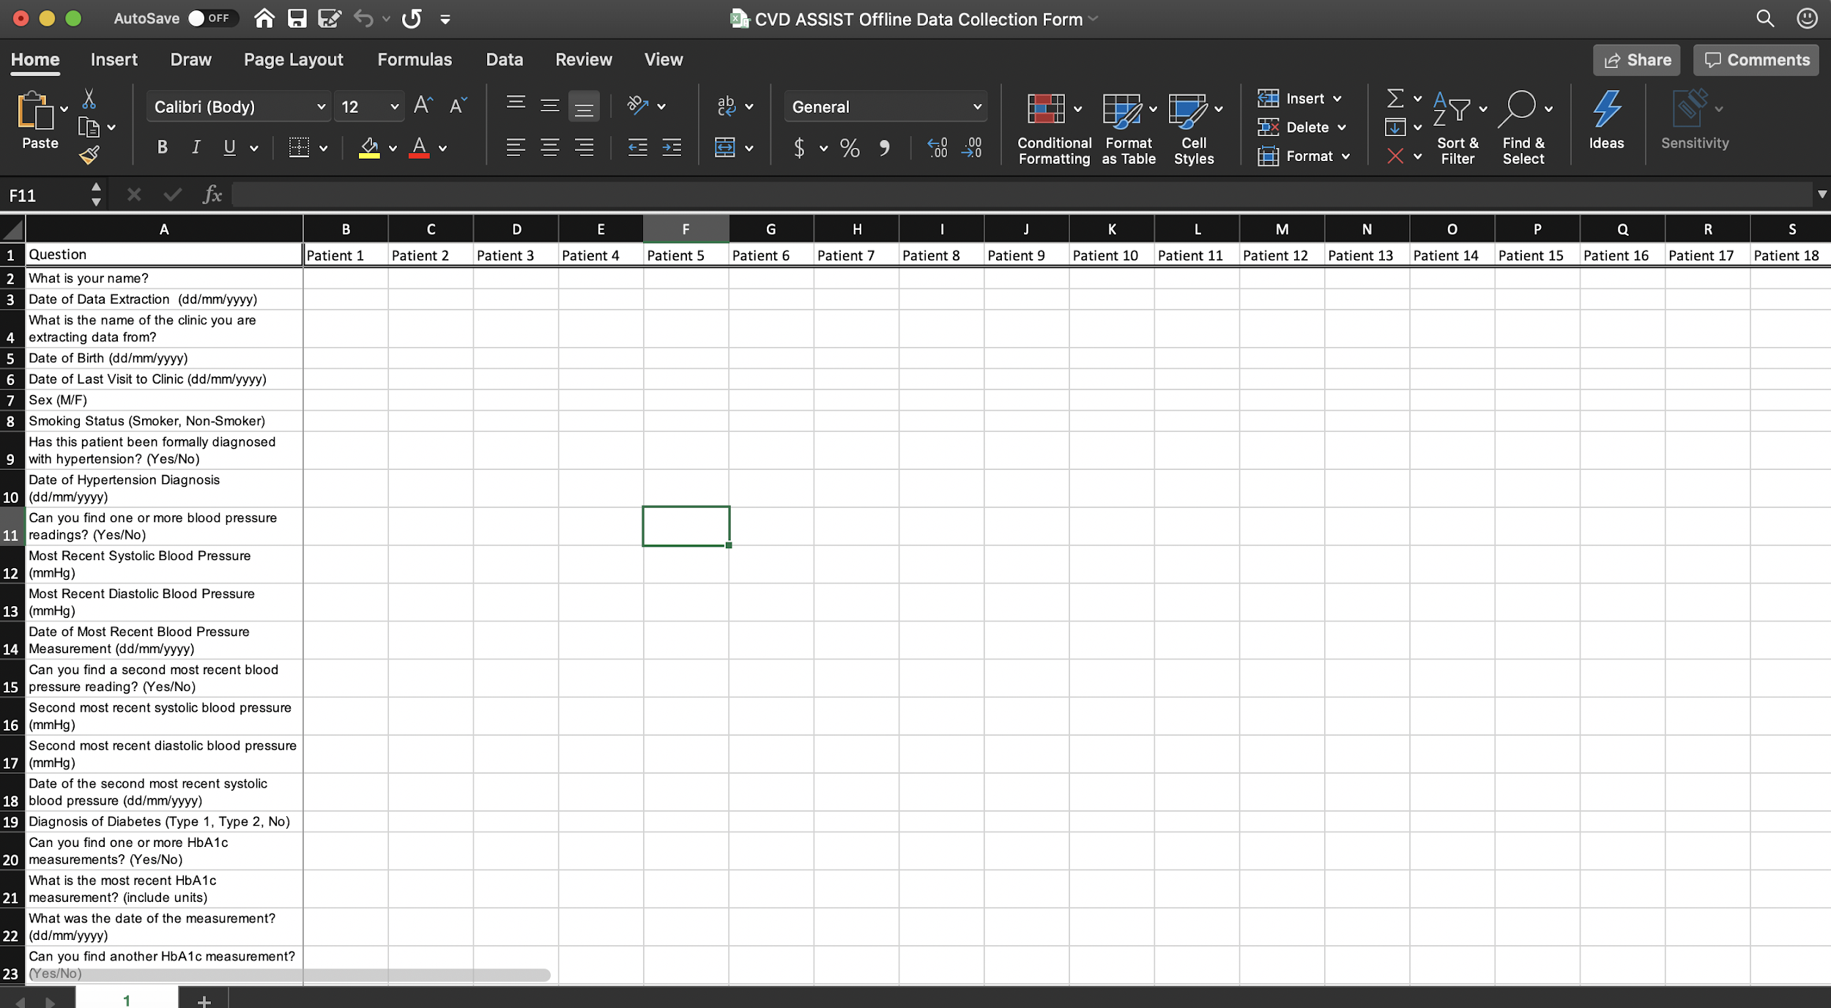
Become familiar with the computer form

Slide 6
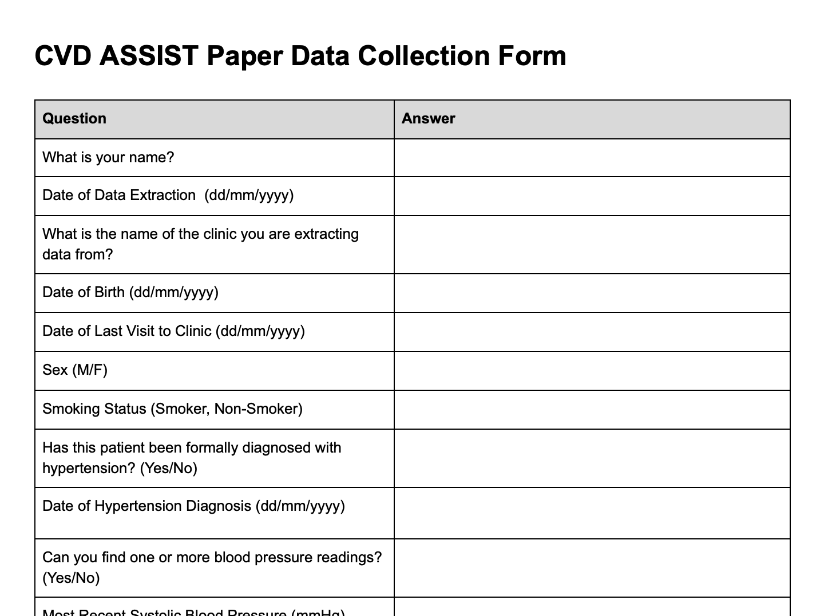
Become familiar with the paper form

Slide 7
Let’s practice.

Slide 8
Use the computer or paper data extraction form.

Slide 9
There are three examples. Use the information provided and practice filling out the data extraction form.

Slide 10
Example one
Clinic: Clinic A
Last visit: 12 December 2019
Date of birth: 1 January 1963
Sex: Male
Diagnoses: hypertension (20 January 2006), stroke
Blood pressure: 140/93 mmHg (23 January 2016)
Cholesterol: 8 mmol/L, 4 mmol/L
Prescriptions: ramipril, aspirin

Slide 11
Example two
Clinic: Clinic D
Date of birth: 19 July 1974
Sex: Female
Diagnoses: Diabetes (20 January 2013)
Blood pressure: 131/87 mmHg (22 July 2016)
HbA_{1c}: 75 mmol/mol (5 May 2017)
Cholesterol: 154 mg/dL (1 March 2016)
Prescriptions: metformin
Notes: smoker, WHO/ISH score = 20% (1 May 2017)

Slide 12
Example three
Clinic: Clinic X
Date of birth: 29 May 1958
Sex: Male
Diagnoses: Diabetes (type 1) (1 January 1964)
Blood pressure: 129/87 mmHg (22 July 2003), 135/97 (17 February 2017)
HbA_{1c}: 62 mmol/mol (17 February 2017), 80 mmol/mol (1 March 2016)
Prescriptions: atorvastatin 10 mg (1 January 2014)
Notes: WHO/ISH score = 30% (1 January 2014)

Slide 13
Example process summary

Slide 14
Check the inclusion criteria and sample until the sample size is reached. Remember, you can select an additional doctor if you need more records!
Keep notes about the clinic, the data extraction etc. and send send any important information to your project coordinator.
Randomly select a doctor whose files you will to extract data from. If there is only one doctor, you can skip this step.
Select doctor
Select files
Inclusion criteria
Extract data
Send notes
Using a patient register, use the Google random number generator to select patient files. If there are fewer than the sample size, include everyone.
Extract the data from the patient files using a data collection form.

Slide 15
The end.

