Slide 1
Improving access and financial protection: spotlight on medicines Lessons from international experience: Estonia
Triin Habicht
Ministry of Social Affairs
Estonia

Slide 2
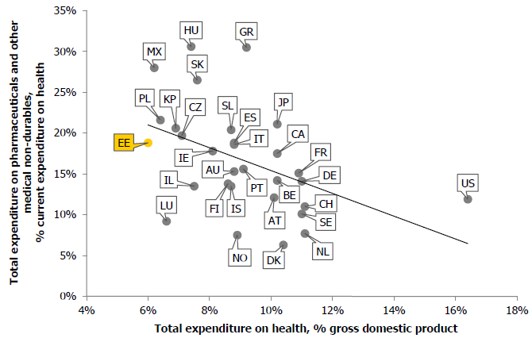
Pharmaceutical expenditure as % of total health expenditure against total health expenditure as % of GDP (2013)
Source: Ferrario, Alessandra, Reinap, Marge, Pedersen, Hanne Bak and Kanavos, Panos (2016) Availability of medicines in Estonia: an analysis of existing barriers and options to address them. World Health Organization, Denmark.

Slide 3
Reimbursement system
EHIF reimbursed pharmaceuticals
Prescription drugs or as part of health services (e.g. chemotherapy)
Different discount rates apply to different diseases and pharmaceuticals
EHIF compensates directly to hospitals and pharmacies
Some medicines are procured and reimbursed without copayment by Ministry (e.g. ARV, TB, vaccines) or Health Board (e.g. Preparedness reserve) or National Institute for Health Development (e.g. dependency treatment)

Slide 4
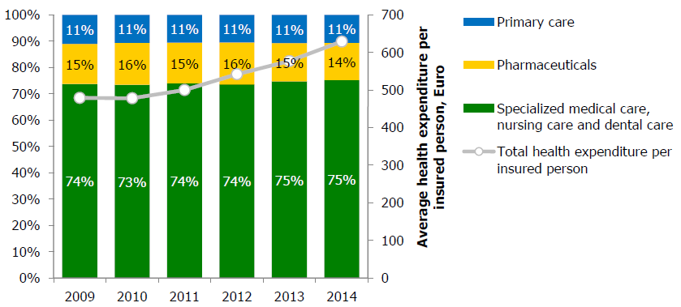
Total health expenditure per insured person and distribution of health spending
Source: EHIF

Slide 5
Number of prescriptions and average cost for EHIF (in Euro)
Source: EHIF

Slide 6
Outpatient prescription medicines: reimbursement rules (1)
Only medicines included to the EHIF’s list of medicines are reimbursed
Reimbursement is according to the reference price or price agreement in case they exist (otherwise retail price)
Reimbursement on the basis of the diagnosis and patient characteristics

Slide 7
Positive list
Reimbursement levels 50%, 90%, 75% and 100%
Complementary reimbursement
If annual individual expenditures for medicines exceeds 300 EUR, EHIF covers additionally 50-90% from the exceeding sum
Individual reimbursement
For individual cases and if medicine is not authorised in Estonia or medicine is in positive list but not affordable in stated terms
75% -> 90% if patient is pensioner, child<18 y or disabled
All medicines are reimbursed by 100% for children<4 y
Minimumco-paymentis 1,27 EUR (75%, 90%, 100%) or 3,19 EUR (50%) perprescription
Positive list is updated quarterly
Has to be applied by patient
Has to be applied by patient
Reimbursement level and period is determined by EHIF

Slide 8
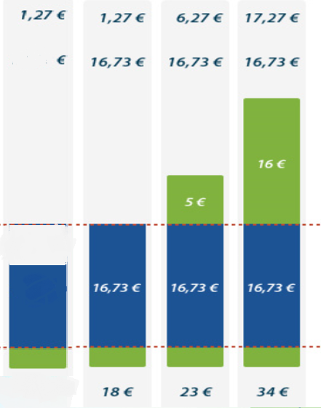
Example: medicine with 100% reimbursement
Patient pays in total
EHIF benefit
8,73 €
Reference price 18 € (Second from to the cheapest)
8,73 €
Obligatory self-financing
for patsients – 1,27 €
1,27 €
1,27 €
1,27 €
1,27 €
Price of drug package in pharmacy
10 €
10 €
Generic1
Generic2
Generic3
Original

Slide 9
Medicines pricing
Applied only in case of medicines in the positive list
Price agreements with the manufacturers
external referencing with EU countries, primarily Latvia, Lithuania, Slovakia
internal referencing case by case (medically proper alternatives)
negotiations in case of patented medicines
simpler requirements for generics, biosimilar and parallel-exported medicines (example, first generic has to beat least-30% from original medicine price)
Reference prices
all packages containing the same active substance and route of administration are grouped, cost per unit of the second cheapest is taken as a reference

Slide 10
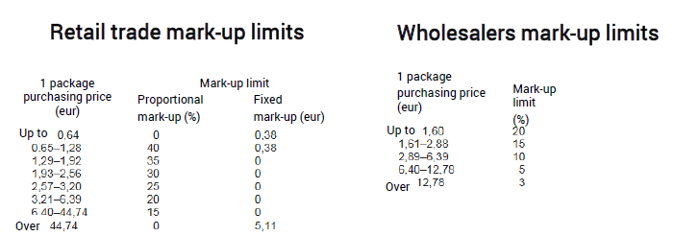
Wholesalers and pharmacies level price control
Threshold values for mark-ups in wholesale and retail trade of medicines and the procedure for their implementation are regulated to all medicines, except veterinary medicinal products

Slide 11
Electronic prescription
Implemented since 2010
Share of digital prescriptions: 66% in 2010, 99% in 2015
Doctor or nurse prescribes medication using their computer software
E-prescription is forwarded to the national database and is immediately accessible in every pharmacy on a patient’s request
Patient can follow the log-file for every prescription
Patient has access to the online report on avoidable OOP afterwards

Slide 12
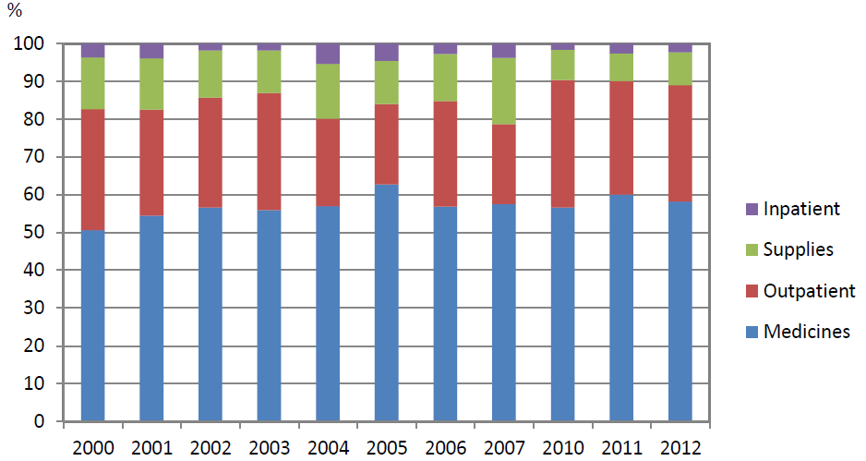
Structure of out of pocket payments
Source: Võrk et al. „Out-of-pocket payments and health care utilization in Estonia, 2000–2012“. World Health Organization (2014)

Slide 13
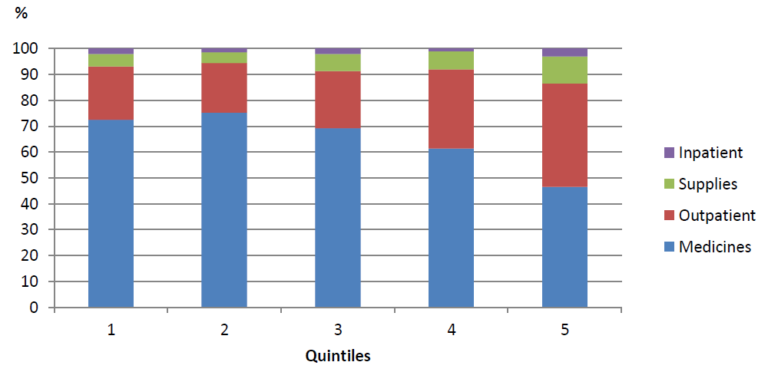
Structure of out of pocket payments by quintile, averages for 2010-2012
Source: Võrk et al. „Out-of-pocket payments and health care utilization in Estonia, 2000–2012“. World Health Organization (2014)

Slide 14
Measures to reduce avoidable OOP payments on medicines: regulatory framework
Required active ingredient based prescriptions (since 2005)
Required offering (has to be available and offered to the patient) of cheapest medication in pharmacies (since 2010)
Systematic supervision of pharmacies (State Agency of Medicines) and providers (Health Board)
Regular feedback to providers on their performance
INN-based prescribing indicator included to the family doctors quality bonus system

Slide 15
Awareness of population
Awareness campaign since 2010
Initial slogan: “The only difference is in medicine’s price”
Current slogan: „Acts! – same quality, better price“
Objective: to empower patients to make more price aware choices in the pharmacy and to ask for an INN-based prescription if not offered already
Target group: population over 40 years of age

Slide 16
Patient OOP paymet per prescription (in euros)
Source: EHIF

Slide 17
Avoidable OOP payment in 2015
Source: EHIF
Notes:
Keskmise soodusretsepti maksumus patsiendile oli 2016. aasta I kvartalis 6,66 eurot ja see moodustas 29% retsepti kogumaksumusest.

Slide 18
TOP 10 OOP payment medicines with reimbursement rate 75/90% (2016 1st Q)
ATC code | Name | OOP in total (in Euros) | Avoidable OOP (in Euros) | OOP per prescription | Share of avoidable OOP %
C07AB02 | metoprolool | 3 022 960 | 2 187 272 | 6,5 | 72,4
C07AB12 | nebivolool | 841 759 | 552 329 | 6,9 | 65,6
C09AA05 | ramipriil | 711 343 | 385 253 | 4 | 54,2
C09BA04 | perindopriil+indapamiid | 671 692 | 402 256 | 7,3 | 59,9
C09DA07 | telmisartaan+hüdroklorotiasiid | 650 772 | 431 932 | 7,7 | 66,4
C09CA07 | telmisartaan | 641 811 | 377 953 | 5,7 | 58,9
C08CA01 | amlodipiin | 630 263 | 369 299 | 3,9 | 58,6
A10BA02 | metformiin | 624 202 | 250 545 | 3,5 | 40,1
C10AA07 | rosuvastatiin | 464 512 | 203 272 | 4,1 | 43,8
R03AK06 | salmeterool+flutikasoon | 436 014 | 103 154 | 11,4 | 23,7
Source: EHIF

Slide 19
Summing up
Pricing, reimbursement rules and clear principles how to add new medicines to the positive list enable to control public expenditures
Analysing the OOP payments raised awareness that there is high OOP payment burden on pharmaceuticals that could be avoided
Multiple measures (eg regulatory, IT, campaign) have lead to the decline of avoidable OOP over time
Still, more can be done to ensure effective coverage with medicines

