Slide 1
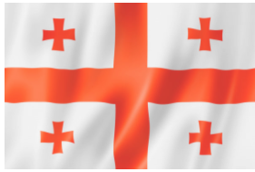


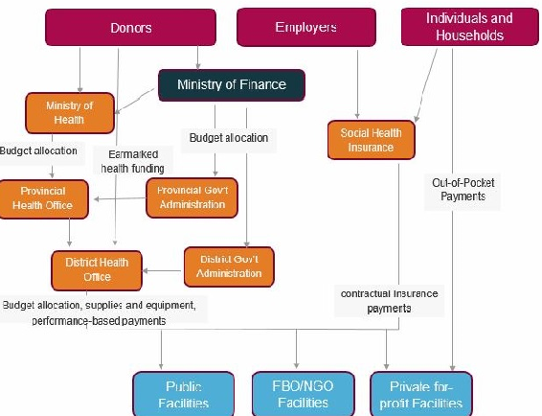
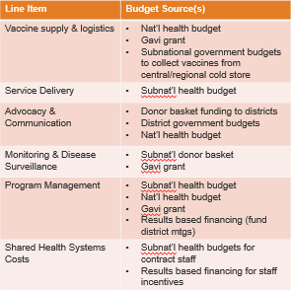
GEORGIA
LNCT Network-Wide Meeting
Tangerang, Indonesia, July 2019
(Exampledonia’s Flag)
I. Economic Context
II. MOH Budget Execution
Ask me how:
Immunization has been made one of the highest Public Health priorities for the Government of Georgia, the clear confirmation of which is that funding of the program significantly increased from 4 mln GEL in 2012 to 22.4 mln in 2019.
I want to know:
How other countries implement results-based financing in immunization programs. How does it work? What impact has this had on program progress?
V. Funding Flows for Immunization
 | MOH Budget (GEL ml) | Subnat’l Gov’t Health Budgets (GEl ml)
Total budget (2018) | 1013.8 | 77.9
Total spent | 1012.2 | 76.4
Total released | 1.5 | 1.5
Execution as percent of budget | 99.84% | 98.01%
III. Sources of Health Expenditure
Year of data: 2017
CHE per capita: US$308
Domestic General Government Health Expenditure as % of General Government Expenditure: 10%
% of Domestic General Government Health Expenditure spent on immunization: 2.9%
VI. Budget Allocation Process
Funds | Responsible Authority/ies | Allocation Guidance and Process | Key Bottlenecks
MOH budget | National MOH | State Budget drafting and submission process is coordinated and responsibility assumed by the MOF. The draft annual budget preparation process begins with working on a Basic Data and Direction Document (BDD). MOH submit their budget proposals to the MOF via an e-budget management system. Government Draft State Budget to the Parliament and Draft State Budget is voted by the Parliament.
Donor support to national level | External donors | Allocated for specific activities based on donor priorities and government input
District government budget | Executive Body of the Local Authority for the Local Budget; | Financial Unit of the Local Authority coordinates the drafting and submission of Draft Budgets of the Local Authority. Representative Body of the Local Authority publicly discusses the Draft Budget and takes decision on the adoption of the Draft Budget for the Local Authority prior to the start of the new fiscal year.
IV. Routine Immunization Budget
Total Expenditure (from all sources) on routine immunization: $10.2 million
RI Budget per Surviving Infant: $199.2
% of RI costs financed by gov’t: 97%
VIII. Challenges
VII. Identification of Gaps
1. Small volumes of purchases
2. Small number of registered vaccines in the country
3. Deficiency of some vaccines in the world market; (Imbalance between supply and demand of some vaccines on the world market)
4. GAVI support in negotiations with vaccine manufacturers to maintain GAVI prices after the graduation period.
Line item | Budget 2020 (M GEL) | Funding Gap (M GEL) | Potential Budget Sources
Vaccines & injection supplies | 25412 | 0 | Nat’l budget (immunization program)
Personnel | 500 | 0 | Nat’l budget (admin. Cost)
Transport | 100 | 0 | Nat’l budget (admin. Cost)
Activities & other recurrent costs | 50 | 0 | Nat’l budget (admin. Cost)
Logistics | 500 | 200 | Nat’l budget (admin. Cost)
Total | 26562 | 200

Slide 2



IV. Routine Immunization Budget – Line Items and Sources
Please edit the table to reflect your country’s line items and budget sources.
This table is illustrative, but please consider all sources of budgets for various immunization line items (see illustrative sources in the table below).
To add lines to the table, right click on a row and from the horizontal tool bar that appears, select “insert” and then “rows below”.
Line Item | Budget Source(s)
National immunization program (NIP) vaccine supply cold chain system service delivery (part) | Nat’l health budget Gavi grant
Universal Health Care program service Delivery (part) | Nat’l health budget
Service delivery (part) | Subnat’l health budget (RBF)
Epidsurveillance program Monitoring and surveillance (routine) | Nat’l health budget Subnat’l health budget
Administrative expenses Logistic (vaccine transportation, delivery, storage, etc.) Personnel salary, perdiem etc. utilities | Nat’l health budget Subnat’l health budget donor grants
NIP monitoring | Nat’l health budget Gavi grant
Advocacy & Communication | Nat’l health budget donor grants
Why are you asking me this?
We want to think in more detail about the various components of a routine immunization budget that go beyond vaccines and consider where resources for these activities may be found.
Where can I find this data? We suggest you consider the line items in your cMYP..
  My line items don’t match the ones listed in the template! That’s okay. These line items are just an example. Please feel free to change the line items to match your budget.

Slide 3
V. Funding Flows for Immunization - Illustrative Diagram
Government of Georgia
Ministry of Finance
Employers
Individuals and Households
Budget allocation
Ministry of Health
Earmarked health funding
private Health Insurance
Provincial Health Office
Provincial Gov’t Administration
Out-of-Pocket Payments
Earmarked health funding
District Gov’t Administration
District Health Office
contractual insurance payments
Public Facilities
FBO/NGO Facilities
Private for-profit Facilities

