Slide 1
health system and health policy developments in Georgia, including current state of UHC
Ministry of Labour, Health and Social Affairs
February, 2019

Slide 2

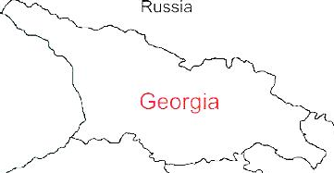



Demographic and Socio-Economic Situation, 2017
Population – 3 728 300
Birth rate (per thousand population) – 14.3
Mortality rate (per thousand population) – 12.8
Life expectancy at birth – 73.5
Maternal Mortality (per 100000 live birth) – 13.1
Infant mortality (per 1000 live birth) – 9.6
Under 5 mortality rate (per 1000 live birth) – 11.1
GDP per capita (at current prices) – 4067 $US
GDP real growth – 5.0%
Government expenditure on health per capita – 104 $US
Government expenditure on health as % of GDP – 2.8%
Government expenditure on health as % of State Budget – 8%
Government expenditure on health as % of GDP – 3.1%
General Government expenditure on health per capita (USD) – 117
Notes:
The population of Georgia has declined during the last 25 years, largely due to the outmigration and according to the census conducted in 2014, it is 3,7 mln.
Georgia has made a good progress in improving health outcomes. Life expectancy has increased by about 5 years over the few decades and currently is at 73.5 years.
Significantly has declined under-five mortality and infant mortality
In 2015 Georgia met MDGs 4th Goal: decrease under-5 mortality rate

Slide 3
Non-communicable diseases are the primary driver of overall disease burden
Cause of Burden of Disease (DALYs)
Injuries
Communicable
diseases
1990
2005
Non-communicable
diseases
2015
Notes:
If we look at the diseases burden, non-communicable diseases are the primary driver of overall diseases burden and it has been for a long time. The major causes of death in Georgia are related to non-communicable diseases, including cardiovascular diseases, cancer, diabetes and respiratory diseases, which together with injures make 94% of deaths.
The large share of premature deaths from NCDs are influenced by the health-related behaviors and risk-factors. STEPs survey results, population-based survey, which was conducted in Georgia second time to evaluate the trends in health related behaviors and risk-factors showed low physical activity, unhealthy diets, smoking and heavy alcohol consumption among the population.
An important breakthrough in this direction is an adoption of tobacco control law in May 2017, the law that is fully aligned with the WHO Framework Convention on Tobacco Control and is one of the strongest tobacco control laws in the European region. Large –scale antitobacco campaign and health promotion national programme with a strong tobacco control component will be implemented to strengthen tobacco control measures.
The primary concern of Georgia’s health system’s is the alleviation of the burden of NCDs and strengthening NCD control activities, including better management of chronic diseases at the primary health care level, improving health promotion and preventive measures is a priority.

Slide 4
Universal Health Care – Socially Oriented Political Platform
Reforms have moved Georgia closer to universal health coverage
Unprecedented Expansion of State Budget for Health care
365 mill GEL in 2012 → 1112 Mill Gel in 2017
Launch of Universal Health Care Program in February 2013
Better access to care
Better user experience
Better financial protection
Notes:
The main goal of the elected government in 2012 and re-elected in 2016, is the poverty reduction and socially oriented political platform. The strong political will pledged in the election platform was translated into an unprecedented, in 2013 almost 2-fold expansion of budgetary allocation for health.
The second major step towards securing enjoyment of health rights in the country was the launch of a Universal Health Care Program in February 2013. Georgia now has a foundation of universal entitlements within its health system, representing a major step towards improving access to health services for the entire population.
Although the health impact of the UHC program remained to be seen and will be apparent in the medium to long-term, very important achievements and results are already visible, specifically with respect to the financing scheme and greater equity in the health system.
The survey carried out by the World Bank, the World Health Organization and the US Agency for International Development showed the main achievements of the Universal Healthcare Program: increased access to medical services, increased utilization of medical services, reduced financial barriers and enhanced coverage
Under the UHC program, patients have almost unlimited choice of provider. In terms of the package of benefits, benefits have been gradually increasing.
From May 2017, the highest earners are excluded from the UHC programme and expected to purchase health insurance. This reduction in coverage is counterbalanced by an expansion in the benefits package for those living below the poverty line to cover the essential outpatient pharmaceuticals for four chronic conditions.

Slide 5
Health sector expenditures
Out-of-Pocket Payment as % of Total Health Expenditure, Georgia
Public Health Expenditure, Georgia
Source: Georgia NHA 2010-2016 (MoLHSA, 2017)
Notes:
The UHC program was accompanied with a substantial increase in the governments budget allocations. From 2012 to 2016, the health budget more than doubled, as a percentage of GDP it increased from 1.7 percent to 3% in 2016, but it’s still lower in comparison with Euro average.
The share of the out-of-pocket payments in total health expenditures has significantly decreased from 73% (in 2012) to 57% (in 2016), mainly due to the lower cost of hospitalization, which is a direct consequence of the universal healthcare program.

Slide 6
Coverage of Healthcare services
Services utilization
Hospitalization per 100 population
UHC Program has led to a major expansion in population entitlement to publicly financed health services (HUES)
Ambulatory care visits per person per years
Notes:
The coverage of population improved as demonstrated by the series of health care utilization and expenditures surveys. Over half of the population were covered first time. We have seen a surge in utilization of the health care services. In Georgia, during last 2 decades, this indicator did not exceed 2.2. In the frame of the UHC programme the numbers of out- and in-patient encounters continued to grow due to increased accessibility of healthcare services. In 2017, the number of contacts with out-patient facilities per capita reached 3.6.

Slide 7
Expanding benefits
I Phase - 28 February 2013 (minimum package)
- Planned ambulatory care
- Urgent outpatient and inpatient care
II Phase - July 1, 2013 (basic package)
- Planned ambulatory care
- Urgent outpatient services
- Urgent inpatient and critical are
- Elective surgical care
- Chemo-, hormone- and radiotherapy
- Maternity services
- Basic drugs for target groups
III Phase - May 1, 2017 - Service stratification according to revenue groups using “social justice approach”
- Outpatient drugs benefit for chronic conditions
Notes:
Under the UHC program, patients have almost unlimited choice of provider. In terms of the package of benefits, on these slide you are possible to see that, benefits have been gradually increasing.
From May 2017, have been started Service stratification according to revenue groups using “social justice approach”
the highest earners are excluded from the UHC programme and expected to purchase health insurance, although for vulnerable groups the packages remained the same. This reduction in coverage is counterbalanced by an expansion in the benefits package to cover the essential outpatient pharmaceuticals for four chronic conditions, at these stage for those living below the poverty line.

Slide 8
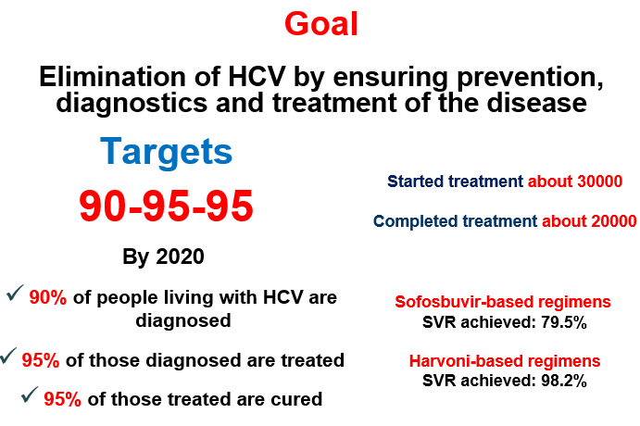
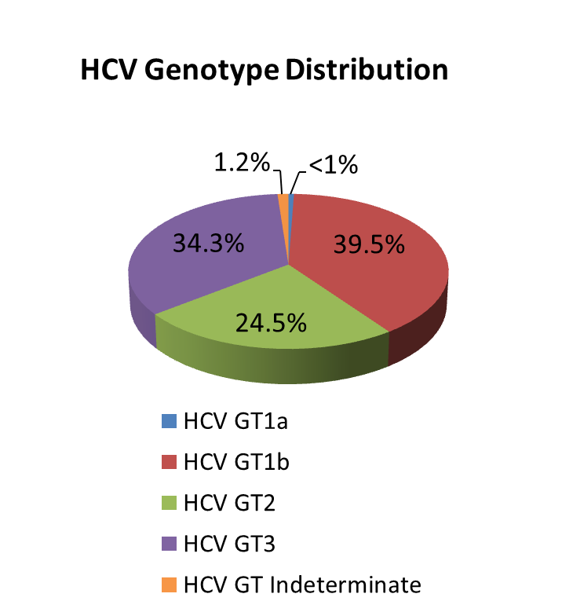
National Hepatitis C Elimination Strategy
Nationalwide survey, 2015
Anti-HCV+ | 7.7%
HCV RNA+ | 5.4%
Screened - 2 373 372
Started Treatment – 51 879
Completed treatment – 47 950
Harvoni-based regimens
SVR achieved: 98%
Notes:
Based on available data, Georgia is among the countries with high hepatitis C (HCV) Prevalence. 2015 National survey conducted by NCDC and CDC revealed that ~150 thousand people are infected with active HCV infection and need to be treated. The survey estimated that 7.7% of population are anti-HCV positive and 5.4% are HCV RNA positive.
In 2015, Hepatitis C elimination program - This flagship public-private partnership has been launched, with greatest efforts of the Government of Georgia, the US Center for Disease Control and the World Health Organization and with support of the pharmaceutical company "Gilead". Starting with 4 sites in 2015, currently 32 service centers in different cities, including 1 center in penitentiary system, are providing diagnostic and treatment services to the elimination program beneficiaries. Since the launch of the program in 2015 through January, 2018, 42597 patients started and 38506 patients completed the treatment. Cure rate reached 98.2%.
Georgia became on of the model country globally, we have a very ambitious goal to eliminate hep.C and hope to reach this goal by 2020.

Slide 9



State program providing drugs for chronic conditions
2017
Chronic Cardiovascular Diseases
Chronic Obstructive Pulmonary Disease
Diabetes (type 2)
Thyroid conditions
2018
Parkinson
Epilepsy
Socially Vulnerable Families (<100 000 rating score) – less than 1 GEL
Pensions and Disabled persons
50%-80%-Discount
Notes:
From July 1, 2017, persons suffering from chronic conditions, who are registered in the unified database of "socially vulnerable families" with the rating score not exceeding 100,000, are eligible for the state program providing drugs for chronic conditions. The program provides patients with selected drugs for chronic cardiovascular diseases, chronic obstructive pulmonary disease, diabetes (type 2) and thyroid conditions. From September 2018, program was expanded and covers not only social vulnerable groups, also pensions and disabled persons.
From December 2018 it is covered Drugs for Parkinson and Epilepsy

Slide 10
Priority directions for the development of the healthcare sect, 2014
Health in all policies – general state multi-sectoral approach.
Development of the healthcare sector governance.
Improvement of healthcare financing system .
Development of quality medical services.
Development of human resources in the healthcare sector.
Development of health management information systems.
Support of maternal and child health.
Improvement of prevention and management of priority communicable diseases.
Improvement of prevention and control of priority non-communicable diseases.
Development of public health system
Notes:
Taking into account principles declared at international level, epidemiological image and social/economic reality of the country, the Ministry develops following 10 priority directions for the development of the healthcare sector:
On these stage The Ministry works on the Health System Development Strategy.

Slide 11
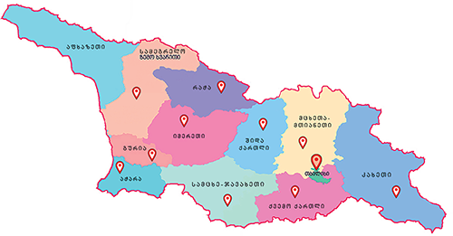
Maternal and Child Health
Georgia Maternal & Newborn and Reproductive Health Strategy 2017-2030 and Action Plan 2017-2019
Perinatal Care Regionalization - “gold” model of maternal and new born service organization
Congenital syphilis and mother-to-child transmission (MTCT) of HIV elimination plan
Universal newborn hearing screening program
Essential Nutrition Action Plan - folic acid and iron supplements for all pregnant women, breastfeeding promotion, multiple micronutrient supplementation for 6-23 months children
Under UHC program selective contracting for childbirth & C-section and neonatal intensive care services
Notes:
Regionalization of maternal and newborn health services – right patient, in right place, at right time equal access to high-quality of care for every mother and newborn along with other new programs such as, universal newborn hearing screening, EMTCT of HIV/Syphils, Essential Nutrition Action Plan, etc are the major initiatives and programs implemented in MCH area since 2015.
The first comprehensive Maternal and Newborn and RH Strategy and Action Plan was developed and approved by the Government in March 2017.

Slide 12

Health management Information system
▪ Electronic system and regulatory mechanisms for vital events registration (since 2011)
▪ Electronic case-based reporting systems for in- and outpatients in health-care institutions (since 2014)
▪ Population-based cancer registry (since 2015)
▪ Birth registry - new electronic registration for antenatal and obstetric services and the surveillance of maternal and child health (since 2016)
▪ E-prescription (2017)
▪ Electronic health records (2019)
Notes:
Development of the health information systems (HIS) in the country is based on the principals of the modern healthcare practice, supported by electronic processes and communication (eHealth), recent activities include:
Implementation of the unique classifications of health interventions and services was an important step for reinforcing the data standardization in Georgia (2011)
a new case-based electronic hospital discharge reporting system (2014)
Population-based Cancer Registry (2015)
A case-based electronic reporting system for primary health care (2016)
electronic system for antenatal and obstetric services - “Georgian Birth Registry” (2016)

Slide 13
Health system development strategy 2019-2030
EU technical Support - Short-term Experts Deployment
Provide a set of recommendations based on the needs of the Ministry of Laboiur, Health and Social Affairs as well as their findings;
Advice on priority areas to be incorporated in the ministerial strategy document
Notes:
By Technical Support of EU Ministry has start elaboration of Health system development strategy for 2019-2030.
EU experts first missien was conducted in November and 2nd In January, 2019. They Provide a set of recommendations based on the needs of the Ministry of Laboiur, Health and Social Affairs as well as their findings; Advice on priority areas to be incorporated in the ministerial strategy document

Slide 14
Main Challenges and future plans…
▪ Still very low public spending on health
Government annually is increase public investment in health care
▪ Expenses on outpatient medications are high
Already started and is continuing expand access to outpatient drugs
▪ Purchasing strategies need improvement for ensuring quality and containing costs
Implement of active purchasing, selective contracting and performance based financing
Elaboration of Health system development strategy
Notes:
Last 5 years the state budget allocations for the health sector substantially increased, but the gap between current public spending and what is needed is large. More public spending and better health policies are important to fill important gaps in coverage.
40% of total health spending is on pharmaceuticals and most of this is paid for out-of-pocket. From June 2017, people living below the poverty line have covered by the essential outpatient pharmaceuticals for four chronic conditions. We are planed extension of coverage of outpatient medicines for better health, wealth and value. We move to a more primary care centered service delivery model.
We are trying to employ efficiency savings: get better value for money from existing resources. By WHO technical support, since March 2017, selective contracting was introduced for childbirth and caesarean section and neonatal intensive care services, from July - II-III level intensive care, and from January 2018 for providers of emergency hospital services. WHO experts help us to implement new reimbursement mechanism and performance based financing. We are finalized DRG implementation plan for 2018-2019. Need to move away from passive purchasing: selective contracting, performance monitoring, make better use of information and health information systems broadly.
We would like to thank our collaborators from the WHO whose support was crucial for us to achieving the main goal: ensure healthy lives and prosperity of our population.

Slide 15
Thank you for your Attention!

