Slide 1
A short Introduction in Software Engineering
further Development of WorkNet
Susanna Burkert 15.06.2020

Slide 2
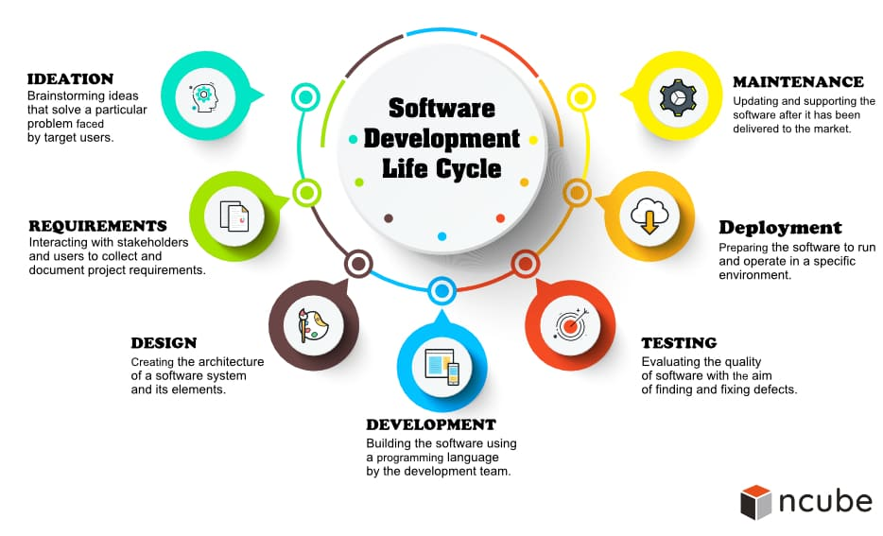
Software Engineering (SE)
SE is the application of principles used in the field of engineering, which f0llows a systematic approach.
Software Development Life-Cycle (SDLC)

Slide 3
Why do we need a systematic approach for the further development of WorkNet?
IT-Systems need to be:
reliable
Scalable
cost-effective
sustainable
quickly and cheaply to adapt
easy and cheap to maintain
robust and highly performant
(these are some examples for quality criteria ´s of software systems)

Slide 4


Sorts of relevant Systems
1. Application Systems
or application systems supports the operative processes in all operational functional areas of an organisation, examples for application Software's are:
Expert Software for Job Counselor´s
BPM Software
Risk Management Software
Scheduling Application
One building block of an application software could be a workflow engine.
WorkNet includes a simple Version of a expert software.
2. Transactional Systems
Transaction systems must be able to support a high number of users and transactions. Examples for such systems are:
Job Exchange Systems
One building block of a Job-Exchange is it´s matching algorhythm.
WorkNet Job Exchange is a simple Version of a transactional system.
3. Information Systems
an Information System/Software is any kind of Information system which improves the functions of business processes by integration. Examples for Information Systems are:
Management Information System (MIS)
Decisions Support System (DSS)
Executive Information System (EIS)
Occupation Information System
One building block of a Management Information System is a Datawarehouse.
LMIMS means technically one of the above-mentioned Information Systems!
Interfaces
Interfaces
Integration
Integration
VerBIS and all above-mentioned Systems
Jobbörse
FIS, DWH and Berufenet, KURSNET

Slide 5
Why destinguishing the types of Systems?
It is important to destinguish the sorts of Software Systems, because the systems serve different purposes and the systems are built differently.
Analogy:
A ship and an airplane are both vehicles, but an airplane cannot fly in water as little as a ship can cruise in the air. Although the vehicles have similar building blocks they are very different.
The same is true for IT Software.

Slide 6
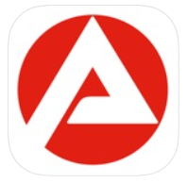


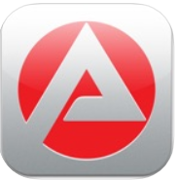

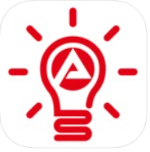
Sorts of relevant Systems
Apps of the Bundesagentur für Arbeit
4. Systems for Mobile Devices
Mobile operating systems combine features of a personal computer operating system with other features useful for mobile or handheld use, and usually including a wireless inbuilt modem and SIM tray for telephony and data connection.
You’ve got 2 main operating system options available:
iOS and
Android.
Others less important are: Windows , Blackberry OS, S40, Kai OS, Symbian, Sailfish OS, Ubuntu touch, Tizen.
APP:
iOS - Released in 2013, until now 513 user comments.
Android – 9731 user comments.
Job Exchange
Job - Application
Recruiting Game App
Statistics App
Social Act II App
Employer Information App
Apprentice World
Jobbörse:

Slide 7
What is a labor market information system (LMIS)?
A Labor Market Information System is technically an IT-Ecosystem consisting of many software systems. LMIS connects data of a job board (or more than one), many internal and external expert systems and has a management information system on the top.
It´s easier to build a wall than a house. A labour market information system is nor a wall neither a house it´s a residential complex, to stay in the picture.

Slide 8
What should be developed by WCC?
The Transaction Software – WorkNet Job Exchange? WorkNet-Customer (WorkNet-C)
The Application Software for Employees? WorkNet-Employee (WorkNet-E)
The Management Information System? WorkNet-Management (WorkNet-MIS)
The Mobile Applications (iOS/Android)? WorkNet-Mobile (WorkNet-Mo)
A Labour Market Information System? WorkNet-C + WorkNet-E +
WorkNet-MIS + WorkNet-Mo (all the above
mentioned Systems

Slide 9
Thanks for your attention!

