Slide 1


WorkNet 4.0
New Platform Business Model FOR SESA
--------------DRAFT--------------

Slide 2
Agenda
SESA´s Digital Maturity
SESA´s next development step – Transitioning from analog to digital
SESA´s FUTURE STARTS WITH A VISION
The Business Model of the WorkNet 4.0 Digital Experience Platform – Platform Canvas
Relevant IT-Systems
Application for Employees – NSM for Jobseekers
Application for Employers – NSM for Employers

Slide 3
SESA´s Digital Maturity according CMMI
Level | Description
1 - Initial | Processes are ad hoc and not defined; success depends only on the individual competence and motivation of the organisation´s collaborators.
2 – Managed | An organisation has ensured that processes are planned, executed and monitored in a recurring way; the processes are unique, but the result of a process is repeatable.
3 – Defined | Processes are described and the output is predictable qualitatively. Processes are tailored from a set of often-uses standard processes.
4 – Quantitatively Managed | Quantitative objectives for quality and performance are etablished and a well-defined criteria system is used for managing all processes in the organisation.
5 – Optimising | Processes are continually improved based on a quantitative system; focus lies on a general continuous improving process.
Actually SESA is in a Beginners Stage of Maturity. Work is done mostly analog.
Source: https://www.bmc.com/blogs/cmmi-capability-maturity-model-integration/

Slide 4

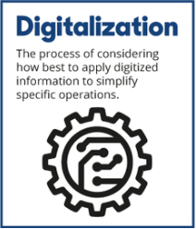
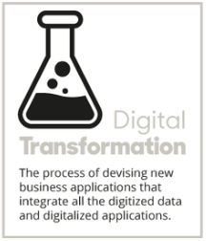
SESA´s next development step –
Starting with the Digitisation
Digitization means: transitioning from analog to digital – Application for Employees “New Service Model”
Digitalization means: making digitized information work.
Digital Transformation means: taking advantages from digitalization to create digital service models.

Slide 5

Future starts now
SESA´s
FUTURE STARTS WITH A VISION

Slide 6






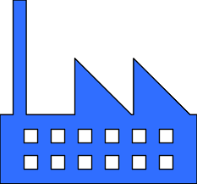
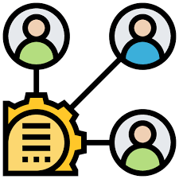






Platform Canvas
WorkNet 4.0
Platform Owner
Enabling Services
(platform to partners)
Core Value Proposition
Transactions
Partners
Job Board Transactions
Jobseeker <-> Employer
Jobseeker <-> SESA Employee
Employer <-> SESA Employee
Financial Transactions
SESA <-> SESA Employees
SESA <-> Jobseekers
SESA <-> Training Providers
Training Database
Adding, editing, deleting measures (VET Provider & SESA)
Booking Trainings (SESA & Employer, Training Seeker)
Data Transfer Transactions
- SESA <-> GEOSTAT
Ministry of Labour <-> Ministry of
Economy
Ministry of Labour <-> Ministry of
Education
Ministry of Labour <-> Ministry of
Finance
Ministry of Labour
Ministry of Economy
Ministry of Education
Ministry of Finance
National Statistica Office – GEOSTAT
LEPL State Employment Support Service - SESA
Activities: Enrollment, Profiling, Creating, Editing, Updating, Publishing, deleting CV,
Communication Channels
Information
Consultation
Search, Memorizing Result Lists an search profiles
Matching
Sending Job Offers
Submitting, Publishing Vacancies
Administrating
Reporting and Planning
Analyses: Employment-related, Economy-related, Education-related
The Job Board of WorkNet is the center of all activities. Thus WorkNet needs to become user centered. WorkNet aims to reach a high number of visitors. Jobseekers is given free access to search for jobs, post resumes and research companies. Employers on the other hand can post job offers for free, search for candidates and contact them directly or either indirectly. The labour exchange becomes easy.
Employers Associations
NGO´s (FES Project)
IOM (Mediation Services for Migrants)
Training Providers
TechCompanies
Tripartite Boards
Mass Collaboration
(platform content for information services and job board)
Platform
Stakeholders
Ancillary Value Propositions
Ministries of labour, economy, education
GEOSTAT and other Data Provider
LEPL – SESA
Social Partners (Employer Associations and Unions as proxies for employers and jobseekers
Education and Training Providers from different levels and forms of education
Research institutions
IOM
Donors
Employers Associations
Employers
Ministry of Education
Training Providers, IOM
Empowering Services
(platform to content producers)
Increased transparency, better and easier decisions making, time and money saving, increased trust in SESA
Channels
Peer-to-Peer
Information, 24-hours availability
Infrastructure and Core Components
Other
Services
(platform to consumers)
Self-Services, Automated Services
Employer Side:
Small, Medium, Big Companies
Jobseekers Side:
Youth, Elder, Disabled, Migrants,
Low/Un-skilled Jobseekers
B2C (on premise, virtual)
Website
Mobile App
Social Media
Press, TV
Meetings, Webinars
Digital and physical asset coordination.
Application Software for Employees
Transaction Software – Job Board
Datawarehouse
P l a t f o r m V i s i o n
P l a t f o r m D y n a m i c s

Slide 7


relevant Systems
1. Application Systems
supports the operative processes in all operational functional areas of an organisation. SESA needs application Software as follows:
Expert Software for Job Counselor´s
BPM Software
Scheduling Application
One building block of an application software could be a workflow engine.
Analogue to the German „Vermittlungs- und Beratungssystem (VerBIS)“
Status Quo
WorkNet includes a simple Version of a expert software.
2. Transactional Systems
SESA needs transactional systems for financial transactions (payments), for transactions with training providers and a Job Board.
Job Exchange Systems
ERP System
The Job-Exchange applies a skilled-based and uses a matching algorhythm.
Analogue to the German „Jobbörse“ and the ERP System (SAP).
Status Quo
WorkNet Job Exchange is a simple Version of a transactional system.
3. Management Information Systems (MIS)
SESA needs an Information which improves the functions of business processes by integration. The MIS delivers automated real-time information which aids the management in evidence –based Decision making.
One building block of a Management Information System is a Datawarehouse with a business intelligence solution.
Analogue to the German “Führungsinformationssystem and Datawarehouse”
Status Quo:
A LMIMS like above-mentioned doesn´t exist yet.
Interfaces
Interfaces
Integration
Integration

Slide 8
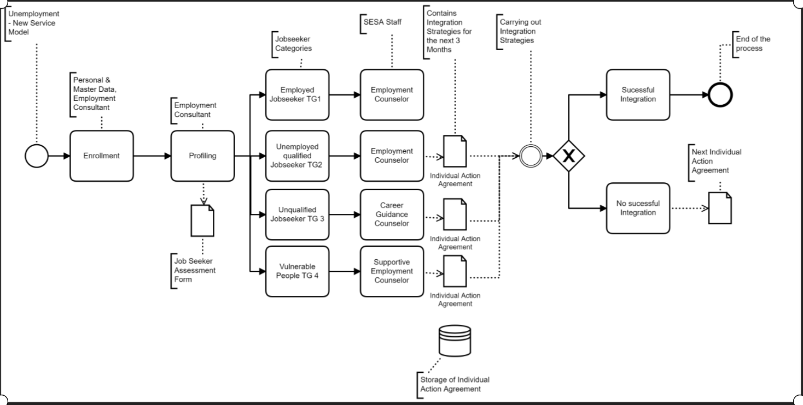
Software Application for Employees
- New Service Model for Jobseekers

Slide 9
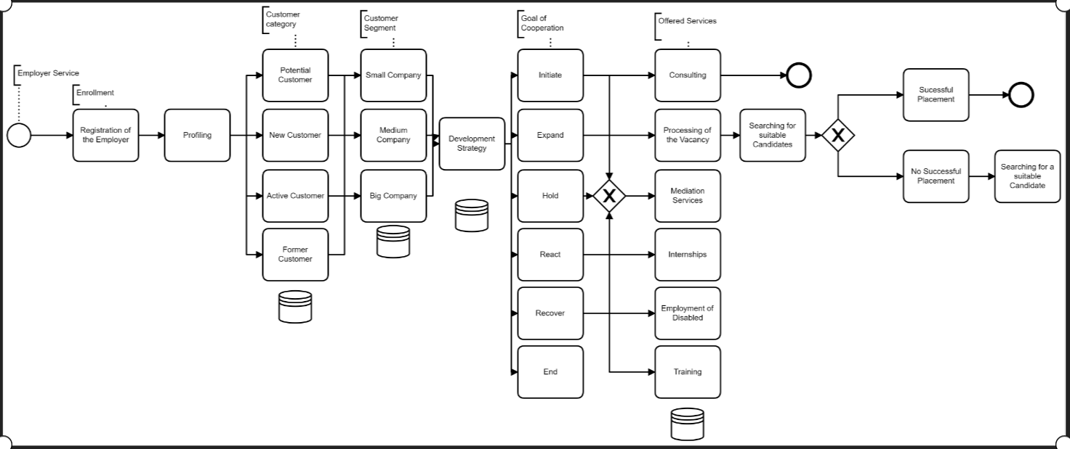
Software Application for Employees
- New Service Model for Employers

Slide 10
Thanks for your Attention

