Slide 1


WorkNet 4.0
New Platform Business Model FOR SESA

Slide 2
Agenda
What is driving SESA´s* Change?
Where SESA stands now?
What are SESA´s Customer related Goals?
What are SESA`s Staff related Goals?
What are SESA´s Partner related Goals?
What are SESA´s Management related Goals?
SESA´s FUTURE STARTS WITH A VISION
7. The Business Model of the WorkNet 4.0 Digital Experience Platform
8. What components to build first?
9. Flow Chart: New Service Model for Jobseekers
10. Flow Chart: New Service Model for Employers
* SESA stands for State Employment Support Agency

Slide 3
1. What is driving SESA`s Change?
SESA as a newly established State Agency is under the pressure to be quickly operational and to meet customer expectations.
The existing WorkNet application is outdated and doesn´t meet the constantly changing expectations of Employers and Jobseekers.
SESA´s customers expectations have risen over the last years, there is a clear demand for digital support and self-services.
SESA´s employees expect a capable software application in order to carry out administrational tasks.
Customer Numbers declined over the past years.
SESA aims to gain back customer trust by widening the service variety and quality significantly.
SESA´s management aims to achieve greater insights into customer behavior, transaction history, success factors and specific performance related topics on mediation and counselling.
The Digital Platform shall enable SESA´s ability to react on market demands faster.
In Addition COVID crises has demonstrated the vulnerability of SESA lacking adequate IT-support.
The number of returning Georgian (Circular Migration) has risen as well the number of Migrants

Slide 4
2. Where SESA stands now?
Customer related:
SESA´s services aren´t seen as pleasant, services are seen as bureaucratic, old-fashioned and insignificant.
There aren´t really any self-services.
The information and service quality is seen as very basic.
Customers choose other Job-Exchanges before using WorkNet.
Data Silos for certain Costumer Groups such as Migrants and People with Disabilities
Staff related:
Most tasks within the State Employment Support Service are done with paper work (analog).
The Service Model Processes are purely IT-supported.
The Service Provision is time consuming.
Employees are overloaded and have very little time for mediation and counselling services.

Slide 5

3. What are SESA´s Customer related Goals?
  Newly created Digital Touch Points based on Customer Survey
  Multi-Channel Approach based on Customer Survey
  Responsive, intuitive Design
  Short Processing and Response Times – Fast Service Delivery
  High Information Quality (Content)
  Self –Services, not only but particularly the Job-Exchange (Job Board) where Jobseeker and Employers can serve themselves
  Agile approach in order to create IT products with Customers for Costumers which are really needed
  Self determined search for staff.
  Self determined search for vacancies.

Slide 6

4. What are SESA´s Staff related Goals?
  The “New Service Model” for Jobseekers and Employers must be comprehensively supported by the IT in order to relieve Employees of the burden.
  Paperwork has to be minimized.
  An user friendly IT-Software Application for staff needs to be developed.
  Concentration of Staff Resources on customers who need personal support (consider the New Service Model) other Customers can help themselves by using Self-Services

Slide 7
5. What are SESA´s Partner related Goals?
  Access to the platform for Partner Organisation's such as the International Organisation for Migration (IOM), various local NGO´s as well Training Providers
  Access to the platform for Regional Government Institutions such as Community Centers
  Secure communication and exchance of Data such as reporting to SESA
  Self Determined Content Actualisation for selected authorized staff of the Partner Organisation
  High data quality due to automated processes
  User friendly, intuitive design

Slide 8

6. What are SESA´s Management related Goals?
The Management aims to gain insights in what works, what doesn´t work, where does it work, where doesn´t. The New WorkNet should meet the following requirements:
  It should give a Cost Overview about how much money is spent where for what, with what success ratio
  It should support Statistics about Job Placement, Demanded Occupations, Gender, Age, Qualification Level,
  It should deliver Real Time Information
  It should possess a Configurable Dash Boards
  The Management Information System is an integrated part of the Labor Market Information System
  It should allow the Execution of Tracer Studies

Slide 9

Future starts now
SESA´s
VISION FOR THE NEW PLATFORM

Slide 10














Platform Canvas
WorkNet 4.0
Platform Owner
Enabling Services
(platform to partners/staff)
Core Value Proposition
Transactions
Partners
Job Board Transactions
Jobseeker <-> Employer
Jobseeker <-> SESA Employee
Employer <-> SESA Employee
Financial Transactions
SESA <-> SESA Employees
SESA <-> Jobseekers
SESA <-> Training Providers
Training Database
Adding, editing, deleting measures (VET Provider & SESA)
Booking Trainings (SESA & Employer, Training Seeker)
Data Transfer Transactions
- SESA <-> GEOSTAT
Ministry of Labour <-> Ministry of
Economy
Ministry of Labour <-> Ministry of
Education
Ministry of Labour <-> Ministry of
Finance
Ministry of Labour
Ministry of Economy
Ministry of Education
Ministry of Finance
National Statistica Office – GEOSTAT
LEPL State Employment Support Service - SESA
Activities: Enrollment, Profiling, Creating, Editing, Updating, Publishing, deleting CV,
Communication Channels
Information
Consultation
Search, Memorizing Result Lists an search profiles
Matching
Sending Job Offers
Submitting, Publishing Vacancies
Administrating
Reporting and Planning
Analyses: Employment-related, Economy-related, Education-related
The Job Board of WorkNet is the center of all activities. Thus WorkNet needs to become user centered. WorkNet aims to reach a high number of visitors. Jobseekers is given free access to search for jobs, post resumes and research companies. Employers on the other hand can post job offers for free, search for candidates and contact them directly or either indirectly. The labour exchange becomes easy.
Employers Associations
NGO´s (FES Project)
IOM (Mediation Services for Migrants)
Training Providers
TechCompanies
Tripartite Boards
Mass Collaboration
(platform content for information services and job board)
Platform
Stakeholders
Ancillary Value Propositions
Ministries of labour, economy, education
GEOSTAT and other Data Provider
LEPL – SESA
Social Partners (Employer Associations and Unions as proxies for employers and jobseekers
Education and Training Providers from different levels and forms of education
Research institutions
IOM
Donors
Employers Associations
Employers
Ministry of Education
Training Providers, IOM
Empowering Services
(platform to content producers)
Increased transparency, better and easier decisions making, time and money saving, increased trust in SESA
Channels
Peer-to-Peer
Information, 24-hours availability
Infrastructure and Core Components
Other
Services
(platform to costumers)
Self-Services, Automated Services
Employer Side:
Small, Medium, Big Companies
Jobseekers Side:
Youth, Elder, Disabled, Migrants,
Low/Un-skilled Jobseekers
B2C (on premise, virtual)
Website
Mobile App
Social Media
Press, TV
Meetings, Webinars
Digital and physical asset coordination.
Application Software for Employees
Transaction Software – Job Board
Datawarehouse
P l a t f o r m V i s i o n
P l a t f o r m D y n a m i c s

Slide 11

8. What components to build first?
WorkNet Job Exchange (Job Board)
Software Application for Staff
Management Information System (Labor Market Management Information System)

Slide 12
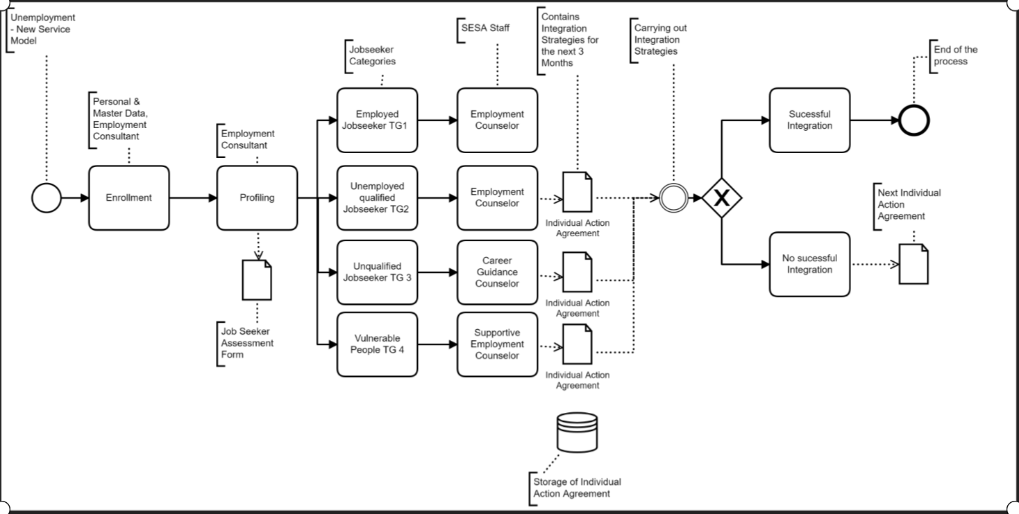
9. Flow Chart: New Service Model for Jobseekers
Hard to employ people, TG4

Slide 13
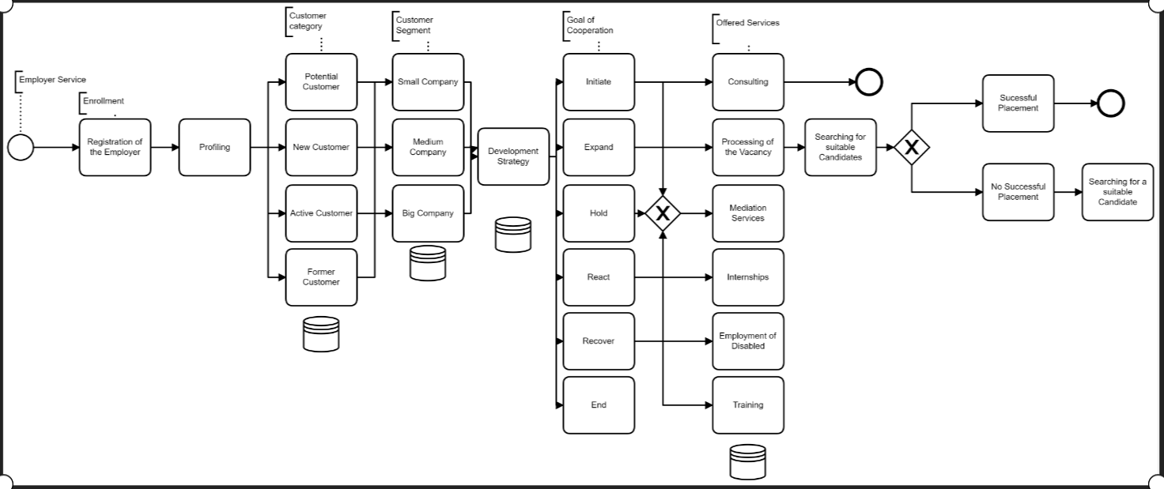
10. Flow Chart: New Service Model for Employers

Slide 14
Thanks for your Attention

