Slide 1


Action Plan: Establishing SESA
National Strategy 2019-2023 for Labour and Employment Policy of Georgia
Discussion Paper

Slide 2
Agenda
National Strategy for Labour and Employment Policy of Georgia – Action Plan: Establishing SESA
New physical structure Plan of SESA
Organisational Chart Tbilisi Office (without Names)
Organisational Chart Tbilisi Office (with Names)
Draft: Ground Floor Tbilisi Office (aligned with the Org.Chart)
Draft: First Floor Tbilisi Office (aligned with the Org.Chart)
Draft: Second Floor Tbilisi Office (aligned with the Org.Chart)
Standard Office for Counselor´s
Standard Office for Managers
Registration and Waiting Zone
Event and Conference Room
Self-Service Area
Call-Center Furniture Design
Characteristics of Healthy Workplaces
To complile by the Head of SESA
Must be compared with the Georgian Law on Organisational Health and Safety

Slide 3
1. Establishment of State Employment Promotion Agency (SESA)
Who is Responsible?
Political Level
Management Level SESA
HR
Strategy
IT
Strategy
What kind of Deliverable?
National Strategy 2019-2023 for Labour and Employment Policy of Georgia
Business Strategy
Nationwide Accesibility
HR –
Measures
…
What kind of Deliverable?
Action Plan:
Establishment of the body providing employment promotion services LEPL - State Employment Promotion Agency
Introduction of a New Service Model
The visual / software / content part of the labour market information system will be updated;
Labour legislation will be improved according to EU and ILO standards
IT-
Measures
…
General Measures:
Establish Physical Organisational Structure
Introduction of Business Process Management
Improve Customer Satisfaction
Introduction of Management by Objectives
Improve the controllability of the organisation
Continous Improvement of the New Service Model
Internal and External Communication
Expanding the network
SESA

Slide 4
2. Current Structure Plan NeW Structure Plan
SESA 2020
SESA 2025
Centralized Organization
F U T U R E S T R U C T U R E
A suitable property still has to be found.
Explanation: The property houses three Departments:
SESA's strategic department,
SESA´s centralized liquid department
a face-to-face counselling department
and a virtual consulting department
Self-Service Area
Headquarter
Tbilisi
9 Mikheil Asatiani Street
Tbilisi Property
Tbilisi Branches
Vake-Saburtalo, Mitskevichi Street N23
Didube-Chughureti, D. Agmashenebeli Street N140a
Dzveli Tbilisi, Kostava street N47/57
Gldani-Nadzaladevi, D. Sarajishvili Street N1
Isani-Samgori, Moskovi Street N25
Decentralized Organization
Regional Branches
Rustavi, Zurtaveli Street N5a
Mtskheta, Samxedro Street N13
Gori, Geldiashvili Street N3
Kutaisi, Chechelashvili Street N26
Zugdidi, D. Agmashenebeli Street N106
Ozurgeti, Gogebashvili Street N2
Batumi, Tabidze N2a
Regional Branches
Rustavi, Zurtaveli Street N5a
Mtskheta, Samxedro Street N13
Gori, Geldiashvili Street N3
Kutaisi, Chechelashvili Street N26
Zugdidi, D. Agmashenebeli Street N106
Ozurgeti, Gogebashvili Street N2
Batumi, Tabidze N2a
One-Stop Shops
Information desks with information terminals in about 84 municipalities
Liquid Organisation
Located in the property of selected companies.

Slide 5
3. Organisational Chart Tbilisi Office
Team: Marketing and Communication (1)
Head of SESA (1)
Team: Regions & Partnerships (2)
Deputy Head,
Chief Executive Officer – CEO (1)
Chief Executive Officer/Chief Digital Officer (CIO/CDO) – (1)
Head of Department Organisational Development and HR (1)
Head of Department HR Finance and Reporting (1)
Head of Department Operations (1)
Head of Department IT Governance (1)
Head of Department ITSM (1)
Head of Department DevOps (1)
Team: Strategy & Standards (1)
Team: Financial Budget (1)
Team: Mediation & Guidance (1)
Team: Strategy & Standards (1)
Team: IT-Processes/ITIL (1)
Team: Architecture & Technology (2)
Team: Strategy & Standards (1)
Team: Financial Sourcing (1)
Team: Active Labour Market Measures (1)
Team: Projects & Change (1)
Team: RfC (1)
Team: Quality Assurance & Risk Management (2)
Team: Staff (1)
Team: Payments (1)
Team: Fluid (1)
Team: Cybersecurity (1)
Team: Monitoring & Reporting (1)
Team: Call Center (3)
Team: Self-Services (1)

Slide 6
4. Organisational Chart Tbilisi Office
Team: Marketing and Communication (1)
Tamar Barkalaia
Team: Regions & Partnerships (2)
CEO
Nino Veltauri
CIO/CDO
n.n.
This Org.Chart should show the names of the people who fill the positions. If n.n. is entered, it means that no one has yet been recruited for the job.
I don't know the names of the staff, please let me know who can fill the posts. The Chart visualizes the GAP´s when there is still staff to recruite.
OD/HR n.n.
Finance and Reporting n.n.
Head of Department Operations n.n.
Head of Department IT Governance n.n.
Head of Department ITSM n.n.
Head of Department DevOps n.n.
Team: Strategy & Standards n.n.
Team: Financial Budget n.n.
Team: Mediation & Guidance n.n.
Team: Strategy & Standards n.n.
Team: IT-Processes/ITIL n.n.
Team: Architecture & Technology n.n.
Team: Infrastructure n.n.
Team: Financial Sourcing n.n.
Team: Active Labour Market Measures n.n.
Team: Projects & Change n.n.
Team: RfC n.n.
Team: Quality Assurance & Risk Management n.n.
Team: Staff n.n.
Team: Payments n.n.
Team: Fluid n.n.
Team: Cybersecurity n.n.
Team: Monitoring & Reporting n.n.
Team: Call Center n.n.
n.n. = nomen nominandum, the person who will fill the workplace isn´t found yet
Team: Self-Services n.n.

Slide 7
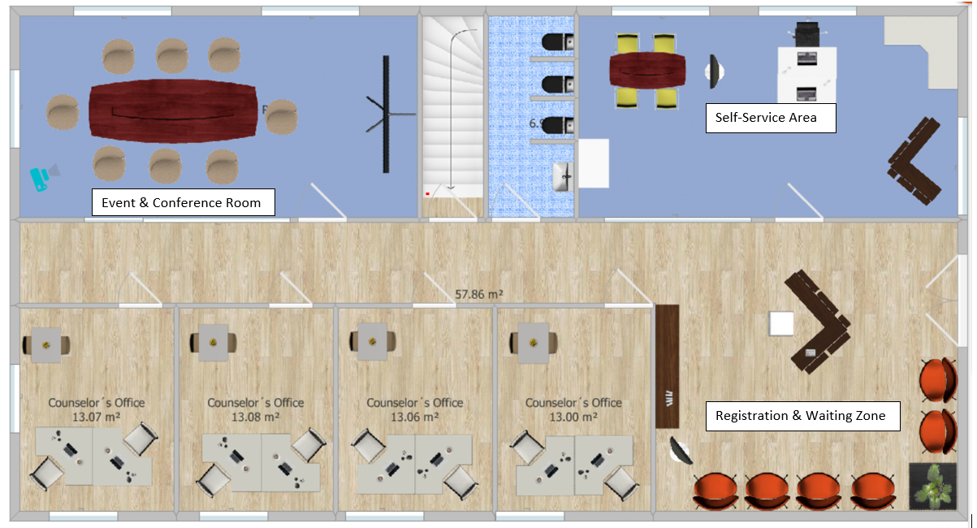
5. Ground plan Tbilisi Office – Ground Floor
Draft
The Color of the Floor covering can be aligned with the Corporate Identity Colors
KIOSK

Slide 8
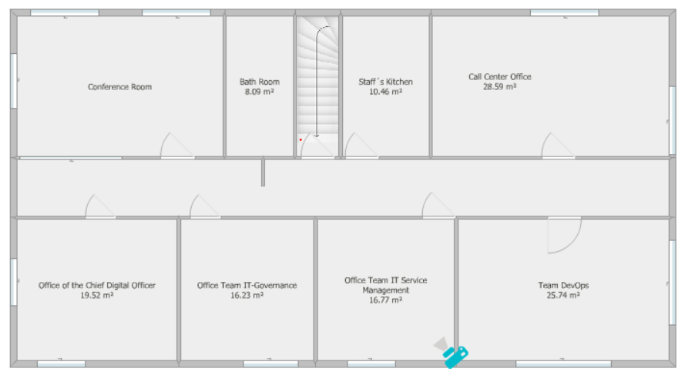
6. Tbilisi Office – First Floor
Draft

Slide 9
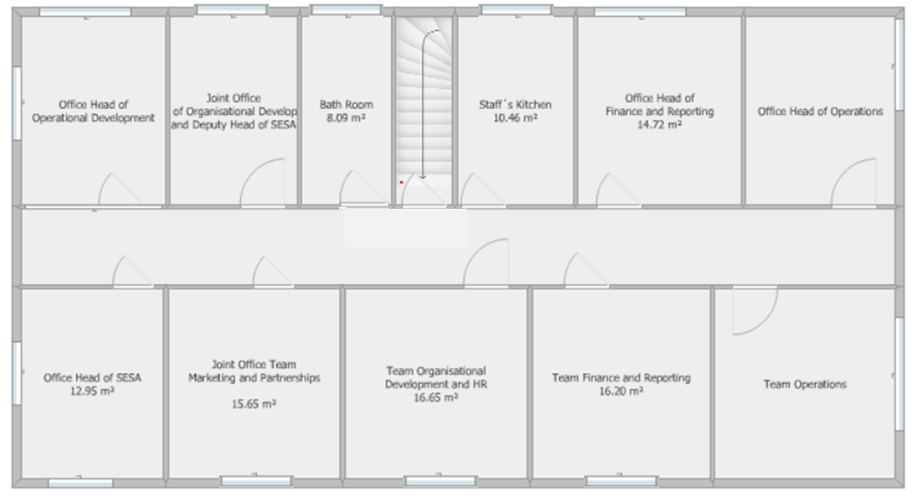
7. Tbilisi Office – Second Floor
Draft

Slide 10
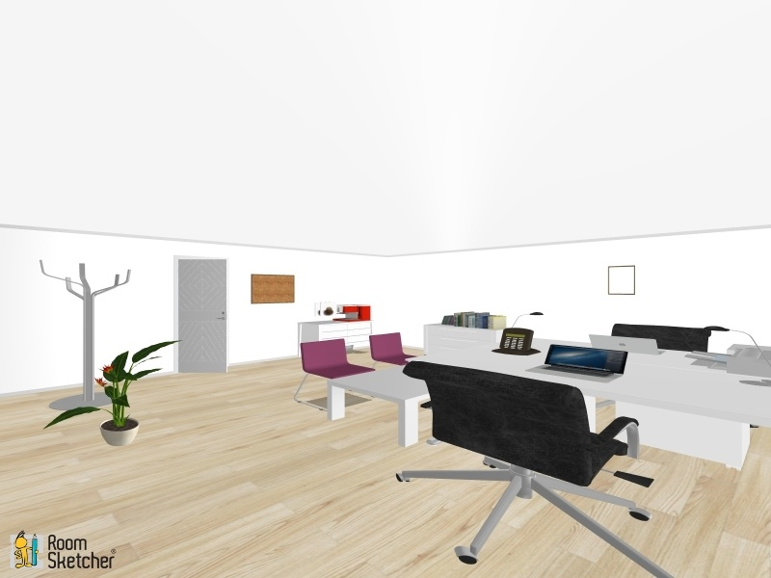
8. View of a Standard Counselor´s Room (2 Staff Members)
Interior Design:
2 Writing Desks
2 Ergonomic Office Chairs
1 Wardorbe
1 Visitor´s Table
2 Visitor´s Chairs
1 Cabinet
2 Book Shelves
2 Recycle Bins
1 Bulletin Board
1 Printer
1 Telefon
2 Laptops (Attention: BYOD?)
2 Headsets
1 Indoor Plant
1 Kettle/1 Coffee Machine
Strategic Decision

Slide 11
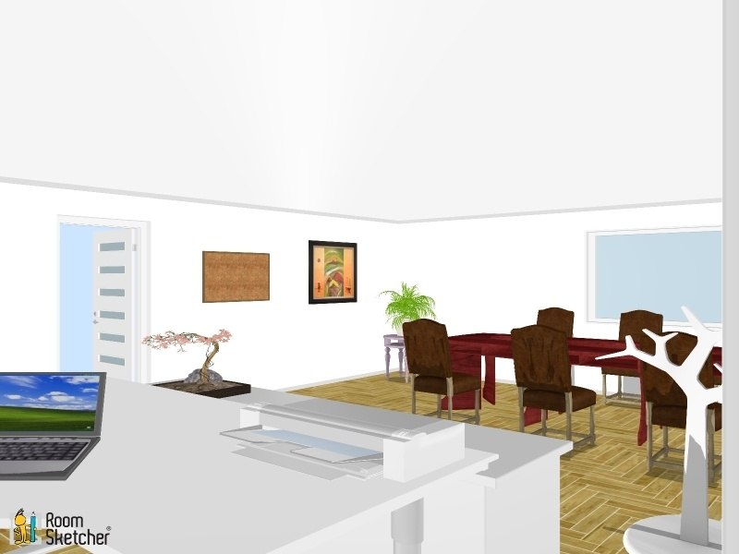
9. View of a Standard Managers Room
Interior Design:
1 Writing Desks
1 Ergonomic Office Chairs
1 Wardorbe
1 Conference Table
4-6 Conference Chairs
1 Cabinet
1 Book Shelves
1 Recycle Bins
1 Bulletin Board
1 Printer
1 Telefon
1 Laptops (Attention: BYOD?)
1 Headsets
2 Indoor Plant
1 Picture
1 Kettle/1 Coffee Machine
Strategic Decision

Slide 12
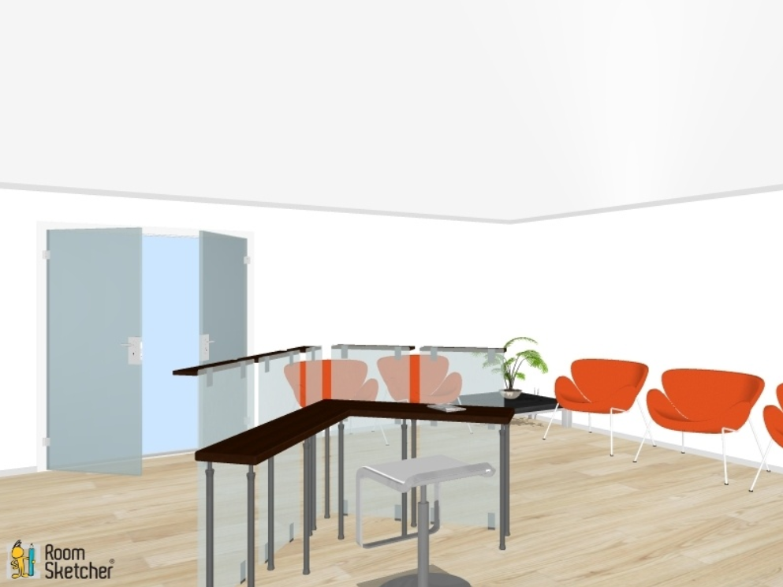
10. Registration and Waiting Zone

Slide 13
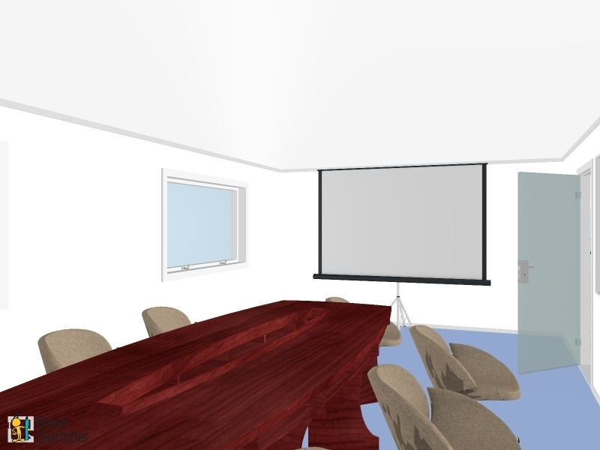
11. Event and Conference Room
Interior Design:
1 Conference Table
8 Conference Chairs
1 Beamer
1 White Board
1 Flipchart and Moderation Set
1 Pin Board
1 Telefon
1 Laptop
1 Picture
1 Kettle/1 Coffee Machine
1 Recycle Bin

Slide 14
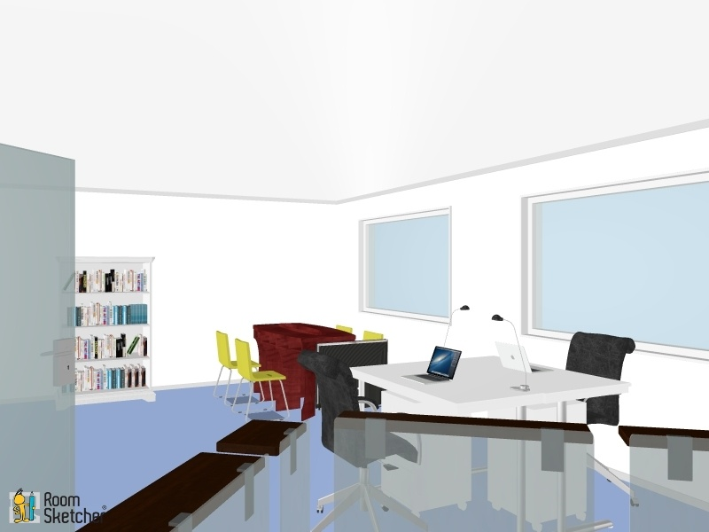
12. Self Service Area
Interior Design:
1 Help Desk
4-6 Information Desks
4-6 Office Chairs
1 Wardorbe
1 Working Table
1 Cabinet
1 Book Shelves
1 Recycle Bins
1 Printer
1 Telefon
1 Laptops (Attention: BYOD?)
1 Copier
Information Desk

Slide 15
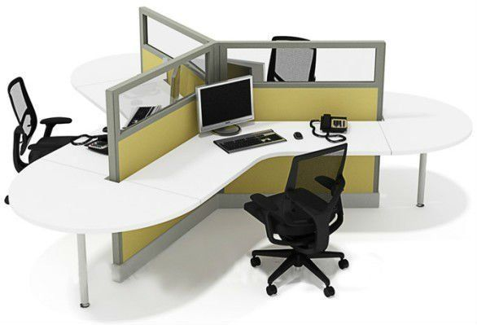
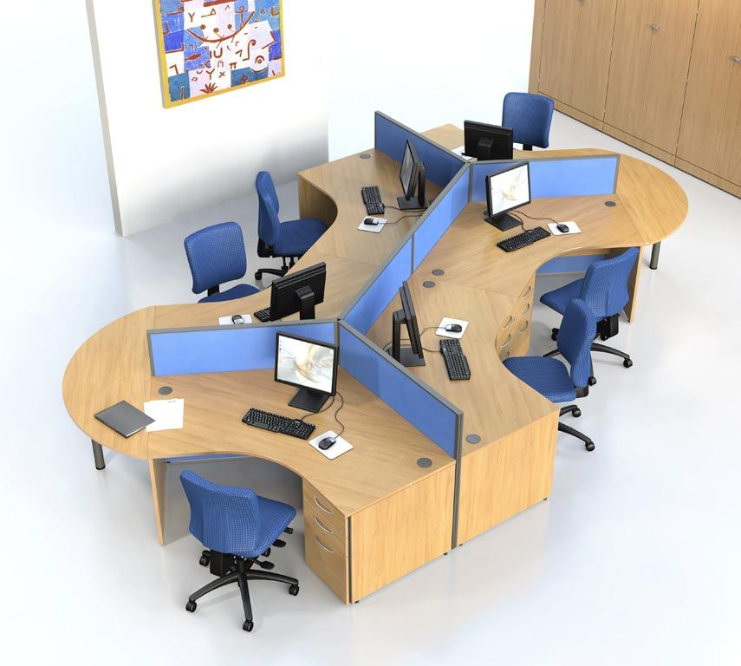
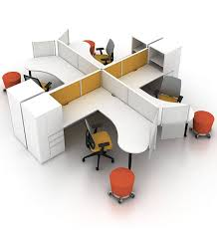
13. Call centre furniture design model
Workspace for 3 Call-Center Agents
Workspace for 6 Call-Center Agents
Workspace for 4 Call-Center Agents

Slide 16
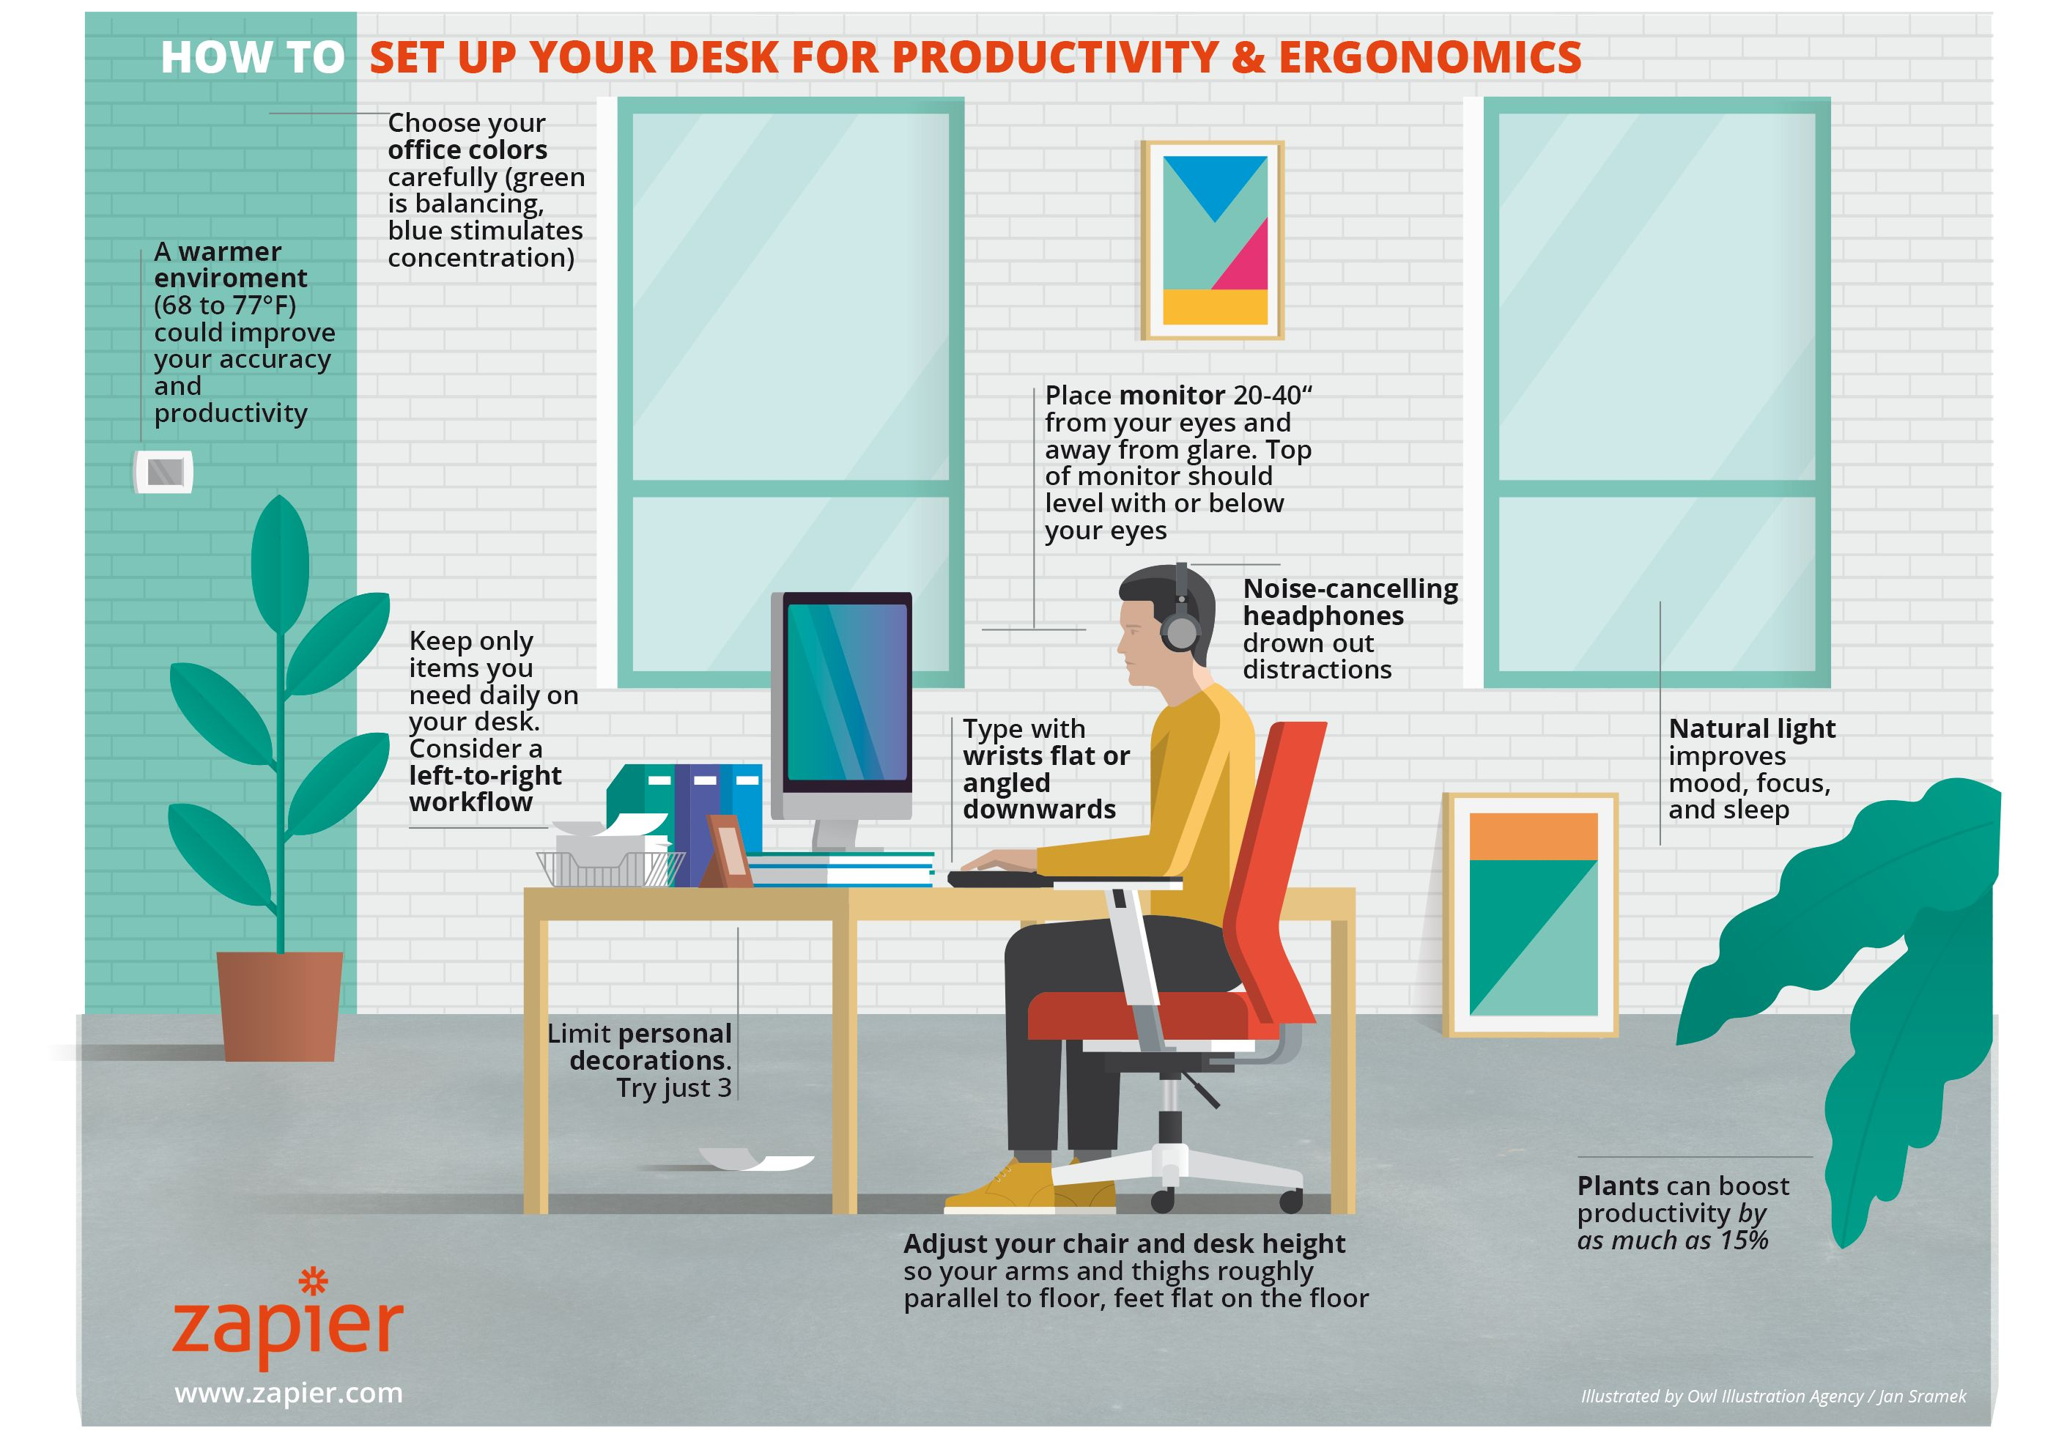
14. Characteristics of Healthy Workplaces
Source: https://zapier.com/blog/how-to-set-up-your-desk/

Slide 17
Contact
Susanna Burkert
Integrated Expert for Migration Governance, Labour Market Policies and Digitalisation
Phone: +995 558 16 27 86
Phone: +49 176 814 848 53
Mail: susanna.burkert.sb@gmail.com
Ministry of IDPs from the Occupied Territories,
Labour, Health and Social Affairs
144 Tsereteli Avenue, 0119 Tbilisi, Georgia

Slide 18
Thanks for your Attention!

