Slide 1


Background Information on Cloud Computing
SESA´s WorkNet 4.0

Slide 2
Agenda
Which route does SESA want to take?
Cloud Strategy
Cloud Migration Strategy
Cloud Deployment Types
Characteristics of Cloud Computing
Hybrid Cloud (Common Governmental Approach)
Cloud Delivery Models
Overview on Cloud Delivery Models
Infrastructure as a Service (IaaS)
Technical Components - Platform as a Service (PaaS)
Platform as a Service (PaaS) – Key Features
Software as a Service (SaaS)
Benefits of Cloud Computing
Concerns about Cloud Computing

Slide 3
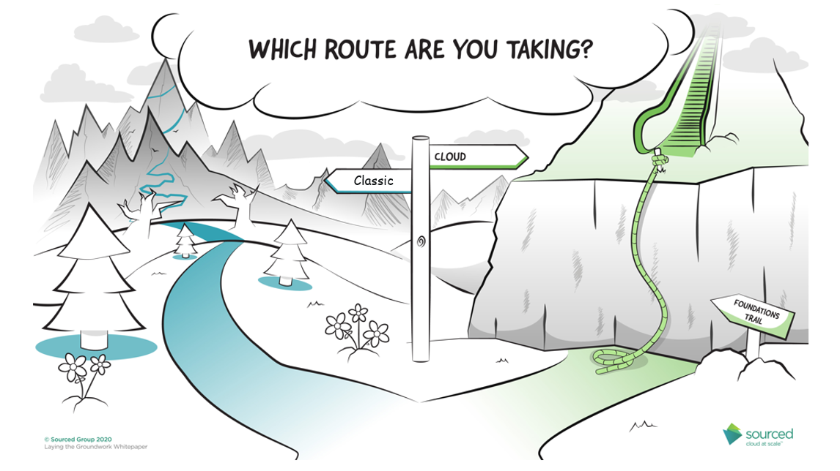

Slide 4
2. Cloud First versus Cloud Only Strategy
The Cloud Strategy is part of an IT-Strategy, which is not yet established for SESA.
Cloud Frist Strategy
Cloud-first is a cloud adoption strategy where organizations always consider cloud-based solutions first when implementing a new IT system or replacing an existing one.
This approach aims at maximizing cloud services’ benefits, namely more cost-effectiveness, faster implementation, and improved business resilience, while at the same time avoiding disruptions caused by having to replace many on-premises systems which may have been in place for years.
Cloud Only Strategy
The cloud-only approach requires organizations to apply cloud computing to all systems and services. Without doubt, there’s a slew of barriers to a cloud-only strategy organizations are facing– cyber security, integration, service reliability, bandwidth availability, service management, data migration, and lack of internal expertise.

Slide 5
3. Cloud Migration Strategy?
Cloud migration is the process of moving some or all your digital operations to your cloud. There are three main types of cloud migration you can perform — on-premises to cloud, cloud to cloud, or cloud to on-premises. When performing any of these three migration types, there are five methods and strategies you can use. These strategies are:
    Lift and shift—moving applications to the cloud as-is. This is also sometimes referred to as rehosting.
    Refactor—modifying applications to better support the cloud environment.
    Replatform—moving applications to the cloud without major changes, but taking advantage of benefits of the cloud environment.
    Rebuild—rewrite the application from scratch.
    Replace—retire the application and replace it with a new cloud-native application.
Notice: Actually we have no IT-Inventory, hence it is unclear what kind of applications actually are used. It´s likely that we will need to apply more than one of the above mentioned strategies. SESA needs to provide for the further process an IT-Inventory.

Slide 6
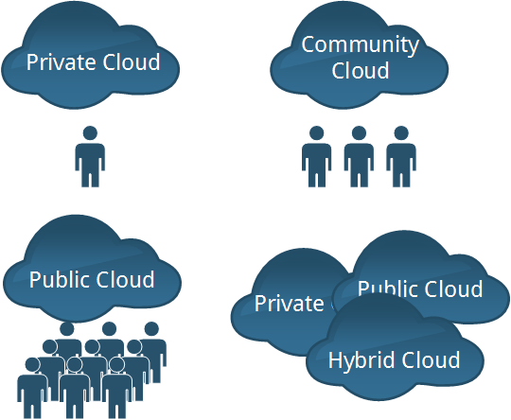
4. Cloud Deployment Types
Private Cloud
The cloud infrastructure is provisioned for exclusive use by a single organization comprising multiple consumers (e.g., business units). It may be owned, managed, and operated by the organization, a third party, or some combination of them, and it may exist on or off premises.
Community Cloud
The cloud infrastructure is provisioned for exclusive use by a specific community of consumers from organizations that have shared concerns (e.g., mission, security requirements, policy, and compliance considerations). It may be owned, managed, and operated by one or more of the organizations in the community, a third party, or some combination of them, and it may exist on or off premises.
Public Cloud
The cloud infrastructure is provisioned for open use by the general public. It may be owned, managed, and operated by a business, academic, or government organization, or some combination of them. It exists on the premises of the cloud provider.
Hybrid Cloud
The cloud infrastructure is a composition of two or more distinct cloud infrastructures (private, community, or public) that remain unique entities, but are bound together by standardized or proprietary technology that enables data and application portability (e.g., cloud bursting for load balancing between clouds).
Notice: The Hybrid Cloud is the mostly used Deployment Type in Government related areas.

Slide 7

5. Characteristics of Cloud Computing
Characteristics
Broad Network Access
Rapid Elasticity
Measured Service
On-Demand Service
Resource Pooling
Service Model
Software as a Service
(SaaS)
Platform as a Service
(PaaS)
Infrastructure as a Service
(IaaS)
Deployment Model

Slide 8
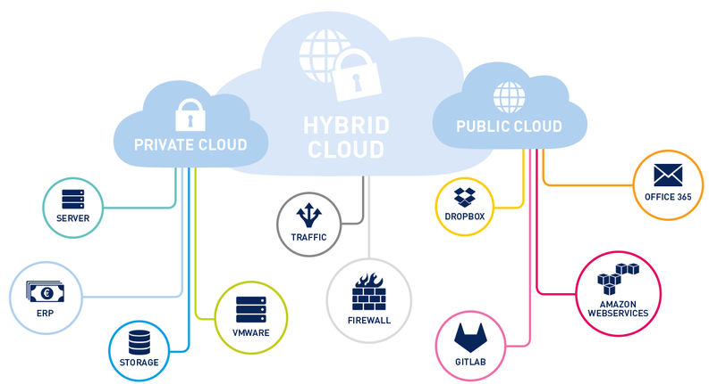

6. Hybrid Cloud
Powtoon
Most Governments and Public Organisations, that have more than 100 employees will have a combination of private and public clouds in their environment. This is the definition of hybrid cloud. Probably 99% will have an on-premise (or 3rd party hosted) private cloud for Active Directory and using public cloud for Office 365 with Azure Active Directory.
-> The Bundesagentur für Arbeit (BA) uses a Private Deployment Model and switches actually to a Hybrid Model.

Slide 9
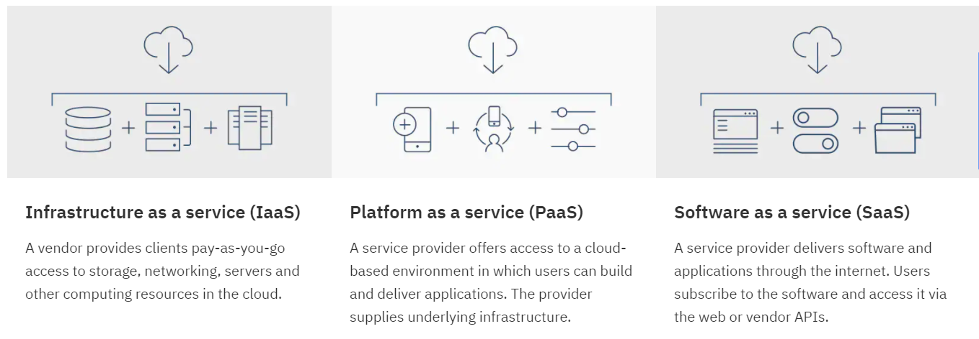
7. Cloud Service Delivery models briefly
Source: https://www.ibm.com/cloud/learn/iaas-paas-saas

Slide 10
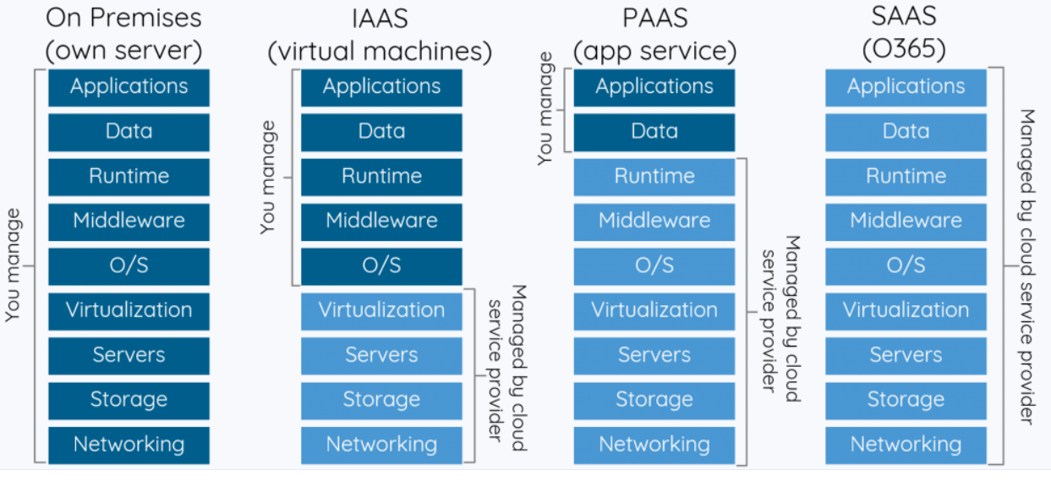
8. Overview on Cloud Delivery Models

Slide 11
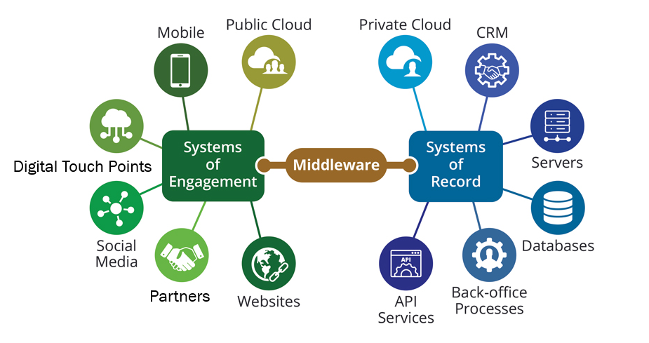
IaaS - Self Managed Components - Middleware
Middleware is software that lies between an operating system and the applications running on it. Essentially functioning as hidden translation layer, middleware enables communication and data management for distributed applications.
Source: https://azure.microsoft.com/en-us/overview/what-is-middleware/

Slide 12
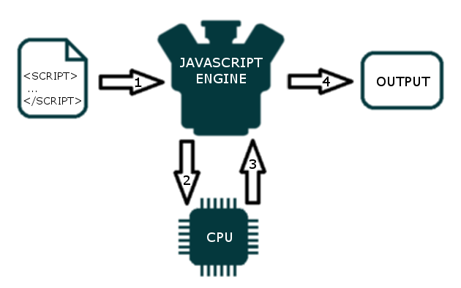
IaaS - Self Managed Components – Runtime
The runtime component consists of an event-based distributed messaging system. An event is any action that triggers a message. The messaging system can be distributed with different components of the system communicating over a WAN. Example: JavaScript runtime environment.
Source: http://dolszewski.com/javascript/javascript-runtime-environment/

Slide 13
9. Infrastructure as a Service - IaaS – Key Features
IaaS is a cloud-computing offering in which a vendor provides users access to computing resources such as servers, physical Data Centers, Virtual Machine, Hypervisors, Load Balancer, Networks, Block Storage, File Storage, Object Storage.
Organizations use their own platforms and applications within a service provider’s infrastructure.
Key features:
Instead of purchasing hardware outright, users pay for IaaS on demand.
Infrastructure is scalable depending on processing and storage needs.
Saves enterprises the costs of buying and maintaining their own hardware.
Because data is on the cloud, there can be no single point of failure.
Enables the virtualization of administrative tasks, freeing up time for other work.
Notice: SESA has actually neither the Hard- and Software Components nor it has the staff to choose that service model. SESA first needs to purchase the lacking Hard- and Software components and even than depends on contract partners.
Source: https://www.ibm.com/cloud/learn/iaas#toc-iaas-platf-uSme6HXr

Slide 14
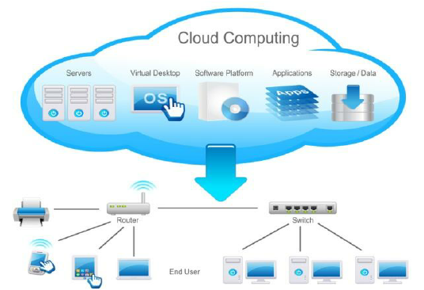
10. PaaS – Technical Components
Components supplied/hosted by the provider.
Components provided by SESA.

Slide 15
11. Platform as a Service - paaS – Key Features
PaaS is a cloud computing offering in which a vendor provides in addition to IaaS a suite of prebuilt tools to develop, customize and test the organizations applications. The PaaS provider hosts everything—servers, networks, storage, operating system software, databases—at the vendors data center; SESA uses it all for a for a monthly fee based on usage and can purchase more resources on-demand as needed.
Key features:
PaaS provides a platform with tools to test, develop and host applications in the same environment.
Enables organizations to focus on development without having to worry about underlying infrastructure.
Providers manage security, operating systems, server software and backups. Facilitates collaborative work even if teams work remotely.
PaaS lets SESA´s future development team build, test, deploy, maintain, update, and scale applications (and to innovate in response to market opportunities and threats) much more quickly and less expensively than they could if you had to build out and manage your own on-premises platform.
Notice: SESA has actually not the developers on board to choose that service model. SESA first needs to hire the right staff. As long as their is no well skilled staff, SESA depends fully on contract partners.

Slide 16
12. Software as a Service – SaaS – Key Features
SaaS is a cloud computing offering in which a vendor provides access to cloud-based software. Organisations do not install applications on their local devices. Instead, the applications reside on a remote cloud network accessed through the web or an API. Through the application, users can store and analyze data and collaborate.
SaaS is defined as cloud-based applications accessed through the web or an API. These cloud-based applications can be cognitive analytics, business processes from CRM, HR, Marketing to finance.
Key features:
SaaS vendors provide users with software and applications via a subscription model.
Users do not have to manage, install or upgrade software; SaaS providers manage this.
Data is in the cloud; equipment failure should not result in loss of data.
Use of resources can be scaled depending on service needs.
Applications are accessible from almost any internet-connected device, from virtually anywhere in the world.
Notice: This Cloud Service Model requires in comparison with the other Service Models the lowest amount of IT-Staff resources and the lowest amount of investments in purchasing processes for Hard- and Software. Nevertheless, this service model also represents a major challenge for SESA. The SESA staff has little or no experience with changes in the application software. For the SESA staff, a switch to the SaaS model means a significant change in the work culture and also in the speed of change associated with it (rapidly fast life-long-learning process starts with it).

Slide 17

13. Benefits of cloud Computing
Lower Computer Costs
Reduced Software Costs
Unlimited Storage Capacity
Instant Software Updates
Universal Document Access
Increased Data Reliability
Latest Version Availability
Improved Performance
Increased Document Format Compatibility
Easy Group Collaboration
Device Independence

Slide 18

14. Concerns about cloud Computing
Requires Constant Internet Connection
Doesn´t work well with low speed connection
Can be slow
Interoperability of Applications (Middleware)
Store of Storing
Energy Constraints
Security of Data (Depending on Deployment Type)
Vendor/Data Lock-in
Code Portability
Data Loss (Probably no physical Data Storage or back- up)
Interoperability between State Agencies
Heterogenity of Protocols and APIs

Slide 19
Contact
Susanna Burkert
Integrated Expert for Migration Governance, Labour Market Policies and Digitalisation
Phone: +995 558 16 27 86
Phone: +49 176 814 848 53
Mail: susanna.burkert.sb@gmail.com
Ministry of IDPs from the Occupied Territories,
Labour, Health and Social Affairs
144 Tsereteli Avenue, 0119 Tbilisi, Georgia

Slide 20
Thanks for your Attention!

Slide 21
Sources
National Institute of Technology: NIST 800-145
Bundesagentur für Arbeit: Das Systemhaus der BA stellt sich vor
Mc Kinsey: How Governments can get ahead in the Cloud
IBM: https://www.ibm.com/cloud/learn/iaas-paas-saas

