Slide 1



Technical Assistance to Social Welfare in Georgia
Activating the social assistance recipients and vulnerable workers: experiences from Finland
Pillar 4: Covid-19 impact and sustainability for employment, labour and social assistance

Slide 2
Temporary amendment of the Act on Social Assistance 2001-2003
Three-year experiment involving a temporary amendment of the Act on Social Assistance in Finland.
In Finland basic social benefits do not guarantee an income above the norm set for receiving social assistance.
To achieve a move from welfare to work, the Finnish government decided to improve financial incentives of social assistance recipients towards taking up work.
The introduction of 'income disregard' enabled social assistance recipients to earn some income without having it deducted from social assistance payments in its entirety as was the case before the reform.

Slide 3
Study design: changes in the income package of social assistance recipients. Note: Plus and minus signs in brackets illustrate what should happen in the numbers of social assistance recipients as a result of the reform.
Work income at the beginning of the period | Work income at the end of the period
 | No | Yes
No | More substantial need remained (-) | Need decreased (+)
Yes | Need increased (-) | Small need remained (+)

Slide 4
Changes in work income according to municipal client records.
 | November 2001 - March 2002 |  | April 2002 - November 2002 |  | Change | The effect compared with the hypothesis | Confidence intervals
 |  |  |  |  |  |  | 1. Period |  | 2. Period
Number of social assistance recipients | n | % | n | % | % |  | % | % | % | %
 | 8,937 |  | 7,973
No work income | 7,923 | 88,7 | 7,040 | 88,3 | -0,4 |  | 88,0 | 89,3 | 87,6 | 89,0
Stable work income | 396 | 4,4 | 278 | 3,5 | -0,9 | - | 4,0 | 4,9 | 3,1 | 3,9
Loss of work income | 373 | 4,2 | 340 | 4,3 | 0,1 |  | 3,8 | 4,6 | 3,8 | 4,7
Start of work income | 245 | 2,7 | 315 | 4,0 | 1,2 | + | 2,4 | 3,1 | 3,5 | 4,4

Slide 5
Conclusions from the evaluation study
Reform was largely positive from the point of view of social assistance recipients:
it enhanced fairness (one got some economic benefit from working),
It ensured fair treatment in the country (the reform made the local disregard practises more uniform), and
It improved incentives (the more extra income, the greater net income).
Further, the temporary reform provided municipal social workers with a new tool that enabled them to encourage their clients to take up even temporal jobs as work income was no longer deducted in full from the benefit.
Increase in labour force participation was clearly smaller than what was expected in the legislative reform.

Slide 6
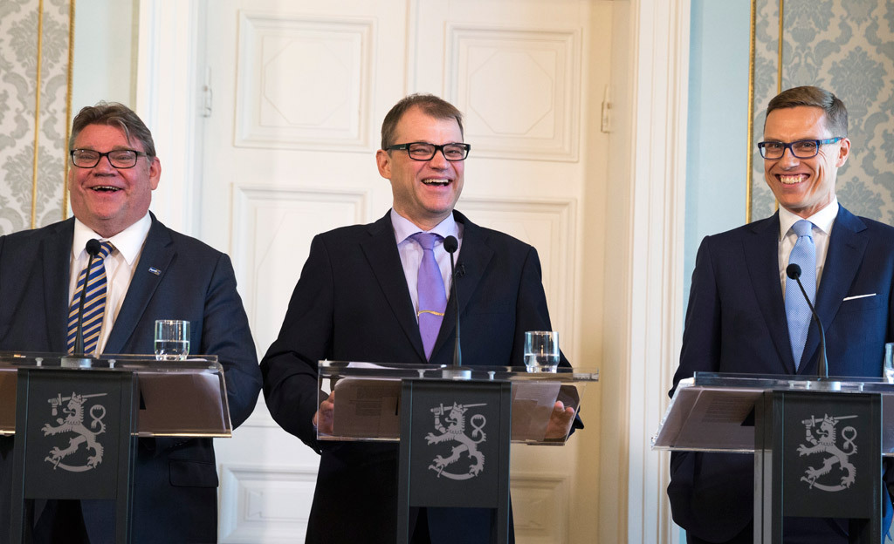
Prime Minister Juha Sipilä’s government programme 2015 (True Finns, Centre Party, Conservative Party): the basic income pilot study will begin

Slide 8
Finnish experiment
Focus on long-term unemployed -> partial basic income (not UBI)
Not possible to evaluate dynamic, system level effects
Exceptional in that participation in the experiment was compulsory and it was designed as a randomised field experiment
Experiment period 2017-2018
Final results released in May 2020

Slide 9
Experimental setting
 | Size of the experiment group/control group | Benefit level, USD/month in experiment group/control group | Target population | Duration
Finland | 2,000/173,000 Mandatory enrollment | 645/645 | Unemployed individuals between 25y and 58y | 2 years, 2017-2018

Slide 10
Employment
Employment effects studied by utilising register data gathered in official registers on employment, taxable income and participation in employment-promoting measures
Basically you test the effect of three different and perhaps contradictory mechanisms
Income disregard -> You may keep BI even if you get a job
Absence of sanctions -> You do not need to accept a job offer or participate in the active labour market policy measures (e.g. training)
Absence of bureaucracy -> No need to report incomes and no need for pay backs

Slide 11
Hypothesis
Income disregard -> better incentives for work -> improved employment
Absence of sanctions & bureacracy ->
people may become lazy and stop seeking employment
OR
basic income may release their employment potential when mandatory measures and involved bureaucracy are removed
Generally, expectation of slightly improved employment

Slide 12
Employment
From November 2017 to October 2018 employment increased on average six days more in the treatment group than in the control group - more positive employment effects among families with children, and among those whose mother tongue is other than Finnish, Swedish or Same
In January 2018, an activation model was implemented as part of public UB system
In the case of very low paying jobs, the control group actually worked as much as the basic income group
The employment effects for the second year of the experiment were a joint effect of the basic income experiment and the activation model
The research group concluded that the huge carrot included in the basic income model did not actually work in increasing employment.

Slide 13
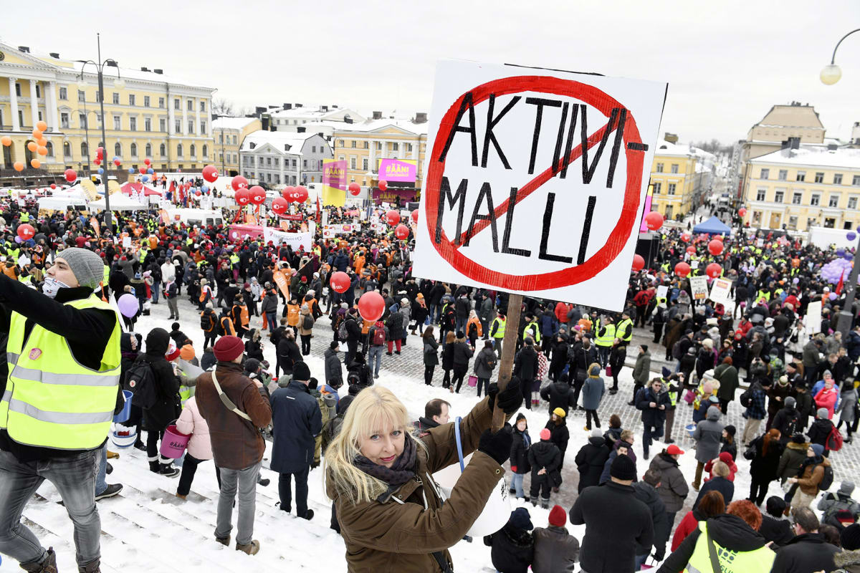

Slide 14
Active labor market policy measures
More surprisingly, the results from the final experiment report revealed that many members of the basic income group did not want to abandon employment services and active labour market policy measures.
Participants were in no way obliged to register at employment office but a great majority of them decided to do so
The share of people among the basic income group who were not registered in the employment office was at most only 17% lower than among the control group
The research group concluded that the majority of the basic income group did not have a problem with the conditionality of employment services

Slide 15
Well-being ”effects” – results from survey at the end 2018

Slide 16
Studying well-being
Not a focal point in the experiment, but budding evidence of positive effects from other studies
No baseline survey, but a telephone survey conducted in October– December 2018
Survey targeted at the 2,000 recipients of a basic income and at 5,000 persons in the control group
Validated questions about social and financial wellbeing, subjective health, job-search activity and employment, as well as about attitudes towards basic income

Slide 18
Subjective wellbeing
The survey results showed significant differences between the groups on key indicators representing different aspects of subjective well-being - basic income recipients assessed their well-being more positively than respondents in the control group
Higher generalized and institutional trust, as well as confidence in the future and self-confidence among UBI recipients - also, less stress and symptoms of depression and better cognitive functioning than the control group
Financial well-being of UBI recipients was better
UBI recipients experienced less bureaucracy
Different aspects of wellbeing were scrutinized in different subprojects – however they are clearly intertwined

Slide 19
Activation model 2018-2019
Aimed to tighten the conditions for benefit eligibility, in order to encourage activation of the unemployed, reduce the duration of periods in unemployment and increase the employment rate.
AM stipulated that the unemployed person had to meet an “activity condition” (participation in ALMPs or small earnings from work) in order to avoid curtailment of his or her benefits.
Received with tough criticism due to the fact that neither ALPMs nor work opportunities were available for all willing claimants
Incoming government scrapped the model in 2019.
Evaluation of employment effects yielded inconclusive results (Kyyrä et al. 2019).

Slide 20
Conclusions
Finacial incentives matter but not a great deal
People on basic benefits generally motivated to improve their situation
Sanctions do not work if there are no opportunities
Key issue is how benefits and employment promotion services are combined

Slide 21
THANK YOU FOR YOUR ATTENTION

