Slide 1

EASTERN EUROPE AND SOUTH CAUCASUS INITIATIVE
Investment Policy Review of Georgia
3rd Task Force Meeting
Thursday, 17 September 2020

Slide 2
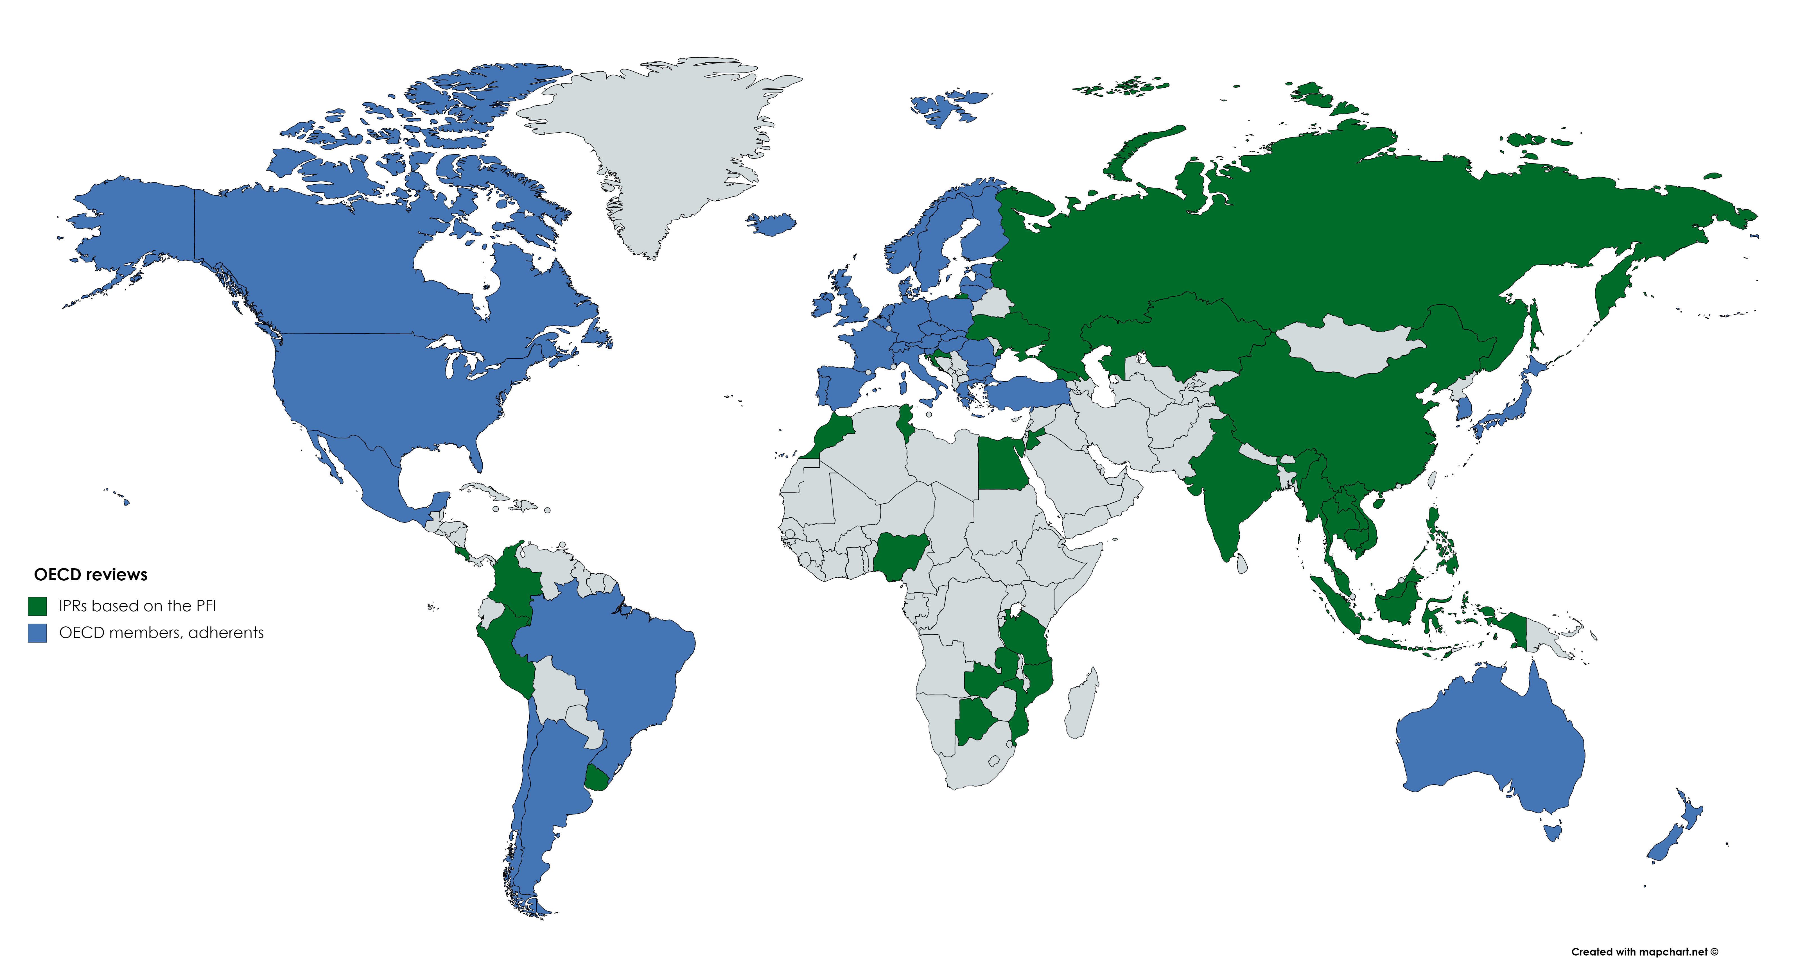
OECD Investment Policy Reviews

Slide 3
Timeline for Investment Policy Review of Georgia
Week 1, September 2020 | Presentation to Investors’ Council
Week 2, September | Presentation to OECD embassies
Week 3, September | Bilateral with MoESD
 | Meeting with government Task Force for IPR
 | Bilateral with World Bank/IFC
28 Sept | Virtual discussion with OECD Investment Committee and a high-level delegation from government
October-November | Revision and finalisation of draft
December | Official launch of the review

Slide 4
Georgia is one of the best performers in terms of Doing Business
Source: World Bank

Slide 5
Georgia among the most open economies for foreign investors
Source: OECD
Notes:
Georgia is among the most open economies worldwide. In general, FDI entry barriers should not be an impediment for investment attraction.
Remaining restrictions are not unusual, such as in air transport companies. Local incorporation for maritime and fishing activities is also common elsewhere.
Inward FDI stocks are high relative to size of the economy, reaching 107% in 2018. In this respect, Georgia performs well compared to other economies at similar levels of investment openness.
However, the recent restrictions on foreign ownership of agricultural land represent a backtracking on openness and may thus send a negative signal to the investment community

Slide 6
Limits of Georgia’s reform process
Georgia’s reform experience is in many ways an example other countries look to for inspiration
But reforms have not sufficiently facilitated broad-based economic growth:
Productivity growth weak
Exports below potential and undiversified
Poverty, particularly in rural areas, high
Unemployment and under-employment high
Skills and quality suppliers gap
Infrastructure and connectivity challenges
Georgia has removed much of the de jure barriers to FDI; its task is now to improve the overall enabling environment for investment

Slide 7
FDI trends and development benefits

Slide 8
FDI has plateaued after strong initial growth
FDI inflows rose sharply after initial liberalisation reforms, but have broadly stagnated over the past decade
Equity investments, including greenfield projects and M&As, have been declining in recent years, in absolute value and as a share of total FDI
FDI is likely to further contract in the near-term as a result of the Covid-19 pandemic, global supply & demand disruptions, and the pessimistic outlook of economic actors
Source: Geostat

Slide 9
FDI in tradable sectors below potential
The majority of FDI in Georgia goes to services – primarily finance, real estate, wholesale trade and tourism – followed by transport and energy
Infrastructure projects and financial services have seen the greatest FDI growth in the past decade
These sectors have contributed to economic growth, but have not sufficiently advanced job creation, particularly in rural areas, or productivity, and may be limited by Georgia’s small domestic market
FDI in export-oriented sectors remains minimal, despite some growth in FDI in tourism and renewable energy
Source: Geostat (FDI inflows), fDi Markets by FT (Greenfield FDI)

Slide 10
FDI contributes to positive development outcomes
Do foreign manufacturers have higher development outcomes? (yes > 0 > no)
Note: Confidence intervals at 95%. If crosses zero line, the difference is statistically insignificant.
CA: Central Asia, EaP: Eastern Partner, MED: Southern Mediterranean, SEE: Southeast Europe
Source: OECD FDI Qualities Indicators.

Slide 11
Domestic regulatory framework and investor protection

Slide 12
Significant strides towards improving the domestic regulatory framework for investors
Investment Law, together with several other laws, provides core protections for investors
Reforms to IP laws and other IP-related improvements in line with DCFTA commitments
Reforms to strengthen the independence of the judiciary
Efforts to promote the use of arbitration and mediation services
Land laws provide a clear framework for property rights
Well-developed laws and institutions on data protection and cybersecurity

Slide 13
Key recommendations to address remaining challenges
Amend Article 7 of the Investment Law to provide further specification on expropriation and the government’s right to regulate
Continue to prioritise initiatives to improve the effectiveness of enforcement measures for IP rights
Sustain momentum for systemic judicial reform
Amend aspects of the Arbitration Law to improve legal certainty; support initiatives to improve public perceptions and awareness of arbitration and mediation
Complete and, if possible, expedite universal land registration reforms; detailed recommendations on land policy in Chapter 3
Maintain data protection and cybersecurity as a national policy priority

Slide 14
Continue to reassess and update priorities for investment treaties
Unqualified FET provisions
Lightly regulated ISDS provisions
Circumscribe MFN provisions; limit treaty shopping
Ensure policy space

Slide 15
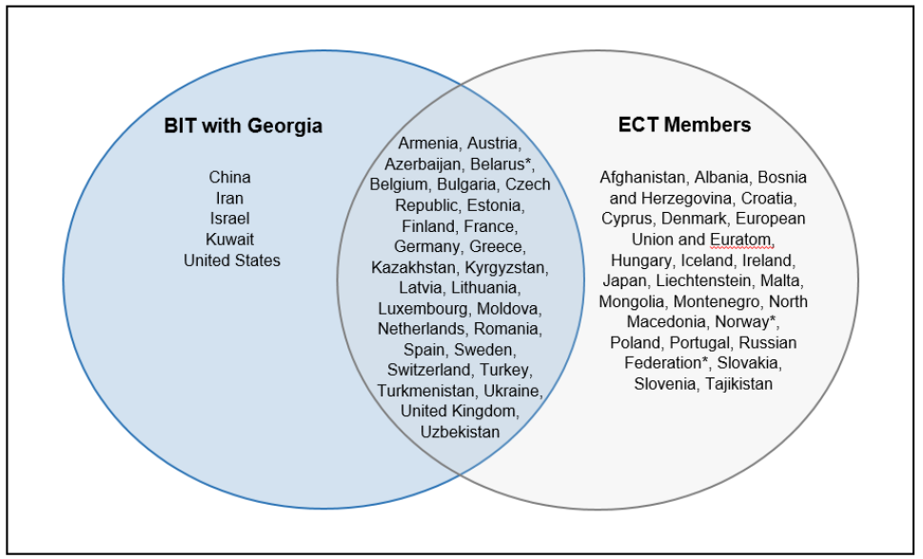
Other recommendations on investment treaty policy
Actively manage the replacement of older investment treaties as part of new treaty negotiations with the same partners
Source: OECD investment treaty database
Continue to participate actively in and follow closely government and other action on investment treaty reforms at the OECD, UNCITRAL and ECT modernisation process

Slide 16
Discussion on investment promotion

Slide 17
Recommendations of the IPR on investment promotion (1/3)
Develop a comprehensive investment strategy and policy statement
The strategic framework of investment promotion could be reinforced, including with an overarching investment strategy that provides a single strategic vision for all stakeholders, enables the development of strategic plans at the level stakeholder agencies (EG in particular), along with key target objectives and KPIs, and gives an opportunity to further articulate FDI objectives with export-led development and innovation ambitions
Strengthen the investment promotion function in Georgia
Resolve the current fragmentation of the institutional setting for investment promotion by reinforcing Enterprise Georgia’s position as focal point and coordinator of the investment promotion effort. This entails the allocation of needed resources (financial and human) to effectively carry out its mission
Link export, innovation and investment promotion
The opportunities presented by the Deep and Comprehensive Free Trade Area (DCFTA) with the EU as an export market should be part of Georgia’s investment promotion strategy. The efforts that Georgia has put into strengthening innovation within its business community should also be considered in the investment strategy. Complementarities between departments of Enterprise Georgia can be further leveraged through shared tools and cooperation mechanisms.

Slide 18
Recommendations of the IPR on investment promotion (2/3)
Formalise strategic coordination for investment promotion
Overall, Enterprise Georgia would benefit from clearer terms of cooperation and mechanisms to work jointly with its key institutional partners, including GITA and the Chamber of Commerce. Well-defined cooperation terms and dedicated tools such as shared information systems, processes and systematised protocols could improve the quality of the cooperation, while potentially increasing efficiency.
Enhance the Invest in Georgia brand
Along with the recommendations above, accentuating the Invest in Georgia brand, which is already well known to the international business community, could help restore the IPA’s visibility and clout vis-à-vis investors and other relevant government agencies.
Strengthen the investment aftercare system and improve one-stop shop services
Aftercare services for investors are vital. Good aftercare and policy advocacy, including transmitting investors’ feedback for more effective policy making, can be the determining factor in a decision to reinvest and help address investment climate challenges. Enterprise Georgia would benefit from strengthening its approach, including to maintain the dialogue with existing investors (e.g. through a key account management approach). The IPA could also consider enhancing its one-stop-shop services for investors. This requires, however, an increase in the IPA’s resources.

Slide 19
Recommendations of the IPR on investment promotion (3/3)
Strengthen investment promotion and facilitation at the sub-national level
Sub-national governments do not have formal mandates and roles in investment promotion and facilitation. According to local stakeholders however, regional governors are interested in attracting foreign capital, and Enterprise Georgia is accompanying them. The next stage of the cooperation could be to establish focal points in the regions, which can be especially critical for investment facilitation.
Foster FDI-SME linkages
Enterprise Georgia is strategically set up to support the establishing of deep linkages with the local economy. A first step in this direction would be to establish some linkages focal points in the investment promotion and enterprise promotion departments, which could identify and explore opportunities systematically.
Set up an investment promotion governing board
A board can be a good mechanism to ensure the representation of different stakeholders in the governance of an IPA, including from the private sector. A Board could provide an outsider’s view to generate new ideas for collaboration and synergies within the agency, as well to identify and unlock opportunities for cooperation with other agencies and the private sector.

Slide 20
Promoting sustainable investment in the
agri-food sector

Slide 21
Foreign and domestic investment can support the development of the agri-food value chain
FDI Inflows in agriculture, 2007-19
The agri-food value chain plays an essential role in Georgia’s economy, accounting for 11% of GDP and 45% of employment
Georgia has favourable conditions for attracting investment in the agri-food value chain
FDI inflows are below potential
Agri-food exports are highly concentrated in beverages
The farm structure is highly fragmented, with most food produced by small-scale family farms
Productivity and wages are low
Agri-food exports, 2015-19

Slide 22
Policy recommendations for the agri-food value chain
Introduce an objective on investment promotion and facilitation in the new Agriculture and Rural Development Strategy 2021-2027
Ensure full completion of the land registration reform
Develop a credit guarantee scheme for agri-food SMEs
Continue investing in transport and utility infrastructure, and improve the quality of logistics services
Rehabilitate outdated irrigation infrastructure and drainage systems and improve internet access in rural areas
Consider allocating resources to encourage the formation of supply chain linkages, including linking foreign investors with local SMEs
Offer targeted incentives to prospective investors, conditional on their engagement with small-scale producers and agricultural co-operatives
Develop well-resourced and functioning agricultural training institutes, extension services and vocational training systems
Strengthen food safety and quality standards

Slide 23
Promoting responsible business conduct

Slide 24
Responsible Business Conduct key to sustainable business environment
In a nutshell: Expectation that all businesses – regardless of status, size, ownership, sector, location - avoid and address negative RBC impacts
Not philanthropy: part of core business and risk management
Important for all businesses, not just MNEs
RBC minimizes risks for businesses and helps prevent/address negative impacts on people and environment – all subject to government regulation and action
RBC attracts quality investment
RBC is increasingly expected and integrated in standards and policies at global, regional, national levels:
OECD Guidelines for Multinational Enterprises, ILO MNE Declaration, UN Guiding Principles on Business and Human Rights
EU: towards mandatory human rights and env. due diligence

Slide 25
Georgia has made strides towards increasing RBC awareness and improving the legal framework that underpins RBC
State of play | Challenges and opportunities
Awareness of RBC on the rise: awareness-raising activities by government (HR Secretariat, sectoral ministries, Ombudsman), business associations, CSOs | Continued activities needed / expansion Moving from MNEs to SMEs
Policy coherence: Business and human rights integrated in the Human Rights NAP 2018-2020 Reforms in other sectors relevant to RBC | Implementation and forthcoming NAP 2020-2022 State as economic actor
Achievements in legal and policy reforms on human rights | Some areas for improvement: access to remedy & independence of judiciary, civic space
Georgia top of its peers in corruption perception; legal & policy frameworks in place | Less attention has been paid on preventing and addressing corruption in the private sector
Major progress made in addressing legacy of de-regularization and weak labour and environmental protection: Re-establishing labour inspection Occupational health & safety New environmental regulations | Finalizing reforms (e.g. labour inspection) and focus on implementation/compliance Sectors identified as high-risks (mining, hydropower)

Slide 26
Georgia can continue on this path by strengthening policy coherence and leading by example in its commercial activities
A National Action Plan is a useful tool to demonstrate a government’s commitment to RBC, highlight relevant policies and ensure policy coherence:
As of May 2020, 23 countries (20 of which are Adherents to the OECD Guidelines) had adopted a NAP on RBC/BHR
NAPs adopted in Czech Republic, Lithuania, Slovenia, Poland; process in Ukraine
Public procurement : core role of government as purchaser of goods, works and services: public procurement averaged 9.9% of the country’s GDP and 31.7% of overall public spending between 2013-2016 (WB, 2018). Steps taken to integrate environmental sustainability into procurement can be built upon.
Investment Promotion Agency: Branding Georgia as a responsible business destination can help attract FDI.
State-owned Enterprises, albeit a small number (400), are large employers and players in the economy. There is scope for improving management of state ownership and defining RBC expectations for SOEs.

Slide 27
Recommendations on RBC (1/2): Coordinating, consolidating and deepening efforts
Strengthen awareness of and commitments to RBC
Clearly communicate expectations that all businesses operating in and from Georgia respect RBC
Increase awareness-raising and capacity-building for employers and employees, esp. in SMEs and sectors identified as high-risk
Promote policy coherence
Strengthen and expand RBC commitments in forthcoming Human Rights NAP, including resources for implementation
Consider National Action Plan on RBC/BHR
Set clear expectations on RBC for State-owned enterprises and public procurement; improve State ownership management

Slide 28
Recommendations on RBC (2/2)
Continue to improve legislation and its enforcement related to adequate working conditions, esp. occupational health and safety; continue strengthening the independence and capacity of labour inspection; guarantee non-discrimination in practice
Promote stronger compliance with environmental protection regulations, esp. impact assessments and environmental information and participation
Promote enhanced due diligence and implementation of RBC standards in mining and hydropower sectors, including meaningful consultations
Continue reforms to combat corruption in the public and private sectors and assist companies in doing so.
Strengthen RBC in key areas

Slide 29
Madloba

