Slide 1

Needs index revision:
Preliminary results for discussion
February 19, 2021

Slide 2
Outline
In the previous meeting we discussed four main steps/methodologies
1. Assessment and revision of the existing approach: “cost of basket of goods”, where the basket is primarily identified and chosen by experts:
a) Critical assessment of methodology
b) Revision of some of the cost estimates based on HIES data => possible proposed adjustments
2. Calculation of needs index based on empirical consumption patterns
Alternative approaches
3. Living standard approach (not yet completed)
4. Minimum income question approach
Summary and next steps

Slide 3
1. A. ASSESSMENT OF the CURRENT Methodology

Slide 4
Current approach (ISET 2015)
The current methodology relies on a number of critical assumptions based on the subsistence minimum computed by Geostat and expert-based opinion:
The methodology focuses on strict equivalence scales: how much a child, woman, elderly, etc. needs in relation to a healthy man aged 30-39
For a healthy male aged 30-39 food needs represent 70% of the subsistence minimum
The calculation is divided in five main categories of needs:
Food needs: using calorific requirement (kcal per day of different age/sex groups as a ratio of kcal of adult male 30-39)
Non-food needs: transportation, basic medical needs, and ‘anything else’ (which by default represents the remaining 30% of the basket for a health man aged 30-39) => with some exception, but these are assumed to be the same for all groups
Extra needs for specific groups other than a healthy man aged 30-39:
Caring needs: implicitly assessed through calorific requirements of the carer
Needs specific to certain age groups and conditions (special means needs): school, baby items, etc.
Additional health needs by age groups and social conditions (monitoring, medicines, rehabilitation)

Slide 5
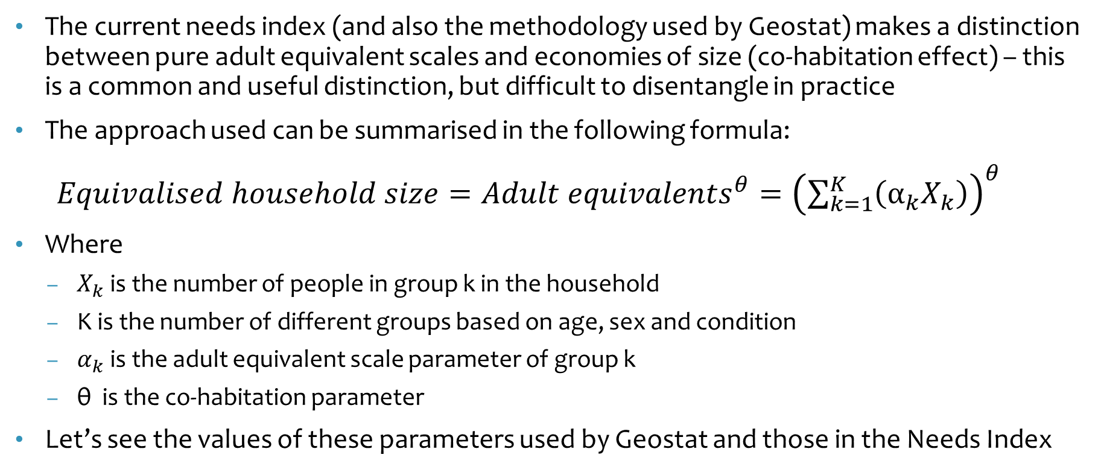
General formula and annotation
The current needs index (and also the methodology used by Geostat) makes a distinction between pure adult equivalent scales and economies of size (co-habitation effect) – this is a common and useful distinction, but difficult to disentangle in practice
The approach used can be summarised in the following formula:
$Equivalised household size={Adult equivalents}^{θ}={\left(\sum_{k=1}^{K}{\left(α_{k}X_{k}\right)}\right)}^{θ}$
Where
$X_{k}$ is the number of people in group k in the household
K is the number of different groups based on age, sex and condition
$α_{k}$ is the adult equivalent scale parameter of group k
θ is the co-habitation parameter
Let’s see the values of these parameters used by Geostat and those in the Needs Index

Slide 6
GEOSTAT scales and Needs Index are not the same
Geostat
Methodology developed in the 1990s
The co-habitation parameter (θ) is equal to 0.8, but 1 if there is only one member
Parameters α:
Child (0-7) = 0.64
Child (8-15) = 1.00
Man (16-64) = 1.00
Woman (16-59) = 0.84
Man (65+) = 0.88
Woman (60+) = 0.76
Needs Index
The same co-habitation effect as Geostat
However, there are more than 60 combinations of age/sex and conditions (disabilities, orphans, etc.) with specific α parameters, below are some examples:
Child (4-6) = 1.15
Child (7-12) = 1.04
Man (30-39) = 1.00 [1.04 for 18-29/40-59]
Woman (30-39) = 0.92 [0.93 for 18-29, 0.95 for 40-59]
Man (60+) = 1.13
Woman (60+) = 1.04

Slide 7
GEOSTAT scales and Needs Index in 2018 HIES
The needs index has higher adult equivalents across all groups
This is because children and elderly have coefficients higher than 1, but also because of high needs identified also in other socio-economic groups: persons with disabilities (PWD), single mothers, IDPs, etc.
Notes:
MH: AE = average sum of AE in the hh

Slide 8
Derived consumption patterns in the current methodology for certain household types
Using the assumptions and numbers presented in the ISET paper, we have computed budget and consumption patterns for certain common household types
Health includes both essential health needs common to everyone + specific health needs of different age/sex groups
Special means needs include: baby items, pre-school, school related expenses and equipment for PWD
Other items includes clothing, phone services, and other expenses, which are grouped together because thought not to affect equivalence scales
We can compare these patterns with those observed in the 2018 HIES
Notes:
Derived consumption is the monetary value of expenses based con the current methodology assumptions.

Slide 9
Observed consumption patterns in 2018 HIES are not aligned with the current methodology
We do not take into account rent and durables
Classification follows standard statistical categories
What was combined in ‘other items’ in the needs index methodology is much higher in HIES
Clothing, utilities & furnishing, communication, recreation/food out and other miscellaneous expenses represent between 26% and 41%, against 15-17% in the needs index
Health is less important in HIES than in the needs index and the same applies for education (compared to special needs items)

Slide 10
Observed consumption patterns in 2018 HIES by income quintiles
Even in the poorest quintile the average food share is only 52% => much lower than what is assumed in the subsistence minimum and in the needs index calculations
Analysis of consumption patterns by household size suggests that some items have ‘public goods’ properties (for example utilities & furnishing): their budget share declines as household size increases
The implication is that the co-habitation coefficient is definitely below 1

Slide 11
Expenses for Caring needs may not be taken into account in the Needs Index
In the HIES we do not find evidence that caring is a need that incurs a monetary cost for households in Georgia
In the context of Georgia it is probably the norm that household members look after young children or elderly members
The cost in this case is essentially an opportunity cost that will manifest itself in lower income levels. Therefore, imputing such cost appears incorrect
Note that in most OECD countries policies to address childcare costs or elderly costs are very important, but these occur to allow parents to work or compensating adult children looking after elderly parents for lost work
However, within caring needs the issue of persons with disabilities (PWD) will definitely need to be taken into account

Slide 12
Estimating in HIES 2018 the cost of ‘special means needs’ under the current methodology
The current methodology identifies a number of age-specific needs or needs specific to certain conditions:
Age 0-3: diapers, baby items, etc.
Age 3-5: pre-school
Age 6-17: school (primary and secondary)
Special equipment for persons with disabilities
We have estimated such costs by looking at households who contain members who have those specific needs and who have an overall consumption close to the poverty line

Slide 13
HIES-based estimates of “special means needs” deviate from values assumed in ISET methodology
The approach used to make these estimates is clearly different, but for baby items value is of the same magnitude, even though measured at different times
For pre-school the value is significantly lower and we should understand whether this is a reflection of new education policies
For school expenses again the value is similar, though a bit lower

Slide 14
Assessing consumption expenditures of poor families
We can compute the full consumption aggregate when households have an overall consumption that we believe should be considered essential:
Households have an overall consumption equivalent to the current subsistence minimum
We should be aware that in such analysis we observe together both the effect of equivalence scales and co-habitation

Slide 15
Expenditure for households with consumption around the poverty line
Clothing: elderly spend less than adults, and children more than adults
Transport and communication: both elderly and children spend less than adults
Utilities/household equipment has clearly a declining cost having characteristics of a public good
Health: elderly spend significantly more than adults and children

Slide 16
Issues of defining costs for specific groups
The current methodology identifies a number of specific groups that are supposed to have differing needs:
PWD, single mothers, pregnant/breastfeeding women, single pensioners, bedridden persons, IDPs and orphans
Some of these groups are very narrow (bedridden persons, pregnant women) and their specific needs are better addressed by adequate programme responses, rather than equivalence scales: for example the special need of a pregnant woman is temporary and short
For other groups it is very questionable why we should expect a different need. For example, on what basis an IDP has a different calorific need? Why single mothers have different health needs? By all means these are groups requiring specific attention, but their vulnerability is due to their ability to work and earn, rather than in their different needs
We have seen that single pensioners have very high health expenditure and we have also evidence that suggest that such expenditure is ‘catastrophic’, since it is incurred affecting the amount of food expenditure, but unless they also have a disability their equivalence scale can be captured as above
The specific groups for which we believe there is need of a specific equivalence scales are PWD, both children, adults and elderly

Slide 17
PWD have different consumption patterns
PWD appear to have significantly higher health expenses: these include not only equipment, but also their maintenance and repair, costs for medicines, therapies, etc.
The literature also identifies other extra costs: home adaptation, costs for specific dietary requirements, etc.
Such costs could vary greatly in relation to the specific disability

Slide 18
Differentiating between actual and opportunity costs: the problem of over-estimating needs for single mothers
Addressing difficulties of single mothers is better done with specific targeted assistance, rather than by changing equivalence scales
In fact, over-estimating needs for single mothers could have negative indirect consequences
Is the extra need of a single mother related to her opportunity to work or to an actual extra basic need?
If the problem is related to work, then the problem is addressed at two different stages:
Support based on needs if the person does not work
Extra support if and when the person works

Slide 19
Summary of issues identified in the current methodology (ISET 2015)
Overestimation of food expenditure
No empirical evidence of expenditure for children’s caring needs
Other expenditures are underestimated (included in “other” category) and ignore different level of expenses across adults, elderly and children: for clothing, transport and communication
Special needs of different groups are tackled focusing only on a subset of items
For certain social groups the current needs index confuses actual costs with opportunity costs and this results in over-estimating their equivalence scales

Slide 20
1.B Possible proposed adjustments to the CURRENT Methodology

Slide 21
Revised scales based on HIES 2018 and proposed changes in the methodology
Calculations have made the following changes:
Food needs of a 30-39 male are 50%, rather than 70%
Caring needs are ignored
New weights by age are given to better account for variations in:
clothing needs
transport and communication
health
special items (education)

Slide 22
2 Calculation of needs index based on empirical consumption patterns

Slide 23
How do we measure equivalent scales using solely consumption patterns?
The starting point is the Engel law and the fact that the percentage of food expenditure in itself can be considered a specific measure of welfare
For this analysis it is critical to establish key comparison groups to determine the equivalence scales of the main groups: adults, elderly and children
In this case we only compare broad groups and cannot be specific as in the previous methodology
We want to compare single to couples, couples with children vs childless couples, single adult vs single elderly

Slide 24
Example of the approach: needs of couple vs single person
We can estimate the Engel curve and we find that this has the expected negative relationship: the higher total expenditure the lower the food percentage
We compare the Engel curve for two groups of interest
The curve for the couple lies at the right of the one of single: at the same food percentage more members have a higher expenditure
The distance between the two curves tell us the equivalence scale => exp(δ)
Average distance calculated within a reliable grid shows that a couple requires 1.65 the resources of a single adult (estimated ratio of needs)
δ

Slide 25
Empirical results of equivalised household size
The estimated needs ratio is average resources ratio between the two groups under analysis
An elderly couple requires 0.72 the resources of a couple of adults
This is in terms of two members, so in order to compute the equivalised household size 0.72 must be multiplied by 1.65 (the resources required by a couple of adults)
Adult equivalents are computed assuming a co-habitation parameter of 0.8 [1.18^(1/0.8)]
Then α for an elderly is between 0.57 and 0.66 assuming that as for an extra adult the second member is female and requires 0.87 the value of an adult

Slide 26
Alternative approaches

Slide 27
3 Living standard approach (not yet COMPLETED)

Slide 28
Living standard approach – Not yet computed
Measure of standard of living (non-monetary)
In this approach it is essential to carefully identify the proxy for the standard of living: self-reported level of welfare or asset index
In other countries this approach has been used specifically to understand the extra cost of disability
We can use this approach to validate size of equivalence scales
Household type A
Household type B (1 more member than A)
Extra Cost
Consumption expenditure

Slide 29
4 Minimum income question approach

Slide 30
Minimum income question (MIQ)
The HIES asks the following question:
In your opinion, how much per month does your household need, in order to be provided with basic food and other necessary non-food items?
There are different variations of this type of question, but this question is also asked in the SILC in the EU and in some cases it is preceded by another question on the amount needed by the household
Answers to this question can be used to compare answers of different household types and thus infer equivalised household sizes and implicit equivalence scales

Slide 31
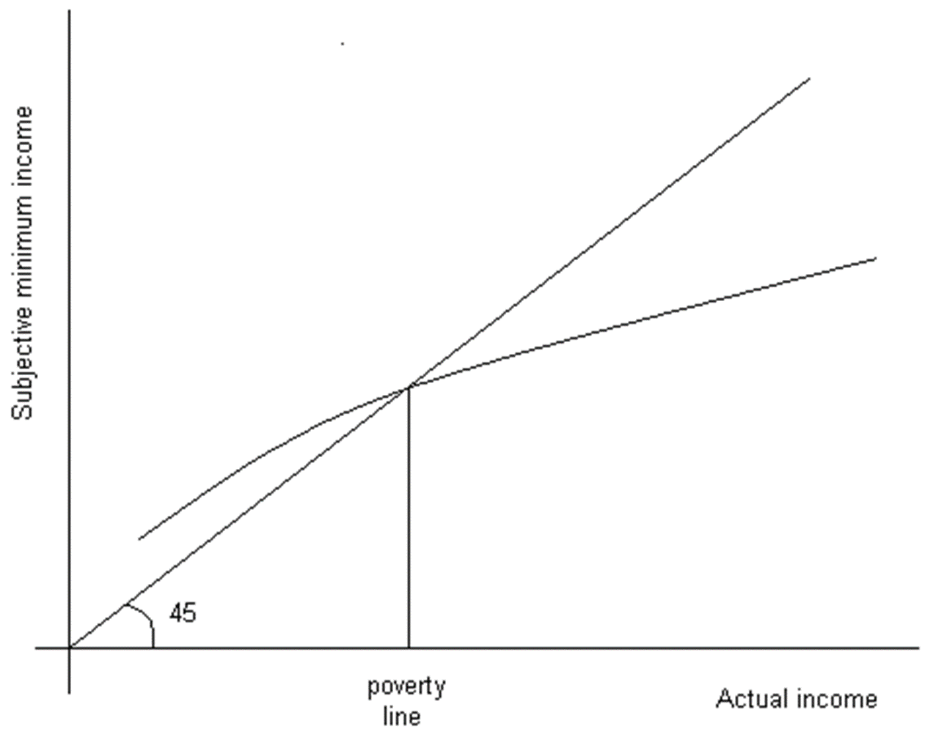
Basic assumption on the relationship between MIQ and consumption expenditure
The higher the actual consumption expenditure the higher the needs
If people have high incomes they overestimate needs
If they have low incomes they under-estimate them
When MIQ = hh income then we are identifying the equivalent of a poverty line and the basis for comparison of needs of different household types

Slide 32
Estimation approach using regression methods
We have estimated the following regression model:
Household types are the usual groups: single (adult/elderly), childless couples, couples with children, etc.
Control variables are factors that can affect the MIQ: location of the household (Tbilisi, other large cities, other urban areas, rural areas), size of consumption coming from own production, whether people need to pay for rent/mortgage, etc.
The calculation of needs of different household types is then computed as follows:

Slide 33
Equivalised household size using MIQ
The calculation of the above formula provides the “estimated need”
Absolute values are relatively high, but we use them to compute equivalence scales, rather than the poverty line
In order to compute the adult equivalents we have maintained the hypothesis of a co-habitation effect of 0.8
These results would suggest smaller equivalence scales or higher economies of size

Slide 34
SUMMARY AND NEXT STEPS

Slide 35
Summary of results
The results in terms of the key adult equivalent groups are reported below comparing the different approaches
The current index is ad odd with other estimates since it over-estimates needs of elderly and children: this is clearly due to some methodological weaknesses
Both the Engel method and the MIQ seem to imply a higher level of co-habitation effect than now, resulting in lower equivalence scales for children, however the MIQ often tends to over-estimate economies of size
Gender differences in equivalence scales were primarily driven by high food needs, but they do not seem to be justifiable
The overall recommendation would be to simplify the approach (number of groups) and reduce the differences in α, probably just between children and adults

Slide 36
Next steps
Can we produce an index that has less detailed groups?
We should look in more detail at needs of PWD (including bedridden persons) and for this we would need to implement also the living standard approach
In general it would be important to reconcile the equivalence scales used by Geostat for poverty analysis and by the Ministry for social assistance
Geostat scales appear somewhat outdated since some gender differences seem to be driven by the high level of food needs in the subsistence minimum
There might be a need to review the subsistence minimum

