Slide 1

Universal Health Coverage: Direct way to financial protection and satisfaction of population
Dr. David Sergeenko
Minister of Internally Displaced Persons from Occupied Territories, Labour, Health and Social Affairs of Georgia
May, 2019
Notes:
I would like to welcome all of you on behalf of the MoLHSA and Georgian society. On the side meeting during the WHA it’s a great honor for me and my country. Generally, the collaboration with the WHO is a great honor for Georgia and our health system. We are member of the Who since 1992 and the Who played and plays significant role for the Georgian health system.

Slide 2
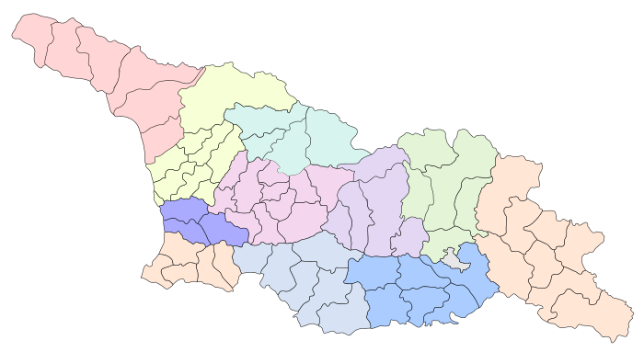




Demographic and Socio-Economic Situation
Maternal Mortality (per 100000 live birth) – 13.1 (2017)
Infant mortality (per 1000 live birth) – 8.1
Under 5 mortality rate (per 1000 live birth) – 8.7
Population – 3 726 500
Birth rate (per thousand population) – 13.7
Mortality rate (per thousand population) – 12.5
Life expectancy at birth – 74.0
GDP per capita (at current prices), (2016) – 4346 $US
GDP real growth – 4.7%
Government expenditure on health as % of GDP – 3%
General Government expenditure on health per capita (USD) – 123
Notes:
The population of Georgia has declined during the last 25 years, largely due to the outmigration and according to the census conducted in 2014, it is 3,7 mln.
Georgia has made a good progress in improving health outcomes. Life expectancy has increased by about 5 years over the few decades and currently is at 74 years.
Significant declines in under-five mortality and infant mortality and Georgia has been able to reach the Millennium Development Goal 4

Slide 3
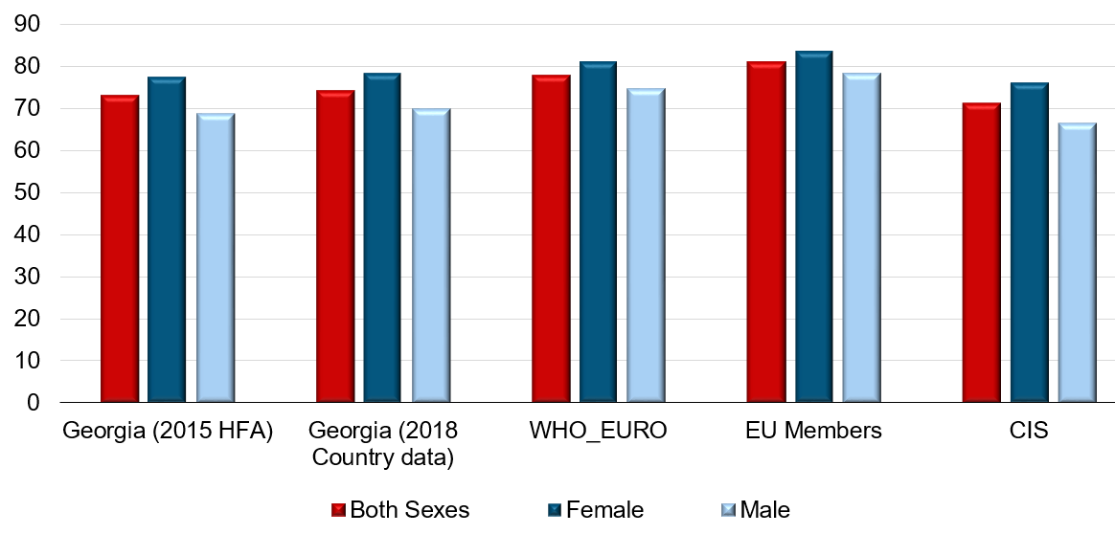

Life expectancy at birth (last available year)
Georgia, 2018
Total | 74.0
Male | 69.7
Female | 78.2
National Center for Disease Control & Public Health
www.ncdc.ge

Slide 4
Burden of diseases(DALYs), Georgia, 2016 (WHO estimation)
Source: WHO
National Center for Disease Control & Public Health
www.ncdc.ge

Slide 5
Mortality structure, Georgia, 2016 (WHO estimates)
Source: WHO
National Center for Disease Control & Public Health
www.ncdc.ge

Slide 6
Under-5 mortality rate per 1000 live births
National Center for Disease Control & Public Health
www.ncdc.ge

Slide 7
Infant mortality rate per 1000 live births
National Center for Disease Control & Public Health
www.ncdc.ge

Slide 8
Maternal mortality ratio per 100 000 live births
National Center for Disease Control & Public Health
www.ncdc.ge

Slide 9
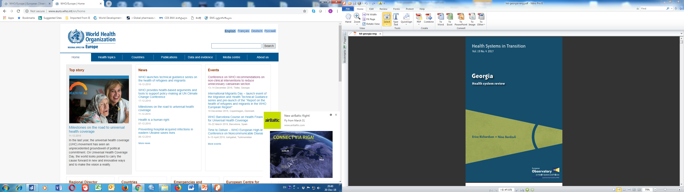


Universal Health Care – Socially Oriented Political Platform February, 2013
WHO evaluation - Reforms have moved Georgia closer to universal health coverage
Increased Services utilization
Increased State Budget for Health care (365 mill GEL in 2012 → 1135 Mill Gel in 2018)
Improved financial Protection
HUES 2017
Improved access to services
Decreased Financial barriers
Increased trust on state-funded health services
Notes:
The main goal of the elected government in 2012 and re-elected in 2016, is the poverty reduction and socially oriented political platform. The strong political will pledged in the election platform was translated into an unprecedented, in 2013 almost 2.5-fold expansion of budgetary allocation for health.
The second major step towards securing enjoyment of health rights in the country was the launch of a Universal Health Care Program in February 2013. Georgia now has a foundation of universal entitlements within its health system, representing a major step towards improving access to health services for the entire population.
The survey carried out by the World Bank, the World Health Organization and the US Agency for International Development showed the main achievements of the Universal Healthcare Program: increased access to medical services, increased utilization of medical services, reduced financial barriers and enhanced coverage

Slide 10
Health sector expenditures
Out-of-Pocket Payment as % of Total Health Expenditure, Georgia
Public Health Expenditure, Georgia
Source: Georgia NHA 2010-2017 (MoLHSA, 2019)
Notes:
The UHC program was accompanied with a substantial increase in the governments budget allocations. From 2012 to 2017, the health budget more than tripled, as a percentage of GDP it increased from 1.7 percent to 3% in 2017, but it’s still lower in comparison with Euro average.
The share of the out-of-pocket payments in total health expenditures has significantly decreased from 73% (in 2012) to 55% (in 2017), mainly due to the lower cost of hospitalization, which is a direct consequence of the universal healthcare program.

Slide 11
Coverage of Healthcare services
Services utilization
Hospitalization per 100 population
UHC Program has led to a major expansion in population entitlement to publicly financed health services (HUES)
Ambulatory care visits per person per years
National Center for Disease Control & Public Health
www.ncdc.ge

Slide 12

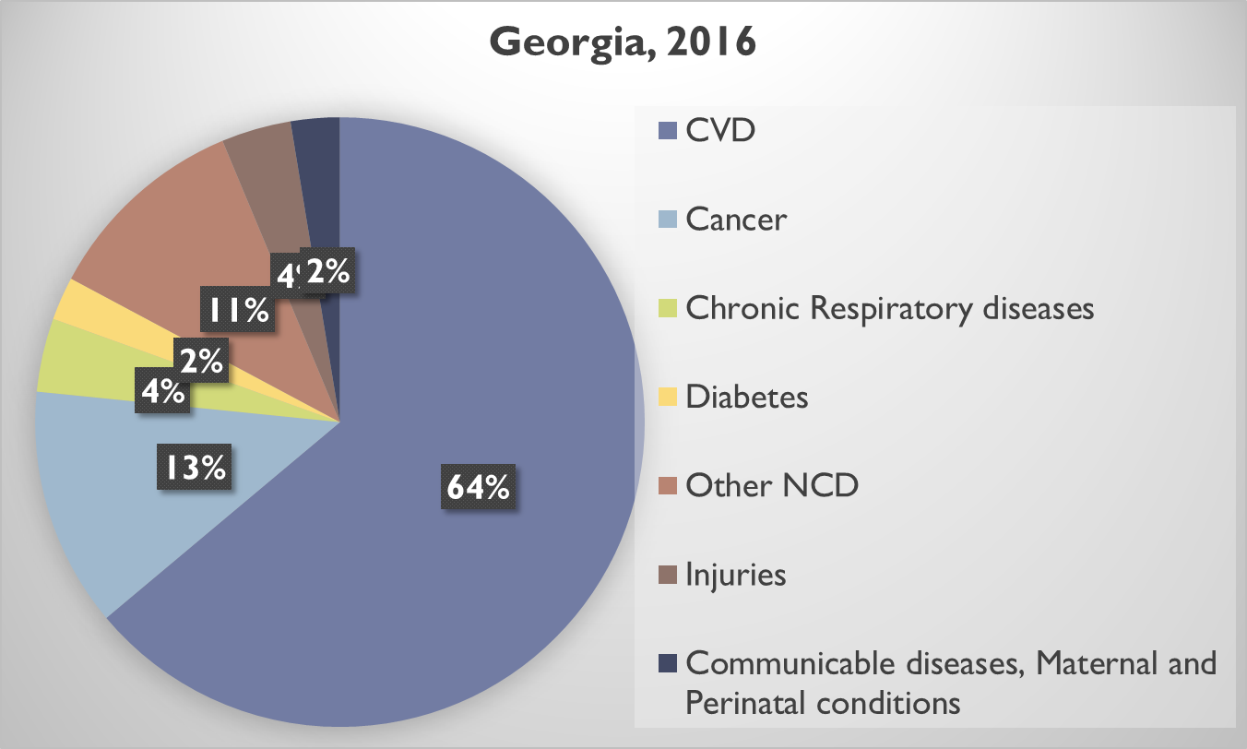

Drugs for Major Non-Communicable Diseases
2017
Cardio-vascular diseases
Type 2 diabetes
Obstructive pulmonary disease
thyroid conditions
2018
Epilepsy
Parkinson’s diseases
Deaths due to NCDs account for 94% of all cases of Deaths
socially vulnerable families – Less than 1 GEL
Pensioners and disabled persons - 50%-80% discount

Slide 13
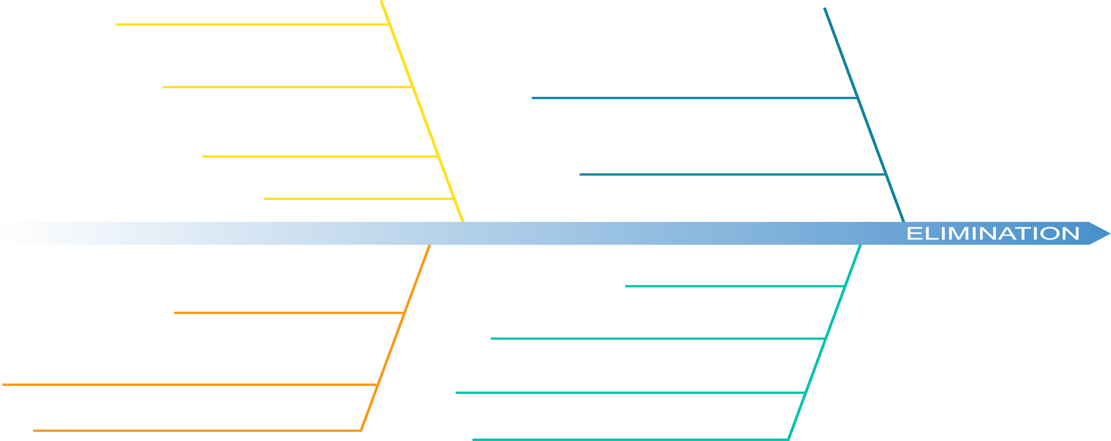

Road Towards HCV Elimination
48% (1.38million) of the adult population is has been screened for HCV 56,318 people (43.9% of the target) are enrolled in treatment
Patient inclusion criteria removed
Long-term Elimination
Strategy 2016-2020 approved
Geographic and financial access to
diagnostic services - significantly increased
2016
2018
Georgia was awarded as a center of excellence in viral hepatitis elimination at the International Liver Congress, 2019
LDV/SOF based regimens
introduced to the program
Moving from vertical to horizontal service delivery systems through active engagement of PHC centers
TAG established
Decentralization of HCV services
Overall SVR rate 98%
Elimination through Decentralization
2nd World Hepatitis Summit
First Regional Consultation on Viral Hepatitis in the WHO European Region Held in Tbilisi
World Hepatitis Summit
Enhancement of electronic information systems
6th National HCV Workshop in March
Memorandum of Understanding between Georgian Government and Gilead Sciences
2015
Expansion of HCV service decentralization
2019
HCV Screening Protocol approved by the Ministry
2017
New Medication Vosevi (SOF/VEL/VOX) to be introduced
Initial phase of HCV elimination action plan and start of the program
TAG recommendation on decentralization
Initiating integrated screening on the
whole country level

Slide 14

Targets
Hepatitis C Elimination Program in Georgia
Goal
Elimination of HCV by ensuring prevention, diagnostics and treatment of the disease
90-95-95
Initiated treatment 56 318
Completed treatment 52, 053
By 2020
90% of people living with HCV are diagnosed
95% of those diagnosed are treated
95% of those treated are cured
Overall cure rate - 98.3%
(April 2019)
დაავადებათა კონტროლისა და საზოგადოებრივი ჯანმრთელობის ეროვნული ცენტრი
დაავადებათა კონტროლისა და საზოგადოებრივი ჯანმრთელობის ეროვნული ცენტრი
National Center for Disease Control & Public Health
www.ncdc.ge
www.ncdc.ge
www.ncdc.ge

Slide 15
HCV Screening among Georgian Population
Since 2015, over 2 million screenings have been registered in the Unified Screening Registry
≈1,3 million individuals have been screened with positivity rate – 9%
National Center for Disease Control and Public Health
დაავადებათა კონტროლისა და საზოგადოებრივი ჯანმრთელობის ეროვნული ცენტრი
დაავადებათა კონტროლისა და საზოგადოებრივი ჯანმრთელობის ეროვნული ცენტრი
National Center for Disease Control & Public Health
www.ncdc.ge
www.ncdc.ge
www.ncdc.ge
Notes:
NCDC is responsible on screening activities in the country.

Slide 16
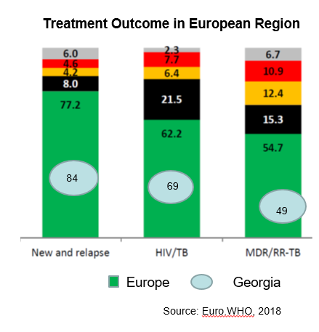
Tuberculosis
TB case notification in absolute numbers, Georgia
National Center for Disease Control & Public Health
www.ncdc.ge

Slide 17
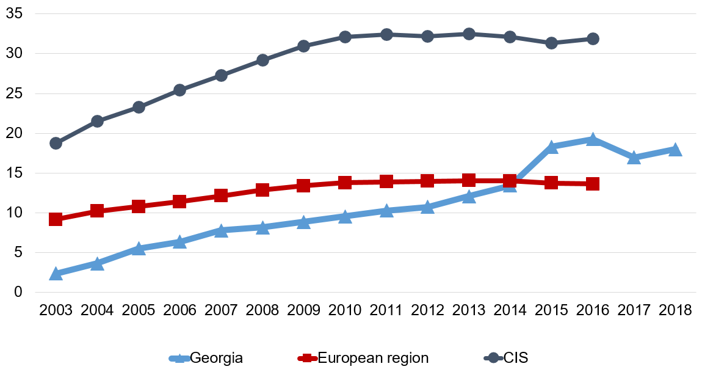
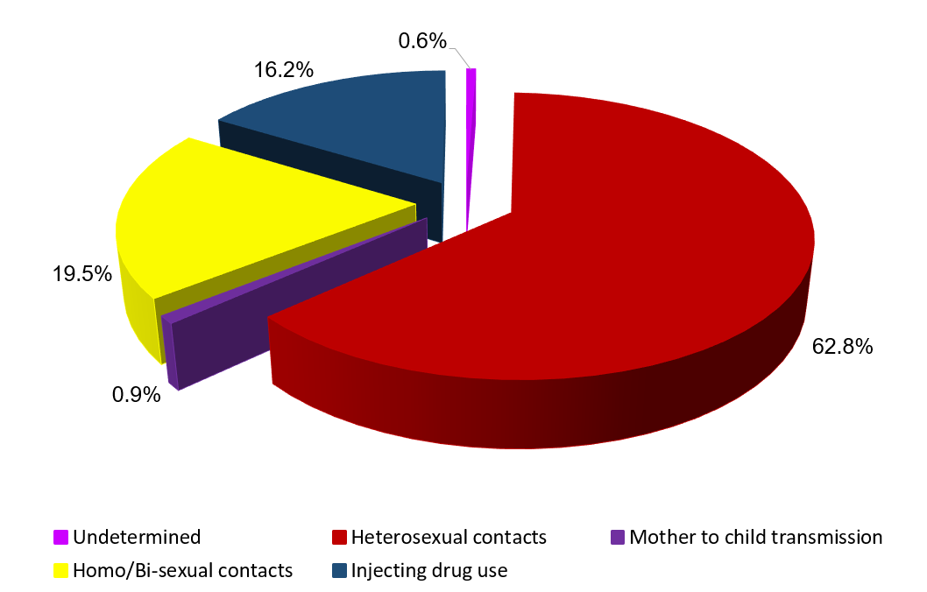
HIV/AIDS
HIV incidence per 100000 population
Distribution of Newly Diagnosed HIV Cases by Routs of Transmission
2008 - National HIV/AIDS Surveillance Plan for Georgia was elaborated
2010 - Guidelines for HIV/AIDS surveillance were developed
Estimated number of PLHIV – 9,360
Registered number alive – 6,024
Main Challenge: Late case detection
2018 - 672 new cases of HIV (incidence per 100,000 population – 18.0)
Universal access to retroviral treatment in Georgia is at place
4310 persons are under the ART (Q1, 2018)
Source: Infectious Diseases, AIDS and Clinical Immunology Research Center
National Center for Disease Control & Public Health
www.ncdc.ge

Slide 18
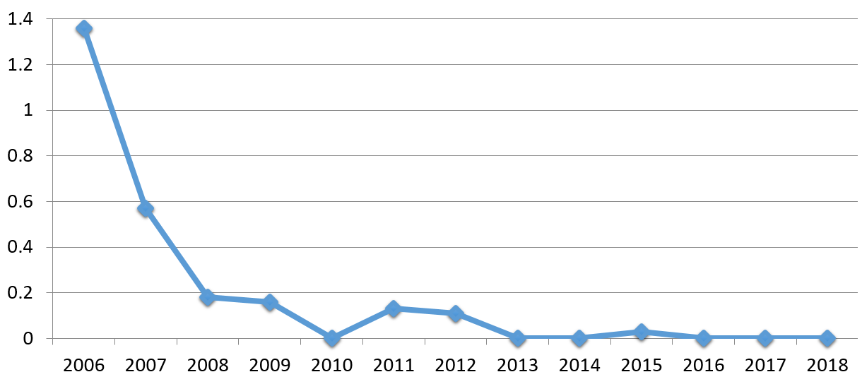
Malaria
Georgia became the first country in the European region granted by the Global Fund for Malaria. As a result of the Project, consistent reduction of malaria cases have been achieved in the country since 2004.
Registered 472 cases decreased to 1 from 2002 to 2009.
Malaria as an endemic disease in Georgia has been eliminated since 2010.
Incidence of malaria per 100000 population Georgia
National Center for Disease Control & Public Health
www.ncdc.ge

Slide 19
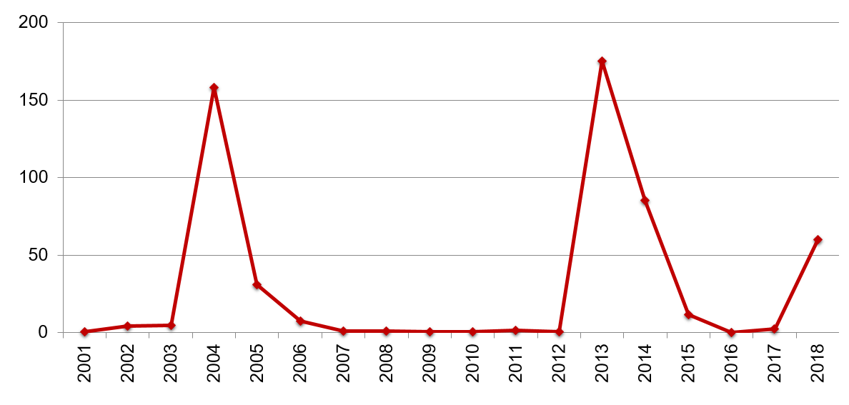
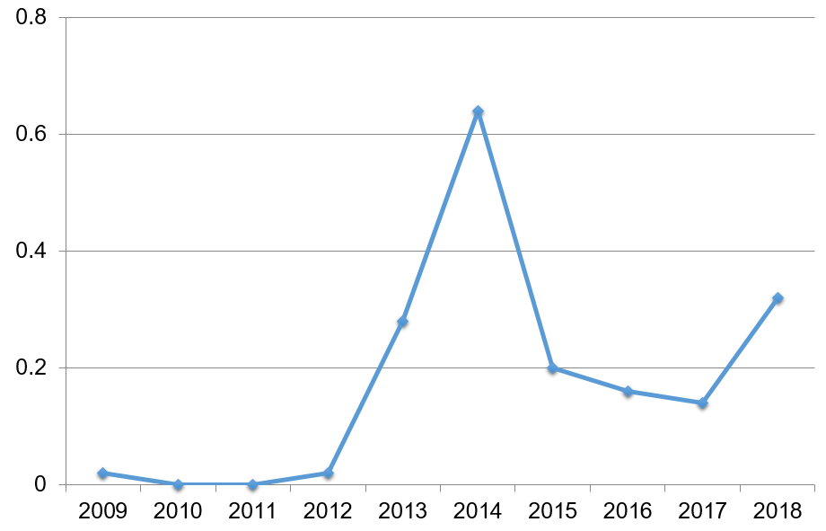
Incidence of Measles per 100000 population
Measles
In 2018, 2200 cases were registered
Crimean-Congo Hemorrhagic Fever Incidence per 100000 population
Crimean-Congo Hemorrhagic Fever
In 2018 12 cases of CCHF were registered, one of them was fatal
National Center for Disease Control & Public Health
www.ncdc.ge

Slide 20

Public health Emergency Preparedness and Responsible Capacity
The revision of Epidemics, Pandemics and Biological Incidents Response Plan
Updating/Developing disease specific plans:
Influenza Response Plan
Ebola virus
Zika Virus
Crimean-Congo Hemorrhagic fever
Polio
Dengue
Emergency Preparedness
WHO IHR was fully implemented in 2012;
NCDC was designated as the national IHR Focal Point;
24/7 Duty Officer System is established;
Georgia, together with other countries is actively involved in support of the 11 Action Package objectives:
Real-Time Surveillance - as a leading country
National Laboratory System – as the contributing country
Zoonotic Diseases – as the contributing country
GHSA
IHR
Notes:
Strengthening of the Public health Emergency Preparedness the highest priority for our country, we are strongly following the requirements of the IHR and GHSA.
Georgia reached the full compliance with the core IHR requirements by the June 2012 deadline set by the World Health Organization (WHO).
Georgia is a part of the GHSA since its initiation till this moment and participates in all of technical meetings. We are lead an Action Package of Real-Time Surveillance with Norway and contribute to Zoonotic Disease and National Laboratory System Action Packages. Georgia is one of the first countries went through the external assessment of the GHSA capabilities.
GHSA has become a new vision for Georgia since it’s launch, when first external assessment of baseline GHSA capabilities was conducted and since Georgia took a path to s and. The National Center for Disease Control and Public Health (NCDC) is designated as the National Focal Point (NFP).

Slide 21

Next Steps Link universal health coverage to Sustainable Development Goal 3
WHO-EU-LUX UHC Partnership (UHCP)
Sustainable improvement of UHC – leaving no-one behind
Sustainable improvement of UHC – leaving no-one behind
Improve quality of healthcare through the accreditation, certification, licensing and human resources development
Promote the development of preventive medicine, PHC and Integrated care system
Expanding of reimbursement of drugs for Chronic Diseases
Implement strategic purchasing, selective contracting and performance based financing

Slide 22
Thank you for Attention

